Slide 1
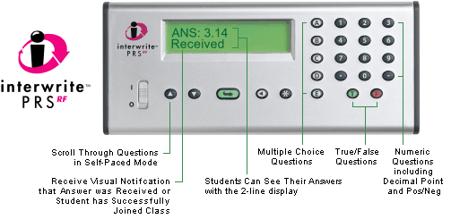
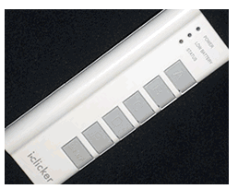
Making Your Classes Click Effective Use of Classroom Response System in Undergraduate Science
Department of Physics
Ryerson University, Toronto, Canada
Dr. Marina Milner-Bolotin
Dr. Tetyana Antimirova
Notes:
Resources:
http://www.educause.edu/ir/library/pdf/EDU07124B.pdf

Slide 2
Session Outline
Motivation for using clickers: So will your students benefit from clicker technology?
Different clicker options: Different clicker systems (what to look for): faculty guide
Clicker pedagogies: How to ask good questions (pedagogy)
Addressing the challenges: Making your classes run smoothly and effectively

Slide 3
I: Motivation for Using Clickers

Slide 4
CPS-1: So Your Students don’t Need Clickers?
Choose YOUR excuse!
Small classes: everybody has a way to contribute anyway.
Upper level classes: the concepts are too complex.
Clickers waste time: will not be able to cover all the material.
My courses focuses on the content: concepts learned later.
My students will not like clickers: expensive, tricky?
Effective clicker use: takes too long to master.
Using new technology: challenges, risks, lack of support.
All of the above!

Slide 5
CPS-2: Why Should You Use Technology?
Educational technology should not be used just because it is there. It should be used because you have clear pedagogical reasons to use it.
It will help students learn!
It will help you address some challenges you could not address without it.
It will help you save time, resources, etc.
It will make your classes more interactive.
The advantages will outweigh the challenges.
All of the above.
Other.

Slide 6
Effectiveness of Physics Instruction
Traditional intro physics courses don’t help the majority of the students develop conceptual understanding.
Quality of conceptual learning in traditional courses doesn’t depend on the class size, lecturer, or quality of instruction.
FCI – Force Concept Inventory
Hake’s index <g>: fraction of unknown physics concepts learned
Reformed large classes
R. Hake, ”…A six-thousand-student survey…” AJP 66, 64-74 (‘98).
Notes:
Traditional approach not effective for developing conceptual understanding.
Lecturer quality, class size, institution,...doesn't matter!

Slide 7
Causes of Seasons: Example of Learning Effectiveness
Textbook representations are often aimed at scientists, not students…

Slide 8
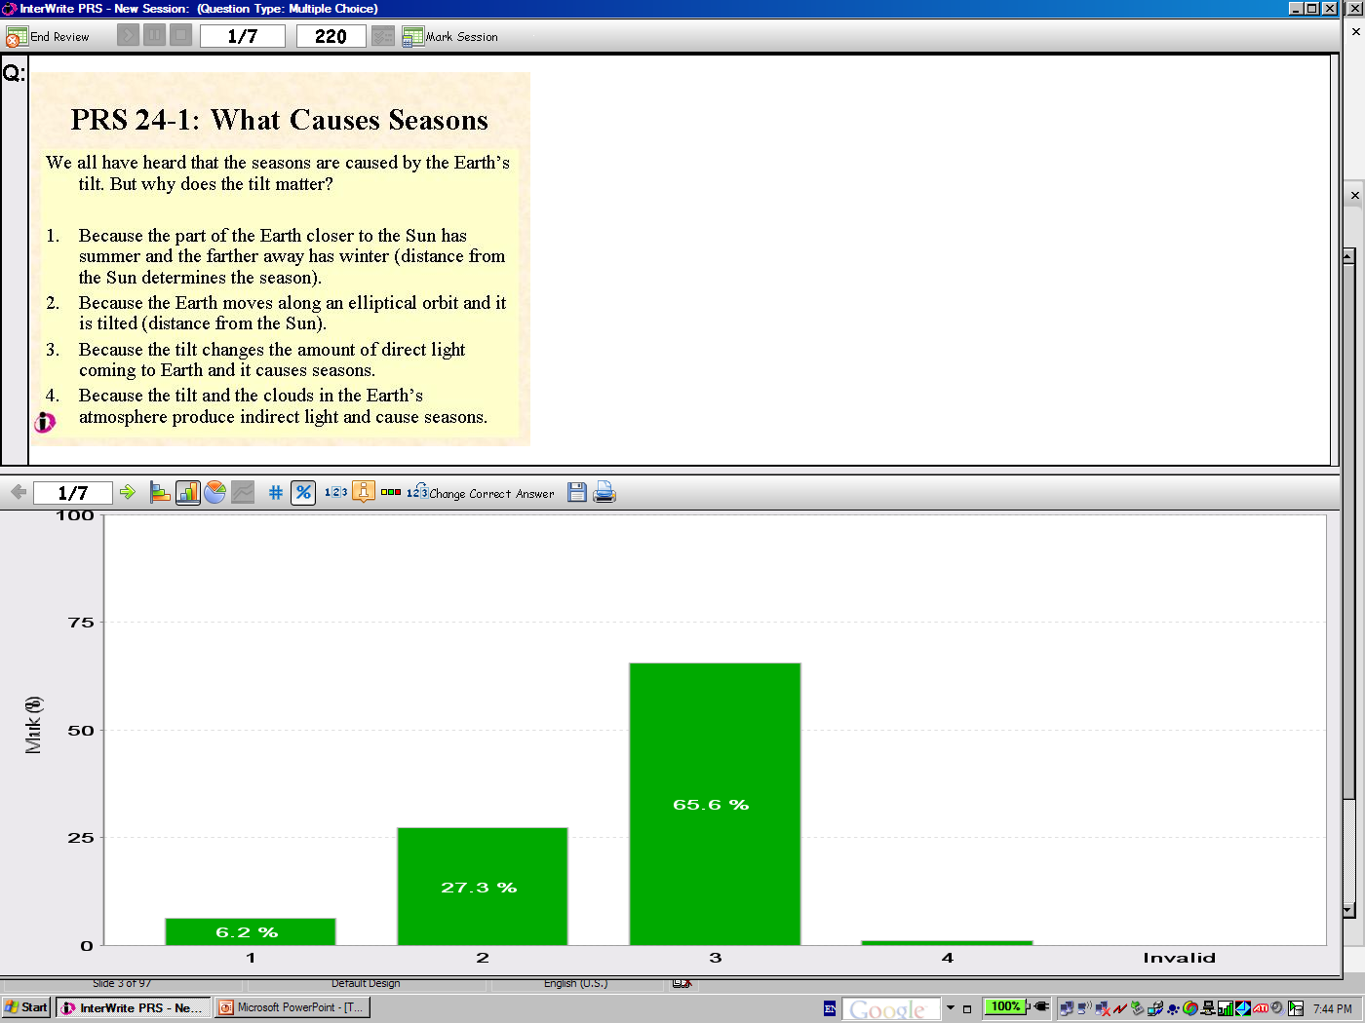
We all know that the seasons are caused by the Earth’s tilt. But why is that?
Because the part of the Earth closer to the Sun has summer and the farther away has winter (distance from the Sun determines the season).
Because the Earth moves along an elliptical orbit and is tilted (distance from the Sun).
Because the tilt changes the amount of direct light coming to Earth and it causes seasons.
Because the tilt and the clouds in the Earth’s atmosphere produce indirect light and cause seasons.
The students were asked to review this topic at home prior to the lecture.

Slide 9
Are Harvard Graduates Any Better?

Slide 10
A Private Universe

Slide 11
II: Different Clicker Options
Standardize your clickers: organize an all campus discussion on different clicker options before you decide which one to adopt campus wide!
Invite different clicker companies to demo their clickers and if possible have demo sets to use for a term by volunteer professors
Decide what are the important features that you might want clickers to have!

Slide 12
Clickers: Student Perspective
Registration (price and convenience):
Is it local or online with the company?
Can students use the same clicker multiple terms without paying more (registration per term?)
Can they swap clickers during the term?
How good is the technical support.
Registering for multiple classes during the same term
Robustness – batteries, durability?
Feedback: Will the student get response feedback on their clicker?

Slide 13
Clickers: Instructor’s Perspective
System set up: RF, USB, technical support from the company and on campus, ease of data review
System features: Compatibility – CMS
Question flexibility: MC, Numeric, HW, Exams
Registration (convenience):
Setting up a new class?
Will there be technical support on campus?
Using clickers with PowerPoint or stand alone?
How easy it is to import questions from elsewhere
Easy and flexibility of the clicker software.
Notes:
CMS – Class Management System

Slide 15
III. Clicker Pedagogies: How to Ask Good Questions
We cannot request our students to move from novices to experts and learn to think like scientists if we do not reinforce expert-like behaviors.
So what does the Science Education Community have to offer?
Notes:
Traditional physics instruction does not help the majority of the students to make progress from on the novice-expert continuum, instead it reinforces novice-like behaviors such as superficial formula recognition and matching, de-contextualized problem solving, finding meaningless answers to meaningless problems and acquiring lots of meaningless information without asking why it is needed and where it is applicable.

Slide 16
http://mazur-www.harvard.edu/research/detailspage.php?rowid=8
16

Slide 17
Canadian In Class Question Database
David Harrison at U of T:
http://cinqdb.physics.utoronto.ca/
Notes:
A brief discussion of why and how In-Class Questions can be effective.
It is now well-established that the model of the traditional "lecture" where the students passively absorb the information being given by the lecturer is educationally ineffective. Rather, attempting to actively engage students with the material is a much more productive strategy. Particularly for large classes, achieving this outcome is sometimes difficult.
One technique that can be very effective is to ask the students challenging conceptually-based questions in class. These are typically posed in multiple-choice format, and the students "vote" on what they think is the correct answer. There are various ways in which the students can "vote" on their answer to the question:
Provide each student with a Personal Response System ("clicker") and tally the votes using a computer. Most clicker systems can display the results instantaneously to the teacher and, if desired, to the class. It is possible to register the student's clicker so that the teacher can track which students are answering the questions and what their answers are.
Provide each student with a set of cardboard squares, labeled "1", "2", etc. Each square is either white or a primary color, each corresponding to a particular label. The students simultaneously all raise the card corresponding to their answer to the question, and the teacher can visually scan the room to estimate the answers. Using this method the responses are largely anonymous.
Have the students raise their hand to indicate their answers. The teacher can say "Hands up everyone who believes the right answer is number 1" and then "Hands up everyone who believes the right answer is number 2" and so on. This is the least effective method, since inevitably the students tend to look around to see what their classmates are answering before raising their hand. Nonetheless, this can be at least moderately successful.
If almost none of the students answer correctly, then it is clearly time to stop and discuss the topic being asked in more detail: this is a form of "Just In Time Teaching."
If almost all students get the correct answer to a question, a common reaction is to congratulate them and go on with the class. However, some people have their students discuss their answers with their classmates in small groups; this leads to the students having greater confidence that their answer is correct.
If about half the class misses a question, one very effective technique is called Peer Instruction; the leading proponent of Peer Instruction is Eric Mazur at Harvard. In this methodology, the students break themselves up into small groups of 4 or 5, and discuss the question amongst themselves. After a few minutes the teacher brings the discussion to a close and again asks the students to vote on the answer to the question. When the method works, the percentage of students getting the right answer goes up dramatically; further if one polls the students about how confident they are in their answer both before and after Peer Instruction, that goes up dramatically too.
For this pedagogy to be maximally effective, it is important that the students have read the relevant sections of the textbook before class. Having regular pre-class quizzes is effective for this. Some key points about such quizzes are:
They should count for a small but non-zero mark. As Priscilla Laws says: If you don't test for it, you don't get it.
They should be trivially easy if the student has actually read the textbook.

Slide 18
Modified Peer Instruction Eric Mazur (Harvard) – original idea
Think how and why you want to use clickers (marks, frequency, group versus individual)
Sell your reasons for clickers use to your students
Design stop to think questions you want to use:
Multiple choice; numeric and alpha numeric, short answer, survey, T-F (during lectures)
Homework questions (answered at home to be submitted in class)
Tests (clicker components in tests).
Decide what mode of Peer Instruction you want to use when.
Modify your lectures to respond to student responses (feedback loop).
Modify your assessment: Use conceptual (why) questions in tests.
Notes:
Traditional physics instruction does not help the majority of the students to make progress from on the novice-expert continuum, instead it reinforces novice-like behaviors such as superficial formula recognition and matching, de-contextualized problem solving, finding meaningless answers to meaningless problems and acquiring lots of meaningless information without asking why it is needed and where it is applicable.

Slide 19
Asking Questions
Bloom’s Taxonomy
of Cognitive Domain
Bloom (1956):
Evaluation
A+
Synthesis
Analysis
Your course evaluation will be based on how high you are able to climb up this taxonomy.
Comprehension
F
Knowledge
Notes:
Assignment: You plan a 45 min lesson on a topic of your choice. You have a class of 50 first year students and you decided to use Peer Instruction.
Come up with three clicker questions from three different levels on Bloom’s taxonomy.
Why do you want to use them?
How to ask good clicker questions:
What are expected students’ answers/difficulties?
What are you planning to do next?

Slide 20
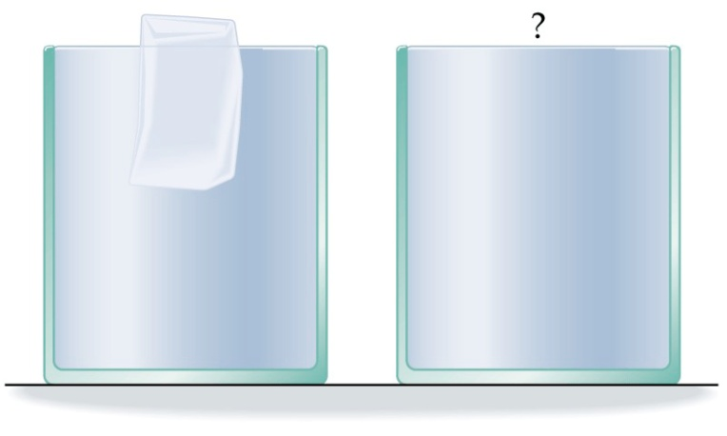
Example 1A: Buoyancy
A cup is filled to the brim with water and a floating ice. When the ice melts, the water level:
Decreases
Remains the same
Increases (the water spills over)
Notes:
The ice displaces the amount of water equal to its weight. Therefore when the ice melts it all turns to water and occupies exactly the same volume which had been displaced before. Therefore the water level doesn’t change!

Slide 21
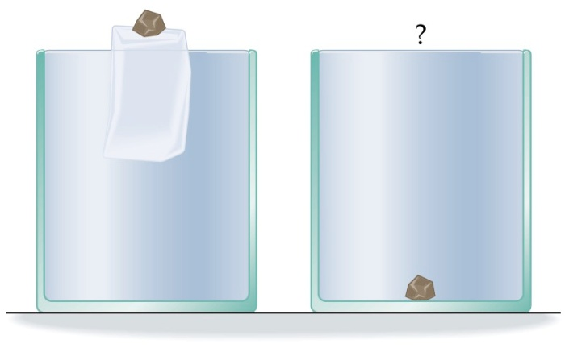
Example 1B : Buoyancy
A cup is filled to the brim with water and a floating ice. When the ice melts, the water level:
Decreases
Remains the same
Increases (the water spills over)
Notes:
The ice displaces the amount of water equal to its weight, however since the density of the pebble is higher than the density of water, the amount of displaced water to support the pebble is more than its volume. Therefore when the ice melts it all turns to water and occupies exactly the same volume which had been displaced before, which is not true for the pebble. It sinks, therefore it will occupy less volume and the water level will go down!

Slide 22
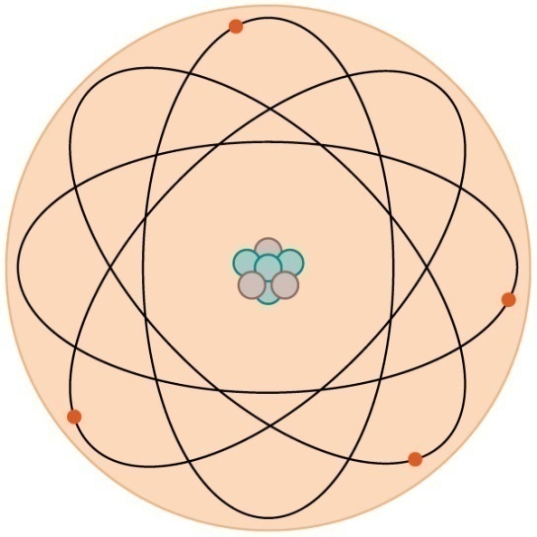
Example 2: Fatal Attraction
A proton (p) that is in the nucleus of the H (hydrogen) atom
attracts an electron (e⁻) orbiting it.
Relative to this force, the e⁻ attracts the proton, p, with:
Less force
More force
The same force
Impossible to answer

Slide 23
Example 3A: Changing Assessment
10.1
0.1
E
S
A
C
23
K

Slide 24
Example 3B: Changing Assessment
O
O
O
O
O
E
S
A
C
K

Slide 25
Administering Tests with Clickers
Q 1- Q5 were solved correctly by most of you – well done.
Q 6 was difficult for many. We will discuss it in class.

Slide 26
Recent Results of Using Clickers in Large Introductory Physics Course
Student active participation in a large class improves significantly.
Clickers allow use of other interactive pedagogies in large and small classes (Interactive Lecture Experiments, etc.).
Most of the students like using PRS and appreciate this opportunity.
26

Slide 27
Thinking like scientists?
THEN
Only 25% of the students chose the correct response. 59% chose the incorrect response (D).
M. Milner-Bolotin et al, Journal of College Science Teaching, January-February 2007, pp.45-49.
Notes:
The way we teach today we do not achieve these goals for the majority of the students. – Traditional lecture demonstrations

Slide 28
Tension in a Pendulum’s String
Students use Logger Pro Video Analysis to analyze the motion of a pendulum.
The students work in groups, define the problem solving strategy, collect necessary data, come up with the analysis and solution and then check if their answer is meaningful.
Traditional lecture demonstrations are replaced by Interactive Lecture Experiments

Slide 29
Thinking like scientists
NOW
Notes:
The way we teach today we do not achieve these goals for the majority of the students. – Traditional lecture demonstrations

Slide 30
Real Life HW & Exam Problems
Thinking like a scientist means being able to analyze real life situation using real data.
Performance on this problem was: 63%.
N =265 students.

Slide 31
Effectiveness of Physics Instruction
Traditional intro physics courses don’t help the majority of the students develop conceptual understanding.
Quality of conceptual learning in traditional courses doesn’t depend on the class size, lecturer, or quality of instruction.
FCI – Force Concept Inventory
Hake’s index <g>: fraction of unknown physics concepts learned
Reformed large classes
R. Hake, ”…A six-thousand-student survey…” AJP 66, 64-74 (‘98).
Notes:
Traditional approach not effective for developing conceptual understanding.
Lecturer quality, class size, institution,...doesn't matter!

Slide 32
Student Feedback
How did you opinion about physics change?
I feel that everyone is capable of learning physics as long as they change the way they think about the course. People need to realize that it is okay to ask the question "why?" and when they ask the question they need to be willing to spend the time to solve the problems associated with the questions.
32
Notes:
I feel that Physics is a lot harder to understand than I had expected. Going into this course I expected it to be a lot of math because that's what I was told by my older sister but in Dr. M's class it was mostly concepts which threw me off a lot.
~~~~~~~~~~~~~~~~~~~~~~~~~~~~~~~~~~~~~~~~~~~~~~~~
Thanks a million! I think i will give it some thought! This could be life changing! =P have an excellent holiday! Hillary From: Marina Milner-Bolotin <milnerm@phas.ubc.ca> To: h w <hillaryw23@hotmail.com> Subject: Re: PHYS 100 102 student email Date: Tue, 19 Dec 2006 10:40:30 -0800 Hi Hillary, I wanted to tell you that we did not do any scaling (I do not beleive in scaling as I think people have to get the marks they earned) and the mark you got, you earned - it is absolutely real. Your mark on the final exam was 41 out of 45, which is 91% and this replaced your midterms. Since your all other marks were exceptional (perfect mark on the lab, MP, almost perfect on PRS, your final mark is 94. I also wanted to tell you that you got 100% on the posttest (remember the multiple choise one hour long test) which was excellent. So the 94% you earned is completely your hard earned marked and I am very proud of you! Out of 260 students in my class you are top 10, so you should think about physics more seriously. Thank you for your nice words. This means a lot to me and have a great holiday. I am very proud of your achievements! I hope your other classes were as great as this one. Best wishes, Dr. M. PS: If you ever want to visit a physics lab or talk to physics students, let me know! h w wrote: Hi Dr. M, I just wanted to thank you for an awesome physics 100 class! you REALLY made physics A LOT easier and a LOT more enjoyable. It helped tremendously that you care so much about us students, and always want the best for us! Just as a specific reference, i got 77% and 66% (after the scaling) on the midterms, and with your help and also the study tips from boyang, i managed to get 94% overall (of course, i'm sure there was some scaling done there as well =P). but in any case, i just wanted to comment on your exceptional teaching! thanks again for a great term! i truly believe i learned the most from your class out of all my other classes. and, most of all, i'm starting to rethink my opinion about physics =D No words can express my appreciation for having you as my professor! thanks! have a good winter holiday! enjoy the break you deserve! Hillary p.s. I was also wondering which other courses you teach?

Slide 33
Student Feedback: Not everybody likes how we teach physics!
I feel that Physics is a lot harder to understand than I had expected. Going into this course I expected it to be a lot of math because that's what I was told by my older sister but in Dr. M's class it was mostly concepts which threw me off a lot.
Notes:
Hillary From: Marina Milner-Bolotin <milnerm@phas.ubc.ca> To: h w <hillaryw23@hotmail.com> Subject: Re: PHYS 100 102 student email Date: Tue, 19 Dec 2006 10:40:30 -0800 Hi Hillary, I wanted to tell you that we did not do any scaling (I do not beleive in scaling as I think people have to get the marks they earned) and the mark you got, you earned - it is absolutely real. Your mark on the final exam was 41 out of 45, which is 91% and this replaced your midterms. Since your all other marks were exceptional (perfect mark on the lab, MP, almost perfect on PRS, your final mark is 94. I also wanted to tell you that you got 100% on the posttest (remember the multiple choise one hour long test) which was excellent. So the 94% you earned is completely your hard earned marked and I am very proud of you! Out of 260 students in my class you are top 10, so you should think about physics more seriously. Thank you for your nice words. This means a lot to me and have a great holiday. I am very proud of your achievements! I hope your other classes were as great as this one. Best wishes, Dr. M. PS: If you ever want to visit a physics lab or talk to physics students, let me know! h w wrote: Hi Dr. M, I just wanted to thank you for an awesome physics 100 class! you REALLY made physics A LOT easier and a LOT more enjoyable. It helped tremendously that you care so much about us students, and always want the best for us! Just as a specific reference, i got 77% and 66% (after the scaling) on the midterms, and with your help and also the study tips from boyang, i managed to get 94% overall (of course, i'm sure there was some scaling done there as well =P). but in any case, i just wanted to comment on your exceptional teaching! thanks again for a great term! i truly believe i learned the most from your class out of all my other classes. and, most of all, i'm starting to rethink my opinion about physics =D No words can express my appreciation for having you as my professor! thanks! have a good winter holiday! enjoy the break you deserve! Hillary p.s. I was also wondering which other courses you teach?

Slide 34
Student feedback
93%
Consistent results!

Slide 35
IV. Addressing the Challenges
Solving technical problems (using tablet or laptop?)
Using PowerPoint or doing separate clicker sessions.
Making use of clickers uniform across the course sections or even various courses.
Using various kinds of clicker questions.
Being reasonable and balanced – marks versus attendance.
Deciding how to incorporate conceptual questions into final course assessment.
35

Slide 36
Session Feedback 1
Would you like to visit our physics classes where we use clickers? If your answer is YES and you can come, please e-mail us: mmilner@ryerson.ca
We can also video tape classes to make them available online.
Yes
No

Slide 37
Session Feedback 2
Strongly Agree
Agree
Neutral
Disagree
Strongly Disagree
I found this clicker session useful and would like to know more about clickers: technology and pedagogy.

Slide 38
Session Feedback 3
Strongly Agree
Agree
Neutral
Disagree
Strongly Disagree
I would like to try clickers in my classes.

Slide 39
Conclusions
Teaching should be based on what we know about how people learn.
Using modern technologies has a potential of creating learning environment conducive to learning.
If you like clickers, your students will like them too.
You have to learn how to use clickers: visit Eric Mazur’s site, observe colleagues, get involved.
Clickers is one of the cheapest technologies that can make a significant difference in learning in large classes.

