Slide 1
Promoting Critical Thinking
David Abbott
Buffalo State College
5/20/2017
AAPT-NYSS

Slide 2
What is CT?
Reasonable reflective thinking focused on deciding what to believe or do. (Ennis, 1993)
The use of thinking strategies that increase the probability of a desirable outcome. (Halpern, 1994)

Slide 3
What are some CT skills?
Generally?
In physics?

Slide 4
What are some CT skills?
Make inferences
Analyze arguments
Identify assumptions
Distinguish fact from opinion
Recognize fallacy, bias, irrelevance
Assess reliability of a source
(Zollner, 2008)

Slide 5
PHY103 Understanding Sound
Gen. Ed. elective
No prerequisites
No science majors
No dedicated “lab”
Small enrollment
Requirement for DMP minor in Music

Slide 6
Encouraging CT in PHY103
Reading Logs
Reflective writing
Argumentation (“REAL” forms)

Slide 7
Reading Log Form
Adapted from Apple, D.K. (2000). Learning Assessment Journal, 4/e. Pacific Crest: Lisle, IL. Available from www.pcrest.com

Slide 8
Reflective Writing
Journal (weekly)
Learning Commentary (one per unit)
Total points scheme
Excellent writers get done early
Poor writers get decent grade for trying

Slide 9
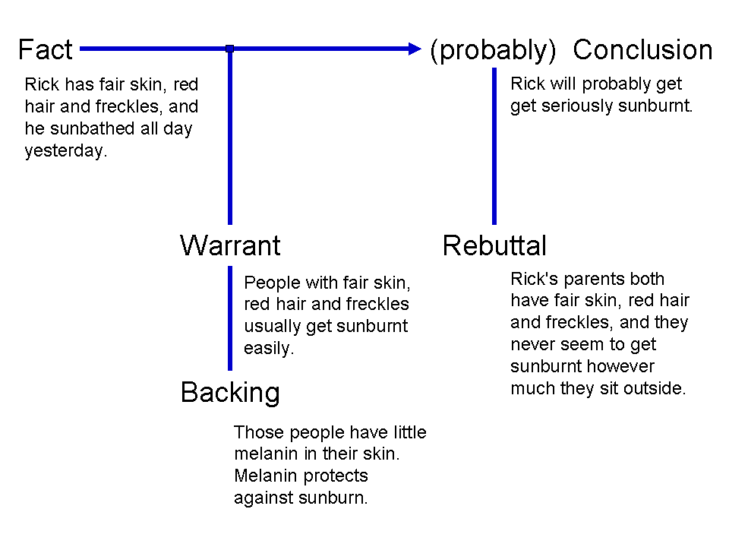
“REAL”- Toulmin repackaged
https://en.wikipedia.org/wiki/Stephen_Toulmin#The_Toulmin_Model_of_Argument

Slide 10
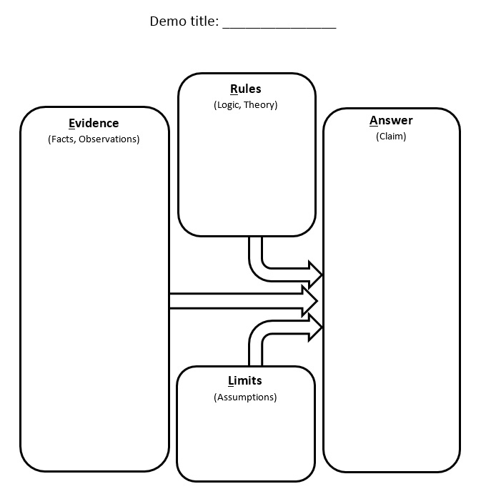
“REAL” (via Tom Foster)
Toulmin | Foster
Warrants, Backing | Rules
Facts | Evidence
Claim | Answer
Qualifier | Limits
(Foster, 2016)

Slide 11
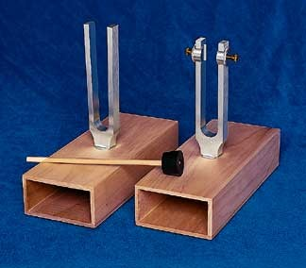
When?
The Silent Demo
After the Lab
Exams
http://serc.carleton.edu/dmvideos/videos/keep_time.html

Slide 12
Sources
Apple, D.K. (2000). Learning Assessment Journal, 4/e. Pacific Crest: Lisle, IL. Available from www.pcrest.com
Ennis, R. H. (1993). Critical thinking assessment. Theory Into Practice, 32, 179–186.
Foster, Tom (2016). W34: Research-Based Alternatives to Traditional Physics Problems, AAPT SM2016 (Sacramento)
Halpern, D. F. (2014). Thought and knowledge: An introduction to critical thinking (5th ed.). New York, NY: Psychology Press.
Zollner, A. (2008). Critical thinking in high school physics. For ED5251 at Mt. St. Mary’s College. https://www.slideshare.net/zollnera/critical-thinking-in-high-school-physics

