Slide 1
Best Practices in Elementary Science Teacher Preparation
Sandra K. Abell
Curators’ Professor of Science Education
University of Missouri
AAPT, February 14, 2009, Chicago

Slide 2
Questions Framing this Talk
What do future elementary teachers need to know to teach science?
How do they learn this knowledge?
How can we (science educators, scientists, K-6 teachers) help them develop this knowledge?

Slide 3
Knowledge for Teaching
Pedagogical Content Knowledge
PCK
Subject Matter Knowledge
SMK
Pedagogical Knowledge
PK
Knowledge of
Context

Slide 4
Knowledge for Teaching
Pedagogical Content Knowledge
PCK
Subject Matter Knowledge
SMK
Pedagogical Knowledge
PK
Knowledge of
Context

Slide 5
Knowledge for Teaching
Pedagogical Content Knowledge
PCK
Subject Matter Knowledge
SMK
Pedagogical Knowledge
PK
Knowledge of
Context

Slide 6
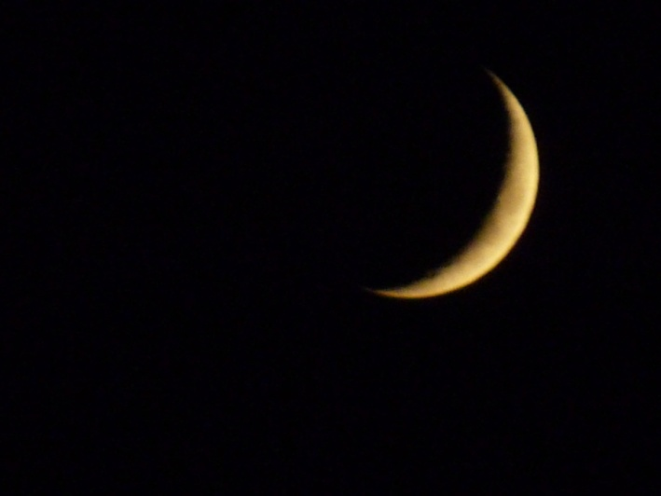
How do preservice elementary teachers (PTs) learn science content?
Moon study pretest:
You may have noticed that the moon appears to be different shapes (e.g., full moon, crescent, half circle). What is your best explanation for this phenomenon? Use pictures and words to explain.

Slide 7
Answers from Research with All Learners

Slide 8
PT Answers
Before the Investigation
The dark part of the moon (or whatever is not shown) is where the earth casts a shadow.
The rotation of the Earth is what puts the shadow on the moon thus changing the shape.
I think, but am not sure, that the sun blocks out the view of the moon Because the moon goes around the sun.
Oh, science isn’t my best subject and I don’t really remember a lot of it from earlier years.
Notes:
Let’s first look at the first goal--that of understanding science concepts. We know from tons of research over the past 25 years, that students come into our science classes at all levels with ideas that differ from the accepted scientific ideas, and that these alternative conceptions are typically strongly held and resistant to change. If we fail to take students’ alternative conceptions into account in our science teaching, we decrease our changes of success.
So, let’s see what some of my students thought about phases of the moon at the beginning of the semester:
When asked:
“You may have noticed that the moon appears to be different shapes (e.g., full moon, crescent, half circle). What is your best explanation for this phenomenon? You can use pictures and words to explain.”
What would you say?

Slide 9
Before
We can only see parts of the moon at certain times of the month because other planets cover it up.
I can’t think of a logical explanation for this phenomenon.
The shape of the moon deals with the earth’s rotation. In a sense the sun shines through or reflects off of the moon giving it the light and shape of the moon.
The moon goes through different stages. It is like a cycle that repeats itself. During these different stages, the moon takes on different shapes. It is always a “whole” moon, but depending on the stage, we can only see certain parts.
Notes:
These answers are very much in line with what the research has shown about students, ages 9 through college.

Slide 10
Before
I believe the reason why there is different shapes of the moon is because of the rotation of the earth. The same phenomenon of why we have different seasons.
When the sun goes down, it provides a shadow to form the moon. Depending on how the sun sets, the shape of the moon differs.
I think that where the earth is positioned on its orbit around the sun and where the moon is positioned in relation to the sun and earth depends on the shape of the moon.

Slide 12
During the Moon Investigation

Slide 13
PT Answers
After the Investigation:
The moon never goes away or changes shape, we just see it differently depending on its position in relationship to the Earth and the sun…When the sun and the moon are on the same side of the Earth, the sun reflects on the side of the moon that is not facing the Earth, so we see nothing. This is called the new moon phase. As the moon slowly revolves, more and more of the moon is seen. This is called waxing…The full moon occurs when the moon and the sun are on opposite sides of the Earth and the sun shines past the Earth onto the entire face of the moon.
Notes:
I will be talking about the teaching strategies that I use in teaching the moon investigation in more depth during the break out session. For now, though, I thought you might like to know that, by the end of the 5-week moon investigation, many students have more accurate and more complete understandings of phases of the moon.

Slide 14
After
Initially…I had no idea of why the moon phases occurred. Today, I believe that the glow of the moon is caused by the sun’s rays…I have learned that the location of the moon and earth in relationship to the sun determines the phase of the moon. When the moon is between the earth and the sun, the back side of the moon is entirely lit, however, we do not see this side of the moon, therefore, we see no moon at all. As the moon revolves around the earth, more and more of the lit portion is visible from earth.

Slide 18
Why did these PTs learn?
Prior learning matters—Students need opportunities to confront and revise their ideas.
Learning is active--Students need opportunities to experience a phenomenon.
Learning is social—Students need opportunities to talk it out.
Learning takes time—Students need multiple and varied exposures to the content.

Slide 19
Knowledge for Teaching
Pedagogical Content Knowledge
PCK
Subject Matter Knowledge
SMK
Pedagogical Knowledge
PK
Knowledge of
Context

Slide 20
Knowledge for Teaching
Pedagogical Content Knowledge
PCK
Subject Matter Knowledge
SMK
Pedagogical Knowledge
PK
Knowledge of
Context

Slide 21
Pedagogical Content Knowledge (PCK)
PCK
includes
Orientations to Science Teaching
which shape
which shape
Knowledge of Science Learners
which shape
Knowledge of Assessment of
Scientific Literacy
which shape
Knowledge of Science Instructional Strategies
Knowledge of
Science Curriculum

Slide 22
Pedagogical Content Knowledge (PCK)
PCK
includes
Orientations to Science Teaching
which shape
which shape
Knowledge of Science Learners
which shape
Knowledge of Assessment of
Scientific Literacy
which shape
Knowledge of Science Instructional Strategies
Knowledge of
Science Curriculum

Slide 23
How do PTs develop science teaching orientations?
(roes.missouri.edu)
Seeds and Eggs Videocase
You are going to watch a first grade teacher beginning a science unit called “Seeds and Eggs.” Before viewing this teacher, think and write about the following: What do you expect to see in this first grade science lesson? On what do you base your expectations?

Slide 24
How would you respond?

Slide 25
PT Answers—Before Viewing
Since first graders typically have a short attention span, I think the teacher will probably provide short periods of instruction and then allow the students to participate in some type of hands-on activity. The materials will probably be presented in a simple straight-forward manner so that the students will stay focused.
In first grade I expect to see simple science lessons. I expect to see the children doing hands-on activities to keep them motivated and interested in the activity or lesson... I expect the lesson to be simple, but interesting and motivating for the child.

Slide 26
Before
I expect this first grade teacher may present this lesson by talking about how things start out and eventually grow and change. I expect the teacher to have hands-on activity, but it may be dominated by the teacher because of the students’ young age.
When I think of a first grade science lesson, I think mainly of the teacher showing and explaining simple science related topics.... It will be the teacher talking the most.
I don’t believe the lesson will be very interactive because I never had interactive science lessons while I was in elementary school.

Slide 27
Before
I expect the teacher to first ask her students if they can identify these two objects. Secondly, the teacher will ask the students what a seed does (grow into some kind of plant) and what an egg forms into (some kind of small animal--chicken). Thirdly, the students will bury the seeds in the dirt and place the eggs gently in a heated cage. Fourthly, the students will make daily observations of the changes these objects experience (with the teacher’s help).
I might expect to see the teacher introducing the seeds and eggs unit through an initial discussion with the students. Questions and answers will help the teacher assess how much the students already know. I would also expect the teacher to show the kids a plant and its seed as well as, for example, an egg and a picture (or real!) of a chicken. I predict the class will plant lima beans in white cups and take them home or put on windowsill. Maybe a book will have been read, also.

Slide 28
Seeds and Eggs Videocase

Slide 29
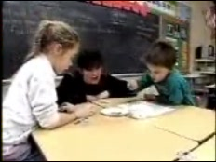
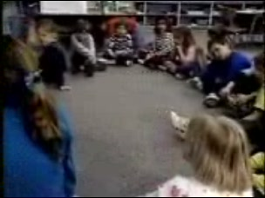
Seeds and Eggs Videocase

Slide 30
PT Answers—After Viewing
I really enjoyed watching the lesson. Before I had only a dry concept of what a seeds and eggs lesson would be. I now see that there are other options for this lesson. I now look at it as a lesson that can be fun and progressive, not just a strict read about lesson.
I most vividly remember how the teacher facilitated the conversation between herself and the students and among the students themselves. Many of my science experiences were with teachers who didn’t want conversation on a topic or students’ opinions about the topic. The teachers just wanted correct answers.

Slide 31
PT Answers—After Viewing
After viewing the video, I know that [the teacher] used creative and innovative methods for teaching about science. I feel that, now, the more innovative methods help children more readily understand concepts because they are involved in the science processes.
The children all got to voice their opinion and ideas without the fear of being told they are wrong.

Slide 32
Yet, Life is not all rosy...
I didn’t like the end--[the teacher] didn’t tell the students if they were right or wrong.
I would feel comfortable using the hands on experiences as she did. However, I would not feel comfortable not ever giving the students the right answers.
I would feel uncomfortable not correcting incorrect conclusions. I would want students leaving the unit knowing some correct generalizations.
One thing that I didn’t expect to happen was the way the lesson ended. I felt that she didn’t “cover” eggs very well.

Slide 33
What can we say about PT learning of orientations?
Prior learning matters—Students need opportunities to confront and revise their ideas.
Learning is active--Students need opportunities to experience a phenomenon.
Learning is social—Students need opportunities to talk it out.
Learning takes time—Students need multiple and varied opportunities to learn.

Slide 34
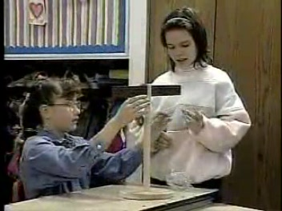
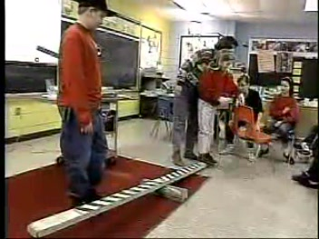
How do PTs learn about science learners?
Levers Videocase (roes.missouri.edu)
Preservice teachers participate in levers activities
Teacher: “Look for children’s ideas of why things balance.”

Slide 35
Levers Videocase

Slide 36
PT Responses—After Viewing
5th graders insist that each setup, including the balancing broom, balances because both sides “weigh the same.” They fail to take distance from the fulcrum into account in their explanations.
Preservice teachers exclaim, “That’s what some of us thought!”

Slide 37
After
5th graders fail to accept the broom-weighing results, and one shouts, “We need a new scale!”
Preservice teachers laugh. In subsequent discussion, they apply the theory they read about--that children’s science ideas are strongly held and difficult to change--to this real classroom episode

Slide 38
What can we say about PT learning about science learners?
Prior learning matters—Students need opportunities to confront and revise their ideas.
Learning is active--Students need opportunities to experience a phenomenon.
Learning is social—Students need opportunities to talk it out.
Learning takes time—Students need multiple and varied opportunities to learn.

Slide 39
How do PTs learn about science assessment?
Levers Videocase
Classroom teacher reflects on lesson: “There isn’t gonna be closure on this lesson as soon as I thought there would be, and even when the lesson is over, there are going to be many kids that still don’t understand, really understand what’s going on. I’m gonna probably have to just accept that. “

Slide 40
How would you respond?

Slide 41
PT Initial Responses
How can she accept all children’s not understanding?
It doesn’t seem to be fair to just go on.
Isn’t it the teacher’s job to motivate students and make sure all students understand?
She should just keep students in at recess and give them extra help until they get it.

Slide 42
PT Later Responses
After class discussions, moon study, and time in elementary classrooms:
I think science is one of those things that you can’t just tell someone 50 times the reason, but it will just hit.
It’s like with our study of the moon in this class. No one understands the moon now like a scientist, but everyone understands it better than when we started.
I wish I could change what I said in class. Now I can see how kids understand at different levels and how unrealistic it is to think all kids will get it at the end of the lesson.

Slide 43
What is important about PT learning?
Prior learning matters—Students need opportunities to confront and revise their ideas.
Learning is active--Students need opportunities to experience a phenomenon.
Learning is social—Students need opportunities to talk it out.
Learning takes time—Students need multiple and varied opportunities to learn.

Slide 44
Who can supply multiple and varied opportunities for elementary PTs?
Scientists
Science educators
K-6 teachers

Slide 45
Roles and Responsibilities in Elementary PT Education
Scientists:
Teach concepts aligned with standards for K-6
Teach concepts in line with how students learn
Science educators:
Understand the knowledge base for teaching teachers
Teach in ways that move students from what they know and believe to reform-minded practice
K-6 teachers:
Sponsor preservice teachers in K-6 classrooms
Help them reflect on their experience in light of what they are learning in their campus courses

Slide 46
Questions or Comments?
abells@missouri.edu

