Slide 1
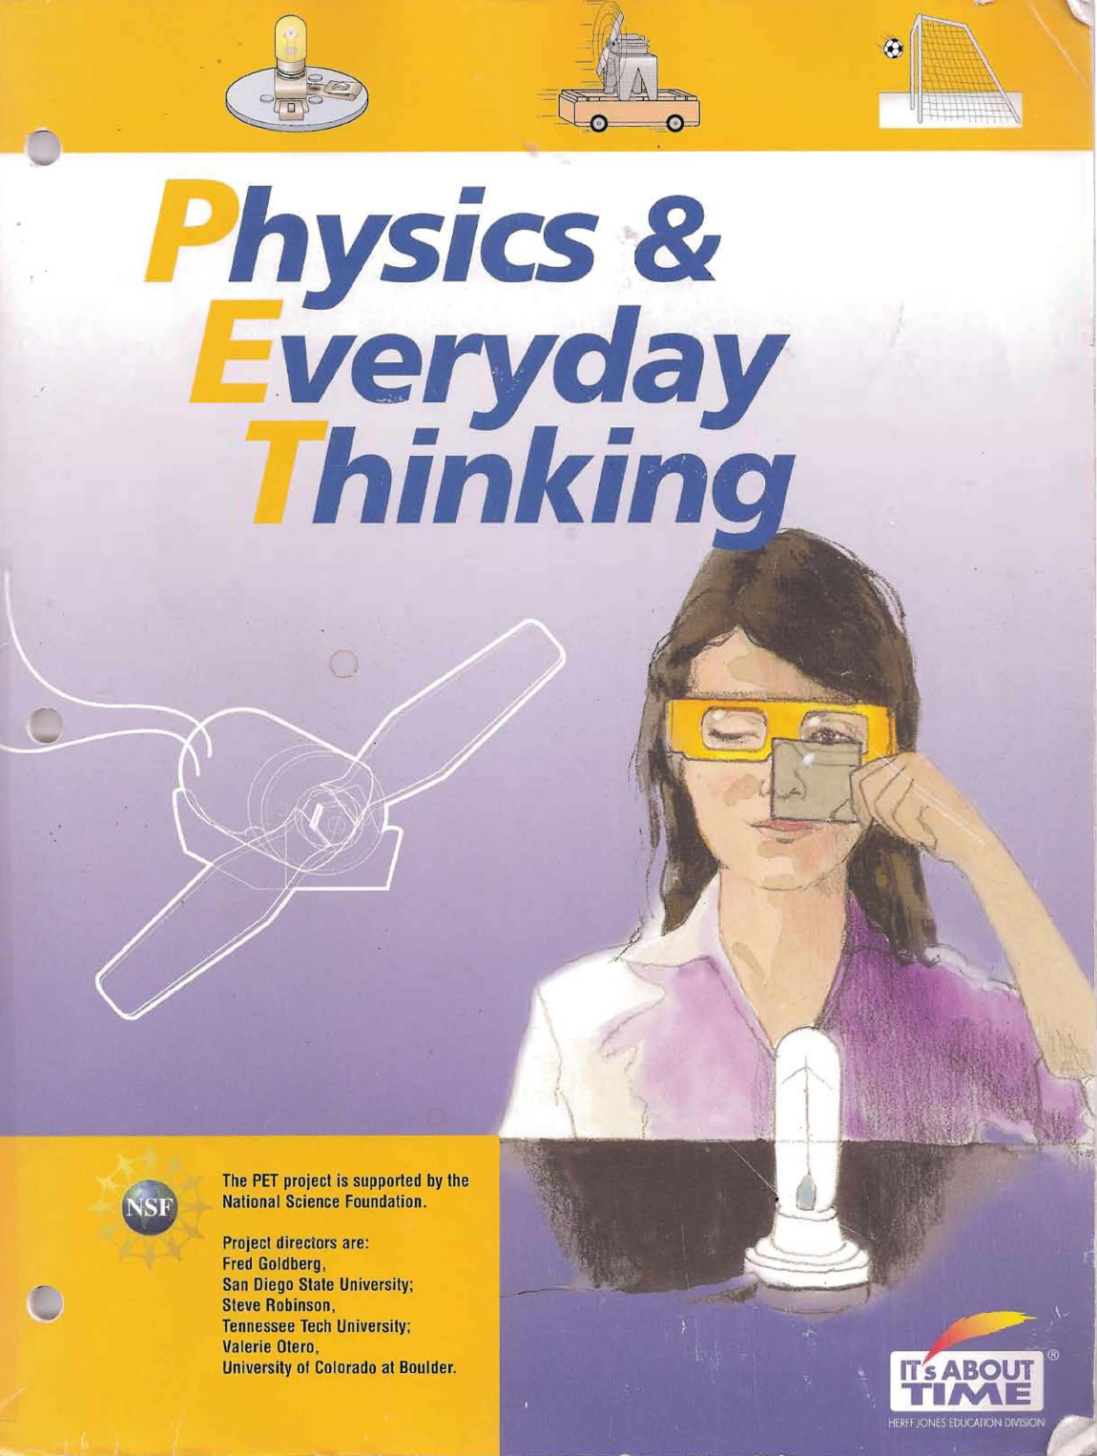
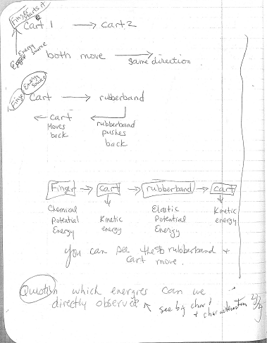
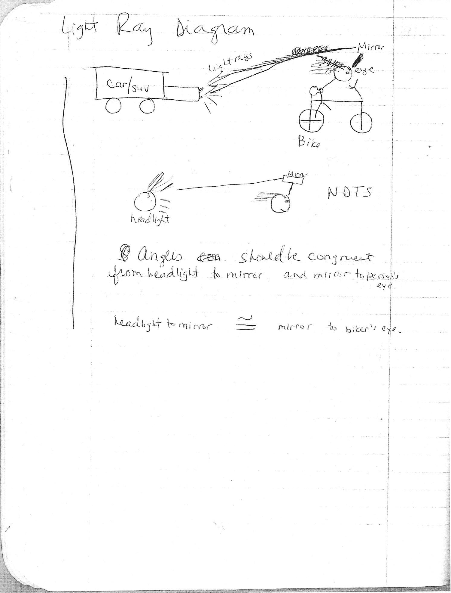
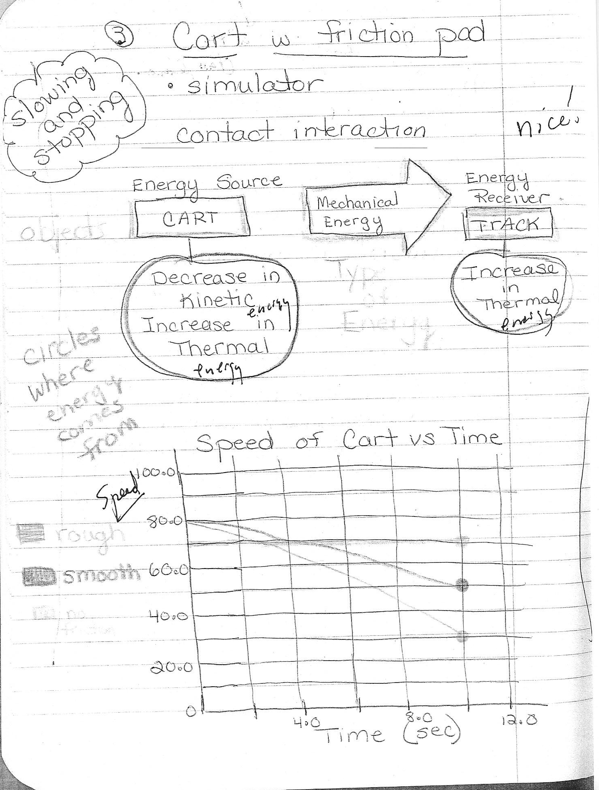
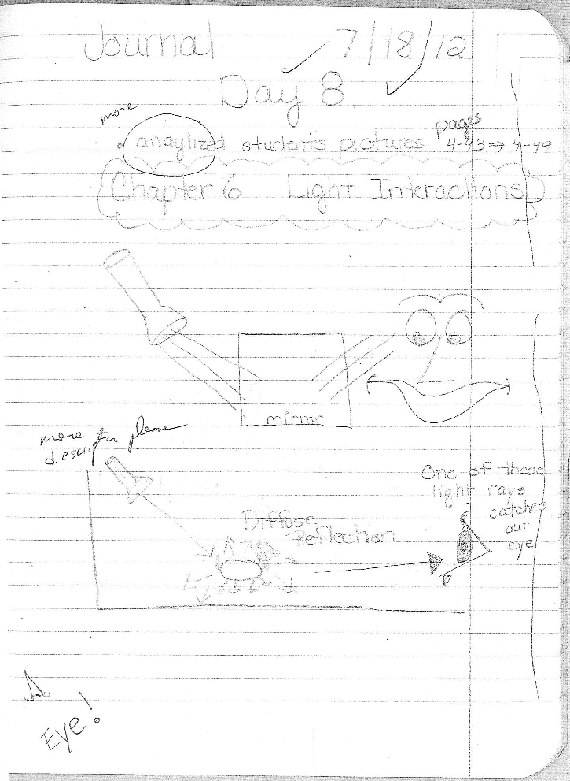
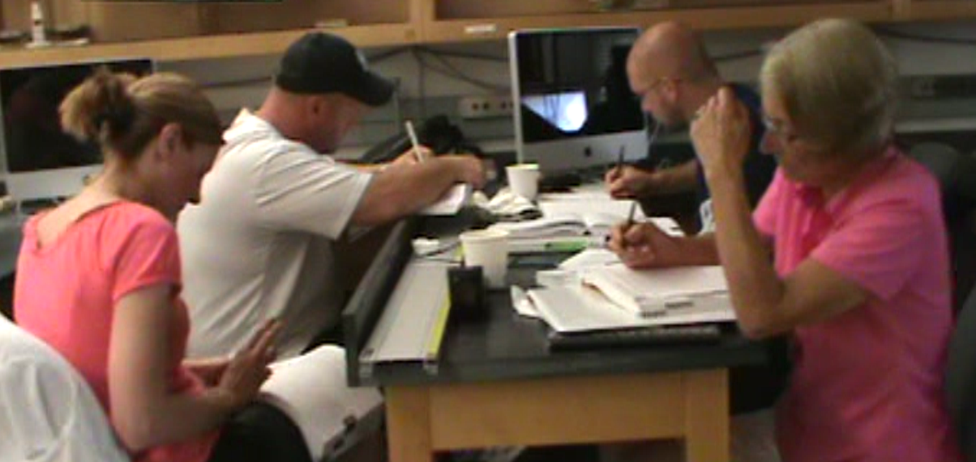
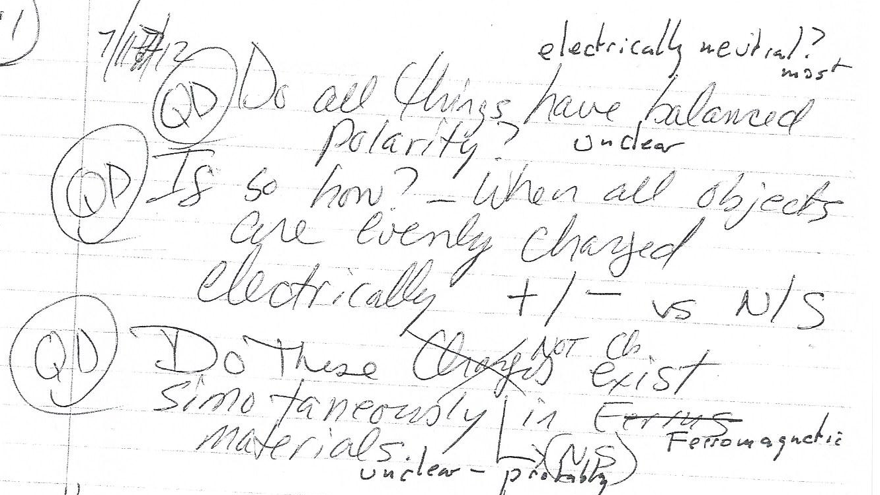
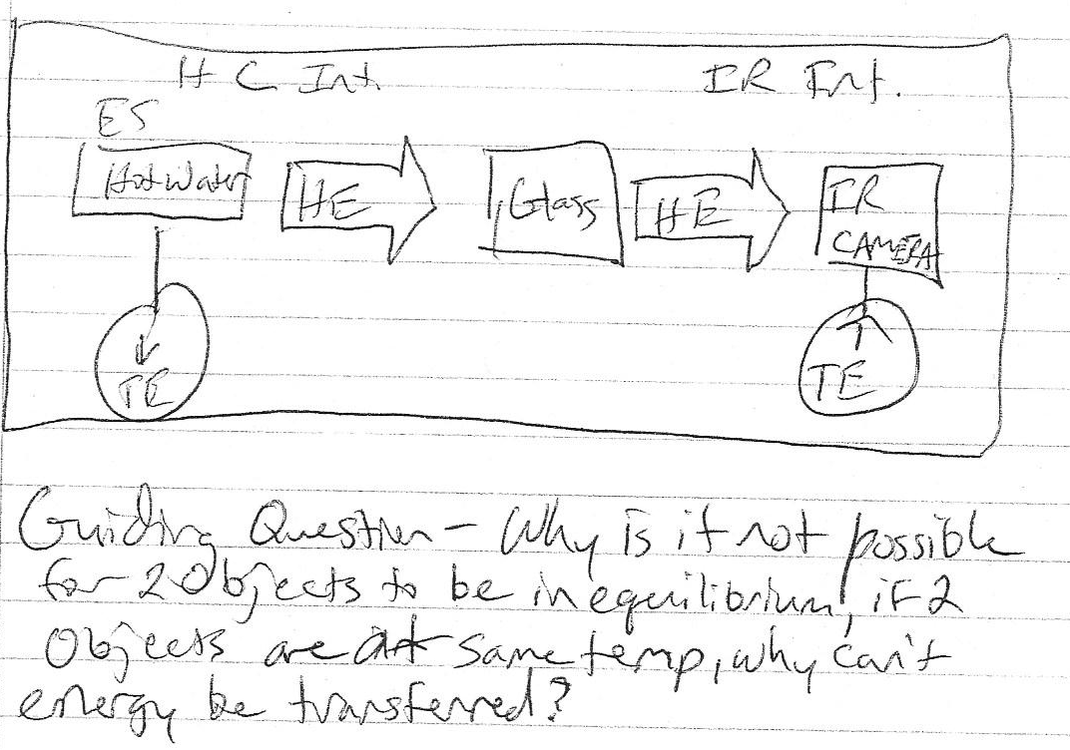
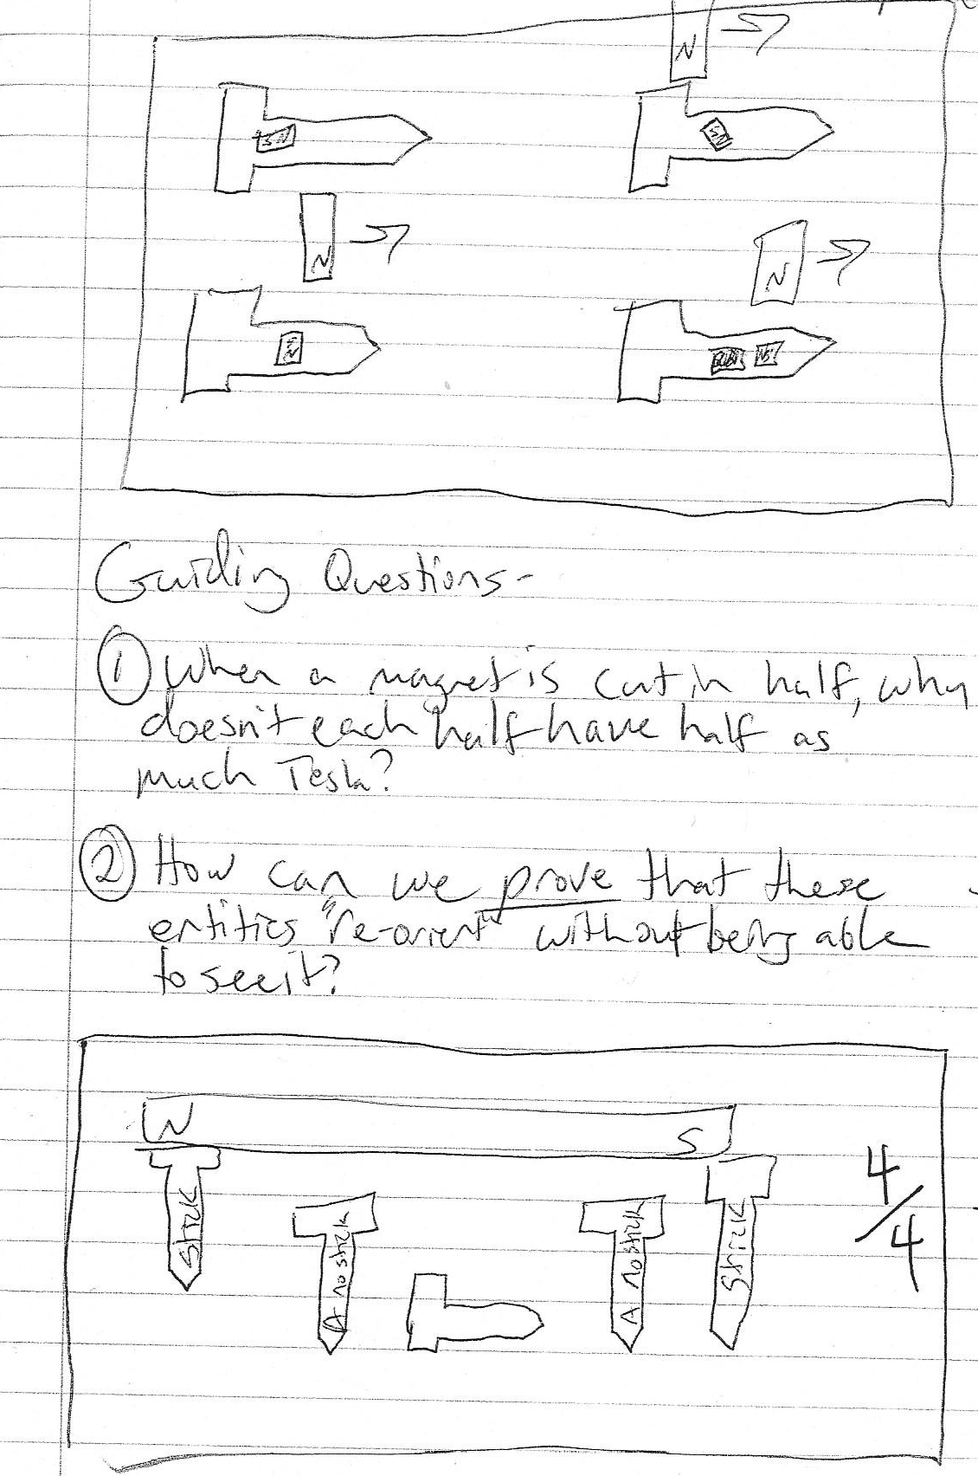
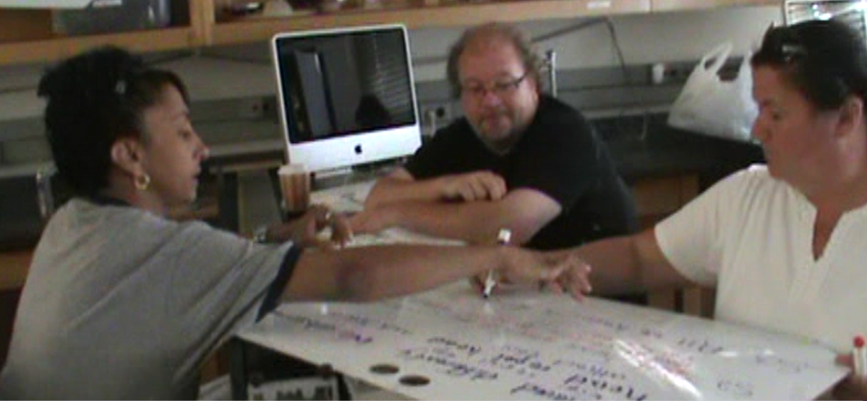
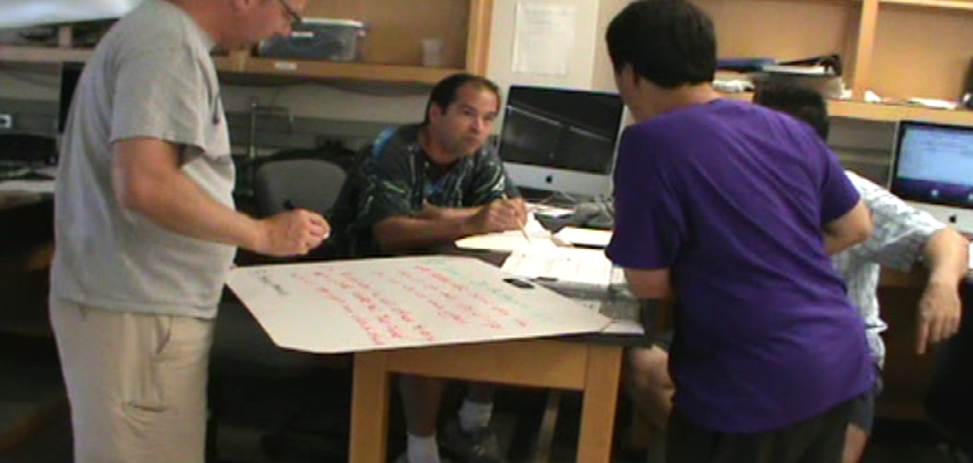
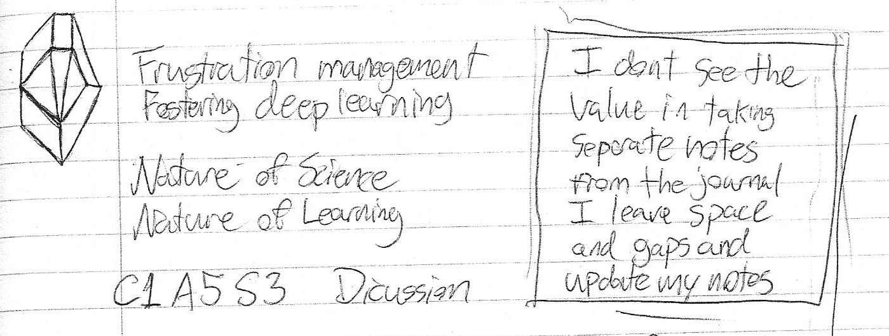
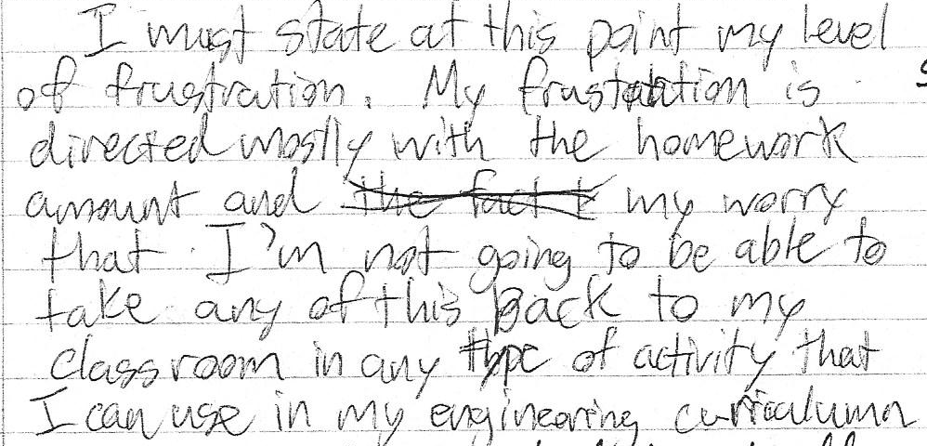
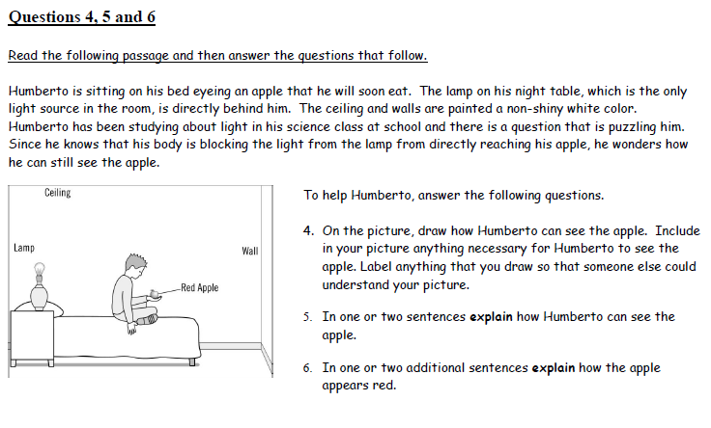
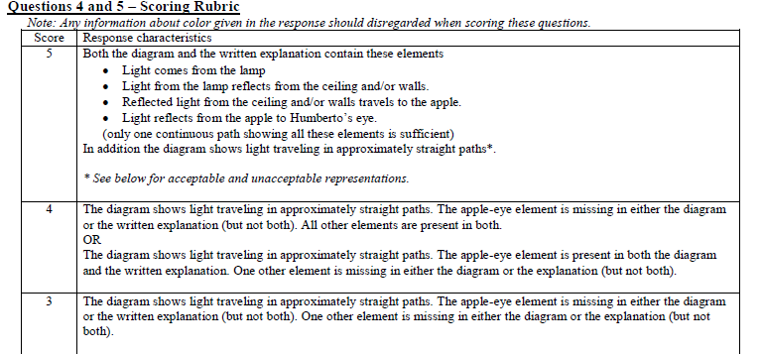
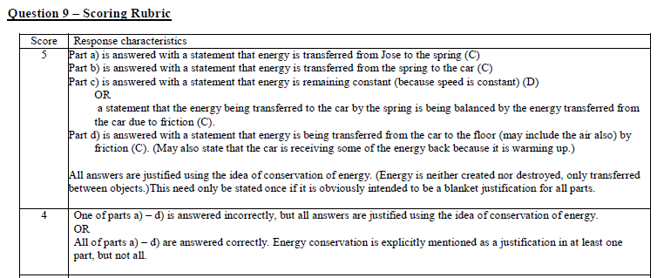
 | Lessons from a Summer PET Course for In-service K-12 Teachers
 | Justin Snook, Dan M^{ac}Isaac, David Abbott & Kathleen Falconer SUNY-Buffalo State College Department of Physics snookj01@mail.bufalostate.edu, danmacisaac@gmail.com
In summer 2012, fifteen K-12 teachers from struggling, low-income schools in an urban school district attended a two-week, credit-bearing course at SUNY Buffalo State College using the Physics and Everyday Thinking (PET) curriculum by Goldberg et al. The course featured whiteboard driven discourse and significant use of hands-on activities linked to probeware and simulations, all of which were unfamiliar to the participants. We reported on pre and post PET diagnostic data and student learning journals. Additional course characterization from video and instructors' comments were included. Findings and lessons learned was presented for this and similar courses. This activity was sponsored by the Integrated Science and Engineering Partnership (ISEP), NSF-MSP project DUE-1102998. Any opinions, findings, conclusions or recommendations presented are only those of the presenter grantee/researcher, author, or agency employee; and do not necessarily reflect the views of the National Science Foundation. |  | Qualitative Data
 |  | Examples of Less Reflective Student Journal Entries |  |  | Examples of More Reflective Student Journal Entries
Background In September 2011, the NSF targeted MSP: The University at Buffalo / Buffalo Public Schools (UB / BPS) Interdisciplinary Science and Engineering Partnership was funded for five years, providing professional development to teachers from twelve high needs urban schools from a large economically and culturally diverse urban system serving over 32,000 students. These twelve schools (including HS, and their feeder middle and elementary schools) were those which have been labeled as Persistently Low Achieving (PLA) schools by NYSED and are amongst those struggling most within the BPS system. Teachers were encouraged to apply for the two week, four hours per day summer graduate course PHY594/TED594: Integrated Physics and Engineering for Teachers I, and those fifteen teachers who applications were selected and who completed the summer received a $1,200 stipend, the PET textbook, tuition, classroom materials, offers of professional development association enrollment and meeting travel support, and a set of whiteboards. These teachers also have and will continue to receive a total of two days follow up support in their regular school year from a retired master STEM teacher, and through professional learning community enrollment in the schools. All fifteen (6 women and 9 men) of these very diverse teachers were fully certified to teach in NYS, though not all had STEM certification, and many had grandfathered certifications predating current rigorous STEM requirements, with nine HS, three MS and three elementary teachers completing the course. Of these teachers, three (mainly the elementary teachers) identified themselves as non-STEM special education specialists. The majority of teachers (six of fifteen) identified their STEM specialty as in Biology, Living Environment, Environmental Science or Forensic Science, with the next largest specialty identified as technology education (three of fifteen). Two teachers each identified with Earth Science and Physics, and one with Math as their STEM specialty. The course was taught by a combination of a college faculty (instructor of record was a physics professor) and three highly experienced master teachers specializing in physics and mathematics, two males from BPS and one woman from a local non-BPS public school. The curriculum was mainly selections from Goldberg, Otero and Robinson’s (2010) energy-centric Physics and Everyday Thinking (PET) curriculum.
 |  | A less reflective journal entry included multiple representations of content, but lacked complete development of either concept or pedagogy. There was little to no connectivity between concepts or evaluation of the course content. The diagrams were ambiguous and may not have contained explanatory texts. The guiding question were procedural, declarative and closed. A more reflective journal entry showed multiple representations of content with clear and complete concept development. The linkages were explicit and showed the connectivity between concepts. The students had evaluated and analyzed the content and pedagogy of the course. The diagrams included explanatory texts. The student applied the tools and strategies learned . The students reflected on their teaching and learning of the topics through the quality of the guiding questions. There was a sense of personal involvement.
 |  |  |  |  |  | Conclusions and Lessons Learned Science Content Knowledge. Participating teachers learned science content, as demonstrated through pre and post conceptual growth, a final exam, and reflective journals. Teachers demonstrated particular growth in their conceptual understandings of the domain model of magnetism, optics and the conservation of energy. This seemed particularly motivational to those teachers with the weakest physics science backgrounds. Pedagogical Content Knowledge. Participating teachers made use of scientific argumentation, probeware and simulations. Several teachers planned to use their final course projects in their instruction, in particular one group worked on a project associated with a Technology and Science Olympics team, while others worked on motion and EKG probe use, and another on magnetism for elementary students. Though some teachers were still resistant, several teachers made plans to incorporate these changes into their own instruction, and we have ordered equipment (mainly physics and biology probeware) specifically for them to do so, and will be visiting, supporting, monitoring and advising them on this in academic year 2012-2013.
 |  |  |  |  |  | Pedagogical Knowledge. All teachers practiced whiteboard discourse in the course, and all were provided with a dozen whiteboards and markers. Only a few felt comfortable with using whiteboards regularly in their instruction, and we are making specific effort to support whiteboard discourse at one school site which has started offering a new conceptual physics course (at which one of the master teachers works, and where we have faculty, graduate and undergraduate students regularly visiting and assisting with classes). Other ISEP schools have expressed an interest in starting conceptual classes and it is likely we will extend this intensive support to another HS in 2013-2014, as well as attempting to recruit more teachers from this second site to the Summer 2013 course offering. Other Goals. ISEP has started a number of both topically-centered and school centered Professional Learning Communities or PLCs, and we have been trying to get some summer course participants involved in the Western NY Physics Teacher’s Alliance. Summer 2012 teachers now have more appropriate shared STEM professional development experiences, and are discussing and exploring some of the same kinds of instructional changes in their own instruction. ISEP personnel have been attending the schools communal planning times and where invited have been participating in STEM classrooms. Trust is particularly problematic and we feel we are making strides. We are in this for the long term (at least through 2016), and have already started accepting teacher applicants for the summer course planned for 2013 -- PHY594/TED594: Integrated Physics and Engineering for Teachers II. Teachers who have made positive changes in their instruction will be particularly encouraged to reapply for the summer program, which will extend the content theme of energy through engineering design.
 |  | This participant was selected because his testing exhibited no conceptual gain but a very high score on the final exam. The selected participant’s journal was examined for reflection, metacognition, connections, types of questions and dispositions. The participant was clearly resistant to metacognition and reflection. The participant did not initially value the coursework or the pedagogy. However, during cycle on magnetism, the participant became aware of their lack of conceptual understanding. The participant’s involvement level increased and frustration decreased. The participant went from asking no questions to comprehension based questions in their journal. There was still a lack of reflection and metacognition. Quantitative Data The PET Diagnostic was administered pre and post instruction. However, only items 4,5 and 9 were used in the analysis since course instruction was focused on Energy, Magnetism and Optics, which correspond to item 4,5 and 9 on the Diagnostic. There is no item assessing magnetism. Participants showed a statistically significant gain in their scores for questions 4,5 and 9 from the PET diagnostic (see Table 1 and graph 1). These gains indicate that students increased in conceptual understanding of optics and energy transfer from course instruction. In contrast, the participants showed no significant gain for the other items on the PET Diagnostic that were no course instruction occurred (Graph 2). This would seem to indicate that the gains were related to the instruction and not some other factor.
The course Two weeks, four hours per day Middle and High School teachers of science and special education One physics teacher Focus on PET Energy, Magnetism and Optics Energy as a unifying topic among different science Magnetism for Nature of Science Optics as a physical science topic that would interest Living Environment instructors. The pre-test scores were higher in Energy and optics Items indicating some prior knowledge Little or no instructional time on Forces and Circuits PHY594/TED594: Integrated Physics and Engineering for Teachers I Course Goals: Content Goals – to learn about energy conservation and transformation as a unifying STEM construct, explicitly in the domains of mechanics (force and motion), thermodynamics, magnetism and optics, with project extensions to biology, earth science, technology and chemistry. Pedagogical Content Knowledge – to learn how to use scientific argumentation and model development (particularly evidence-based hypothetico-deductive reasoning in models of magnetism), to become familiar with the use of probeware and simulations in STEM teaching. Pedagogical Knowledge – to practice listening to and analyzing student thought, practice cooperative group learning, practice using whiteboarding in small and whole group discourse, and practice the use of reflective journals and projects to learn and teach science Other Goals -- to foster membership in a professional learning community associated with ISEP, to establish and develop trust with colleagues and ISEP staff. The PET Diagnostic is a nine item extended response instrument scored via a rubric from a total of twenty-eight possible points. The instrument item domains include Newton’s laws, force, motion and friction, elementary optics and circuit concepts and energy conservation. The Reformed Teaching Observation Protocol (RTOP) is an observational instrument with twenty-five items characterizing classroom activity emergent from science and mathematics educational research literature. RTOP has been demonstrated to strongly correlate with student conceptual learning gains identified through pre and post testing in a number of STEM disciplines and age ranges.
 |  |  |  |  |  | References Crouch, C. H., & Mazur, E. (2001). Peer Instruction: Ten Years of Experience and Results. American Journal Of Physics, 69(9), 970-77. Goldberg, F., Robinson, S., & Otero, V. (2008). Physics & everyday thinking. Armonk, N.Y: It's About Time, Herff Jones Educational Division. Goldberg, F., Otero, V., & Robinson, S. (2010). Design principles for effective physics instruction: A case from physics and everyday thinking. American Journal of Physics, 78, 1265. Henry, D., Henry, J., & Riddoch, S. (2006). Whiteboarding Your Way to Great Student Discussions. Science Scope, 29(7), 50-53. MacIsaac, D. (2012). Physics! Blog! by modeler Kelly O'Shea of St. Andrew's School Physics kellyoshea. wordpress. com. The Physics Teacher, 50, 446-446. MacIsaac, D.L. & Falconer, K.A. (2002). Reform your teaching via the Reform Teaching Observation Protocol (RTOP). The Physics Teacher. 40(8), 479-486. May, D. B., & Etkina, E. (2002). College Physics Students' Epistemological Self-Reflection and Its Relationship to Conceptual Learning. American Journal Of Physics, 70(12), 1249-58. Monet, J. A., & Etkina, E. (2008). Fostering Self-Reflection and Meaningful Learning: Earth Science Professional Development for Middle School Science Teachers. Journal Of Science Teacher Education, 19(5), 455-475. PET: Resources for Faculty. In Physics and Everyday Thinking. (2007). Retrieved January 3, 2013, from http://petproject.sdsu.edu/resources/resources.html. Piburn, M., Sawada, D., & Arizona State Univ. Bd of Regents. (2000). Reformed Teaching Observation Protocol (RTOP) Reference Manual. Technical Report. Sawada, D., Piburn, M. D., Judson, E., Turley, J., Falconer, K., Benford, R., & Bloom, I. (2002). Measuring Reform Practices in Science and Mathematics Classrooms: The Reformed Teaching Observation Protocol. School Science And Mathematics, 102(6), 245-53. Thornton, R. K. (2004). Uncommon knowledge: Student behavior correlated to conceptual learning. In PROCEEDINGS-INTERNATIONAL SCHOOL OF PHYSICS ENRICO FERMI (Vol. 156, pp. 591-602). IOS Press; Ohmsha; 1999. This poster is available from: http://physicsed.buffalostate.edu/pubs/AAPTmtgs/AAPT2013Winter/
 |  |  |  | RTOP scores of the instructors ranged from 60 – 71. Two of the four instructors were evaluated with RTOP.
Table 1
Selected Items from PET Diagnostic
 |  | Pre |  |  | Post |  |  | gain
Summer 2012 (Total 4,5,9) | 3.29 | ± | 2.87 | 6.50 | ± | 2.93 | 0.47 | ± | 0.42**
Question 4,5 (Optics) | 1.64 | ± | 1.55 | 3.60 | ± | 1.65 | 0.48 | ± | 0.53**
Question 9 (Energy) | 1.64 | ± | 1.69 | 3.13 | ± | 1.96 | 0.32 | ± | 0.58*
* p < 0.05. **p < 0.01
Table 1

