Slide 1
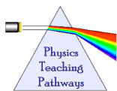


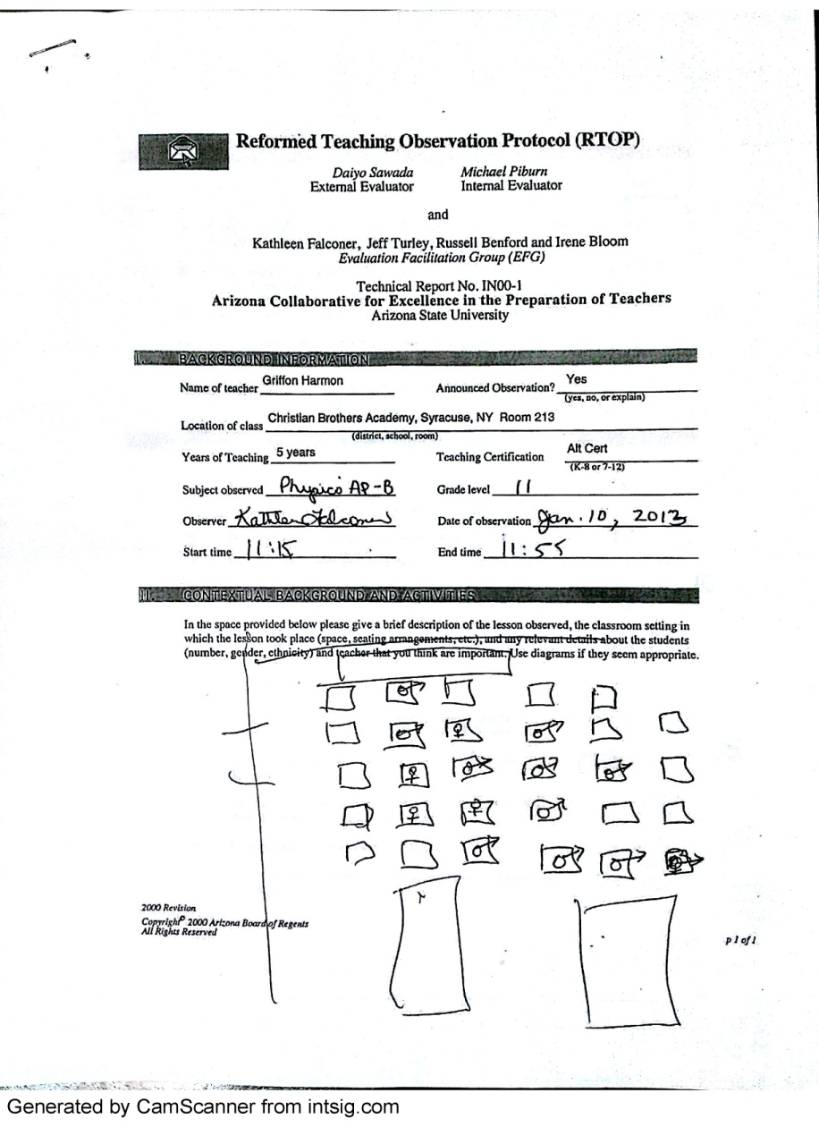
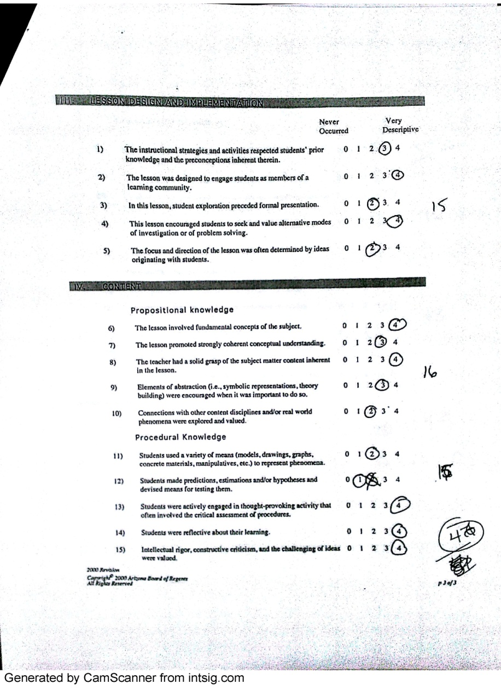
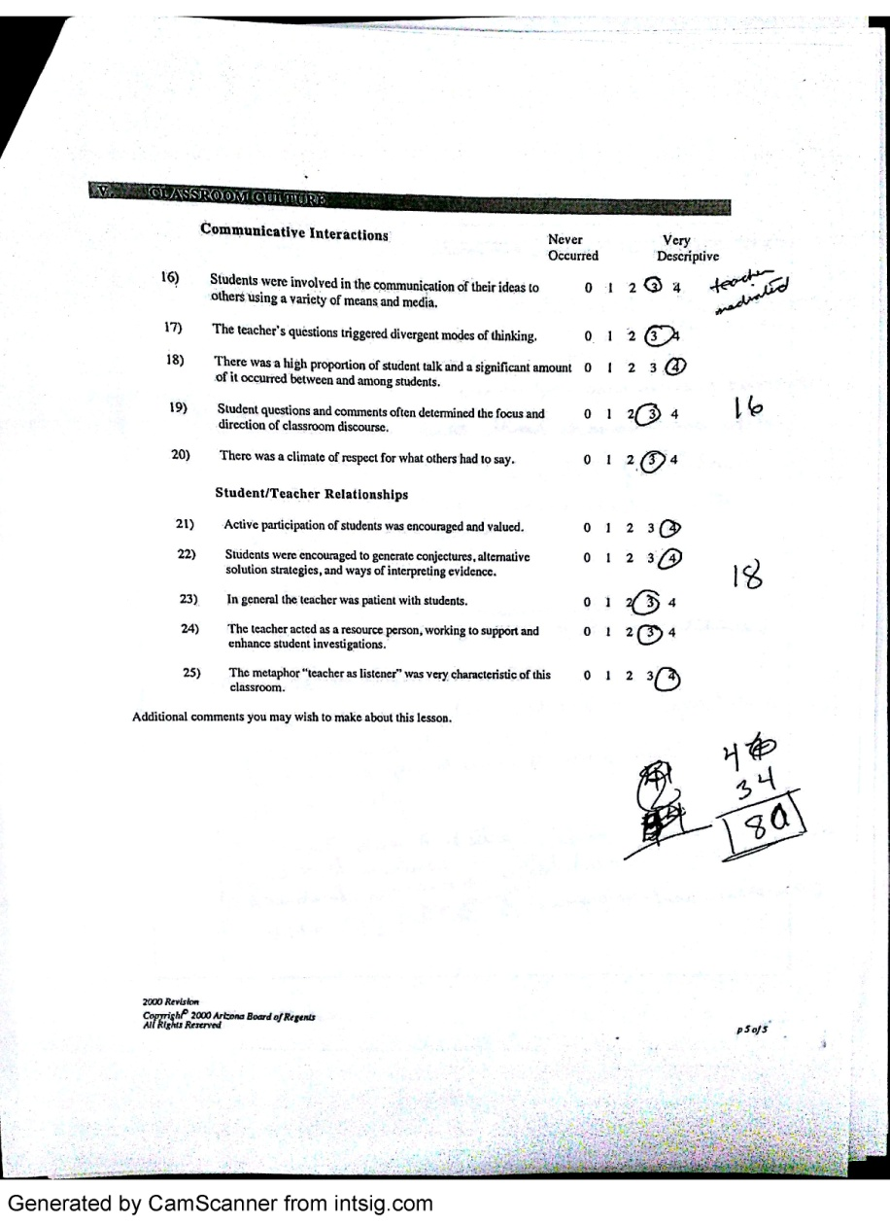
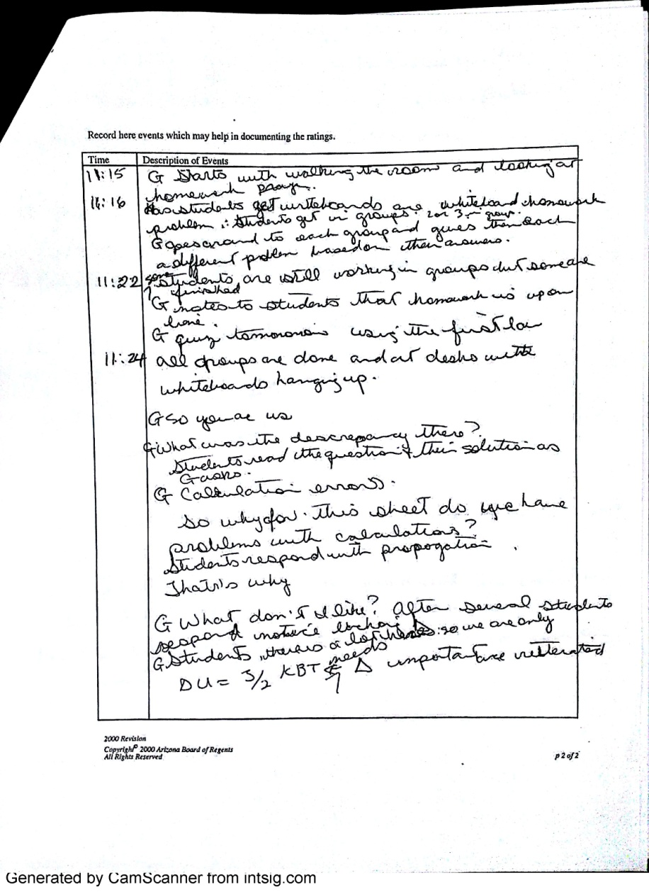
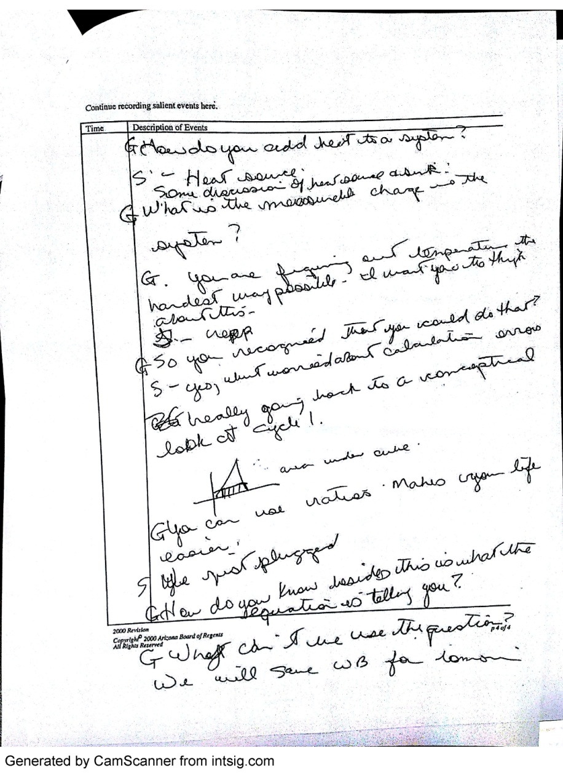
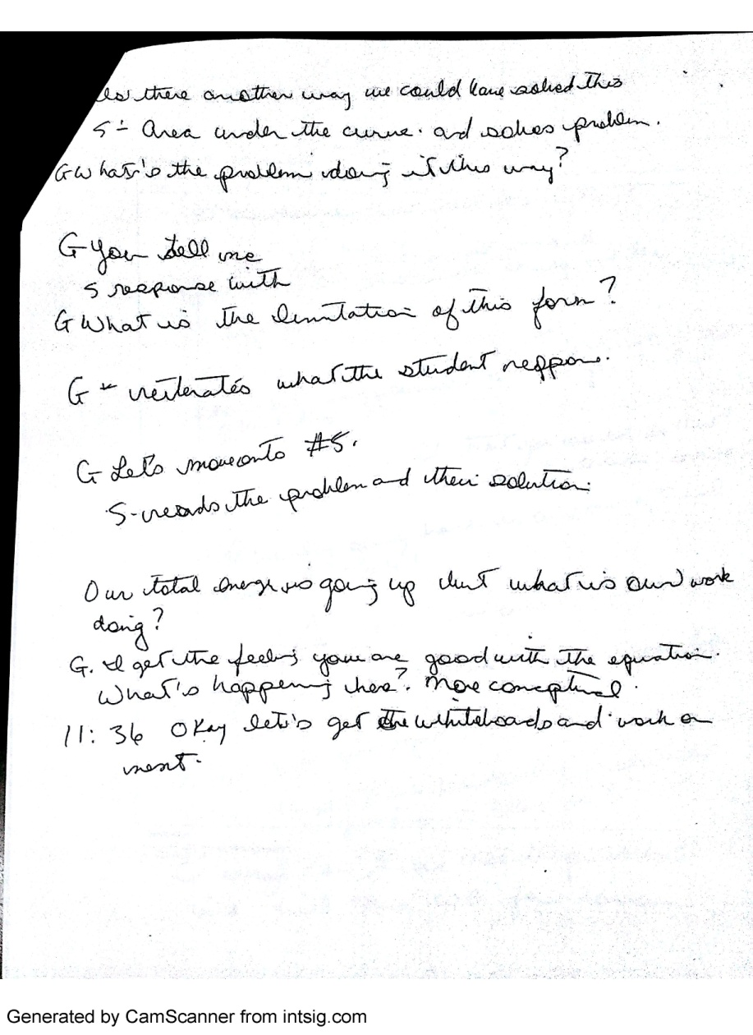
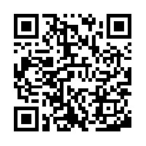
Characterizing Noyce Scholars' Classrooms with RTOP
Kathleen Falconer, falconka@buffalostate.edu, Dan MacIsaac, Buffalo State College
Griffin Harmon, Christian Brothers Academy, Syracuse, NY 13214
Abstract
RTOP Forms
Data
In 2009, we proposed an extension of the Robert Noyce
Teacher Scholarship Program at Buffalo State College to support an
additional 35 scholars seeking initial STEM teacher
certification over the next five years (beyond our initial 42 scholars).
As a component of the Phase 2 Noyce Project at Buffalo State College,
We proposed a Teacher Effectiveness
Study including research and evaluation of the Noyce participants.
Several Noyce scholars in their first few years of teaching have been
observed and evaluated using the Reformed Teaching Observation
Protocol (RTOP). We will be reporting on the results from several
classrooms.
There have been forty two Phase I Noyce Scholars and fifteen Phase II Noyce Scholars funded. Of these, two physics Noyce Scholar have been RTOPed and videotaped. Pre-post FCI scores have also been collected. The RTOP scores ranged from 62 to 80. The average scores was 68 ± 8.2 over the two participants. Both participants showed growth throughout the observation and mentoring process.
All the instructors of the university physics courses taken by these Noyce scholars, which are integral to the Physics programs, have been RTOPed. The RTOP scores ranged from 43 to 84. The scores indicated the instruction for the physics Noyce participants is reformed. The normalized gains (<g>) on the conceptual instruments ranged from 0.03 ± 0.30 on the FMCE in summer 2012 to 0.58 ± 0.08 on the TUG-K in summer 2010. The majority of the <g> were above 0.30, which indicates a good level of concept development. The attitudinal and efficacious results were mixed. There was not a clear trend in the data.
Background
RTOP
The Reformed Teaching Observation Protocol (RTOP) was developed as a classroom observation instrument to provide a standardized means for detecting the degree to which K-20 classroom instruction in mathematics or science is reformed.
RTOP was developed, refined, and validated over a period of two years (1998-2000). In its final form, the RTOP is a highly reliable instrument with strong predictive validity RTOP has been used in thousands of K-20 science and mathematics classrooms to provide a precise quantitative reading of the degree to which teaching is reformed. RTOP both operationally defines and assesses reformed teaching in the classroom.
NOYCE
Over a five year period spanning April, 2004 to late September 2009, the Western New York Noyce Scholars Project for New Science and Mathematics Teachers supported forty-two individuals seeking initial science, technology or mathematics teacher certification with scholarships and stipends of between $4,200 and $17,000 totaling just over four hundred and fourteen thousand dollars. These included twenty-one women and twenty-one men, and ten under-represented minority students in STEM teaching fields. All of these individuals had service obligations requiring either two or four years of full time employment in high needs (disadvantaged) school districts, and about 75% of these recipient teachers have certified as teachers and are satisfying or have satisfied their service obligations as of this date. Some of the local educational authorities these teachers have been employed by include: Buffalo Public Schools (employing several scholars), Charlotte Valley Central School District, Cheektowaga-Sloan Union Free School District, Holy Angels High School, Hornell City School District, Lansing Central School District, Oakfield Alabama Central School District, Christian Brothers Academy, Springfield Public Schools (PA), and the Western New York Maritime Charter School.
In 2009, we proposed an extension of the Noyce project to support an additional thirty-five scholars seeking initial science and mathematics teacher certification over the next five years. Currently, fifteen scholarships have been funded. This renewal and extension included research and evaluation of the Noyce participants. The research portion of the grant was proposed to better monitor and support the Noyce scholars in their studies and in their first few years of teaching by observation and critical evaluation and feedback using RTOP. RTOP was used to measure and characterize Noyce scholar’s classrooms. Teacher and students interactions was observed in working high school STEM classrooms.
Conclusion
The physics preparation for the Noyce Scholars is reformed.
Since the numbers of participants in the high school are so low, we will only report that both teachers’ RTOP scores were reformed and not report the FCI results.
For many reasons, there has been very limited response to requests for RTOPing and videotaping in the high school classrooms.
There needs to be a reward for participating in the research for the school or school district. Many of the teachers were willing, but the LEA (local educational authority) was not.
Permission Forms
New York is a very litigious state (one of the most litigious in the US.) As a result, we have had some problems with parental permission for observation of students.
The following statement is considered a problem. Many parents want the risk to be no risk at all.
“Risks: There should be minimal risk to you as a result of participating in this research study.”
Many high schools/superintendents were unwilling to agree to even present the idea to parents.
REFERENCES
Adamson, A.E., Banks, D., Burtch, M., Cox III, F., Judson, E., Turley, J.B., Benford, R. & Lawson, A.E. (2003). Reformed Undergraduate Instruction and Its Subsequent Impact on Secondary School Teaching Practice and Student Achievement. Journal of Research in Science Teaching 40(10), 939-958.
Cochran-Smith, M., Jong, C., Pedulla, J. J., Reagan, E. M., & Salomon-Fernandez, Y. (2010). Exploring the link between reformed teaching practices and pupil learning in elementary school mathematics. School Science and Mathematics, 110(6), 309+.
Flick, L. B., Morrell, P. D., Sadri, P., Schepige, A., & Wainwright, C. (2009). A cross discipline study of reformed teaching by university science and mathematics faculty. School Science and Mathematics, 109(4), 197+.
Lawson, A. E., Benford, R., Bloom, I., Carlson, M. P., Falconer, K. F., Hestenes, D. O., Judson, E., Piburn, M. D., Sawada, D., Turley, J., & Wyckoff, S. (2001). Reforming and evaluating college science and mathematics instruction: Reformed teaching improves student achievement. Journal of College Science Teaching, in press. Discusses links between RTOP scores and student achievement gains for six physical science and four university physics classes, amongst many others.
MacIsaac, D.L. & Falconer, K.A. (2002, November). Reforming physics education via RTOP. The Physics Teacher 40(8), 479-485. Available from
< http://physicsed.buffalostate.edu/pubs/TPT/TPTNov02RTOP/ >, describes physics-specific RTOP use.
Piburn, M., Sawada, D., Falconer, K., Turley, J. Benford, R., Bloom, I. (2000). Reformed Teaching Observation Protocol (RTOP). ACEPT IN-003. The RTOP rubric form, training manual and reference manual containing statistical analyses, are all available from
< http://PhysicsEd.BuffaloState.Edu/AZTEC/rtop/RTOP_full/PDF />. IN-001 contains the RTOP rubric alone, IN-002 constains rubric and trainingmanual, IN-003 adds the statistical analyses.
Sawada, D., Piburn, M., Judson, E., Turley, J., Falconer, K., Benford, R. & Bloom, I. (2002). Measuring reform practices in science and mathematics classrooms: The Reformed Teaching Observation Protocol. School Science and Mathematics, 102(6), 245-253. M
Wyckoff, S. (2001). Changing the culture of undergraduate science teaching. Journal of College Science Teaching, XXX (6).
This activity was sponsored by the National Science Foundation under Grant No. 0434103 & 1035360.
Any opinions, findings, conclusions or recommendations presented are only those of the presenter grantee/researcher, author, or agency employee; and do not necessarily reflect the views of the National Science Foundation.
This poster is available from:
http://physicsed.buffalostate.edu/pubs/AAPTmtgs/AAPT2014Jan/

