Slide 1
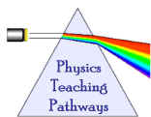
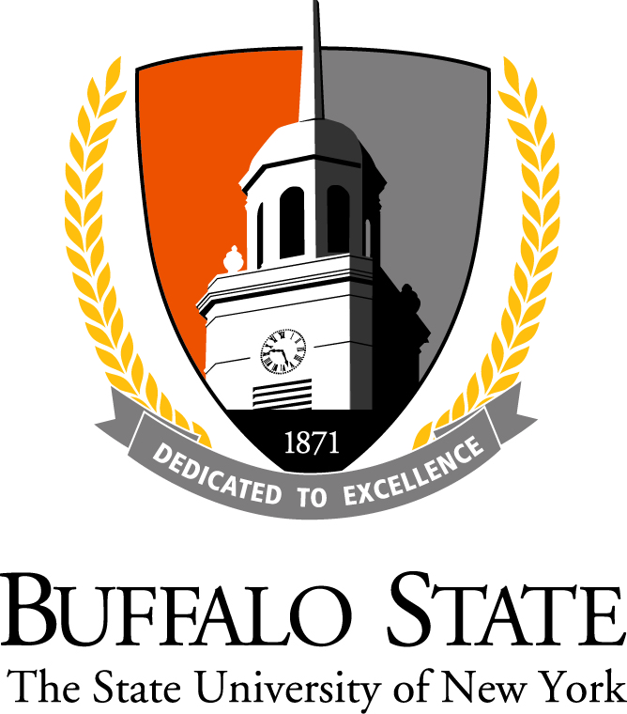
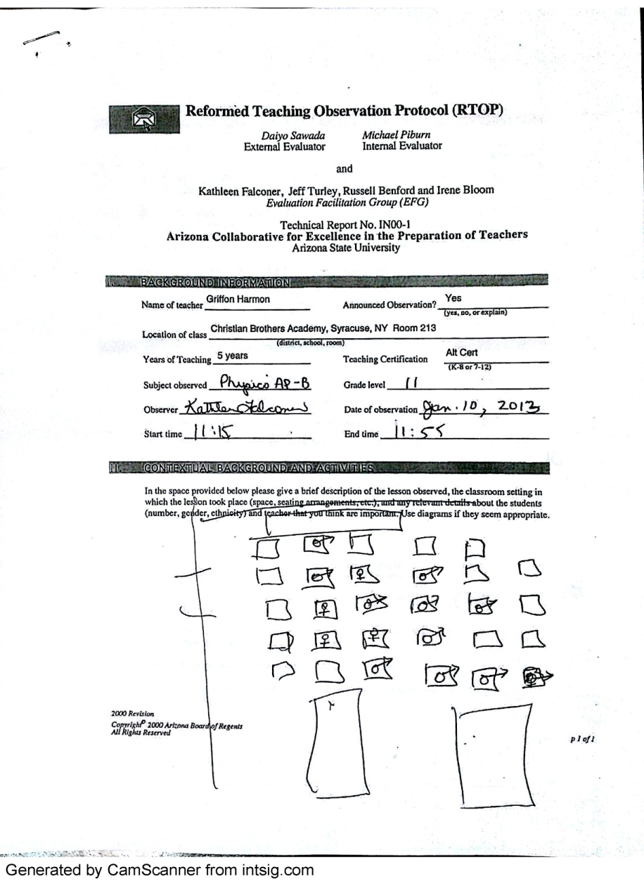
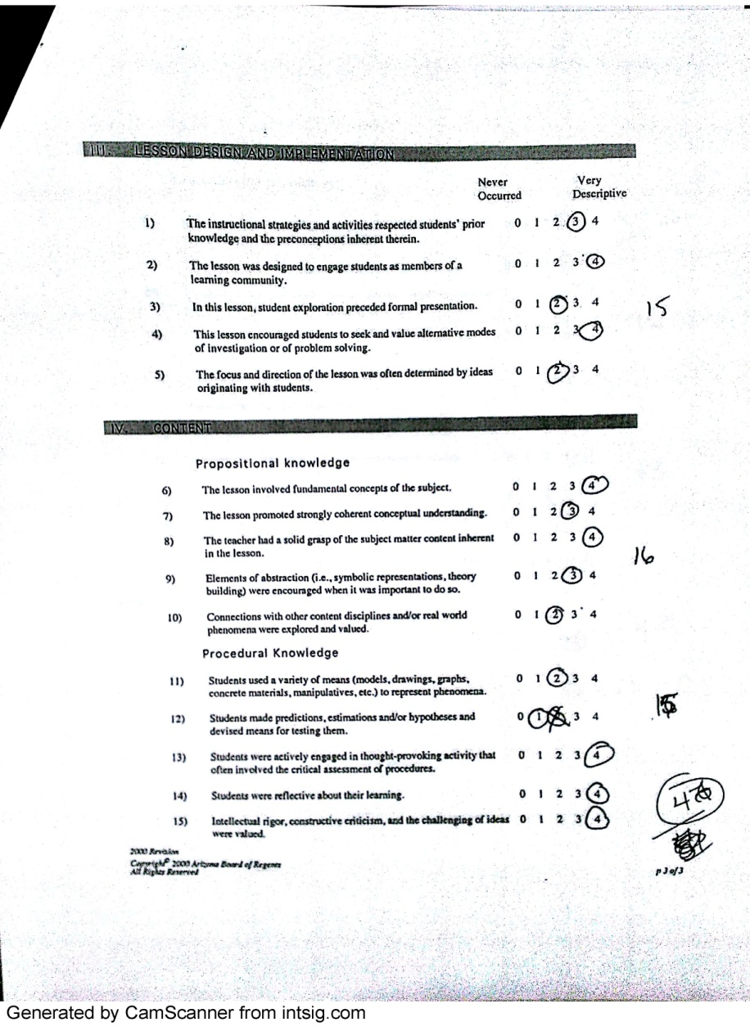
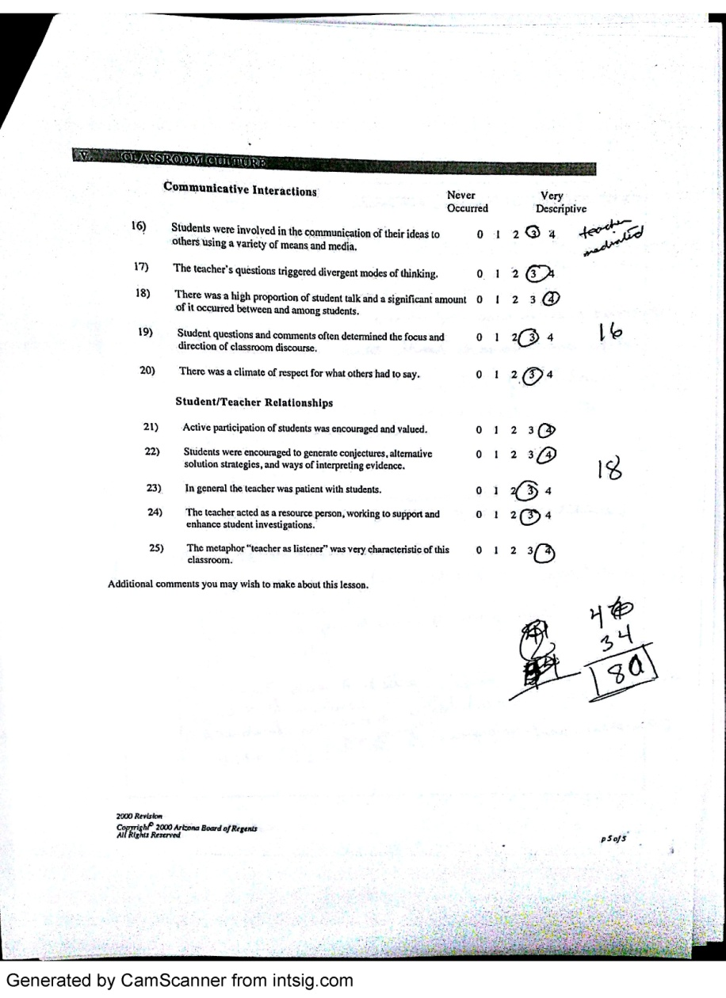
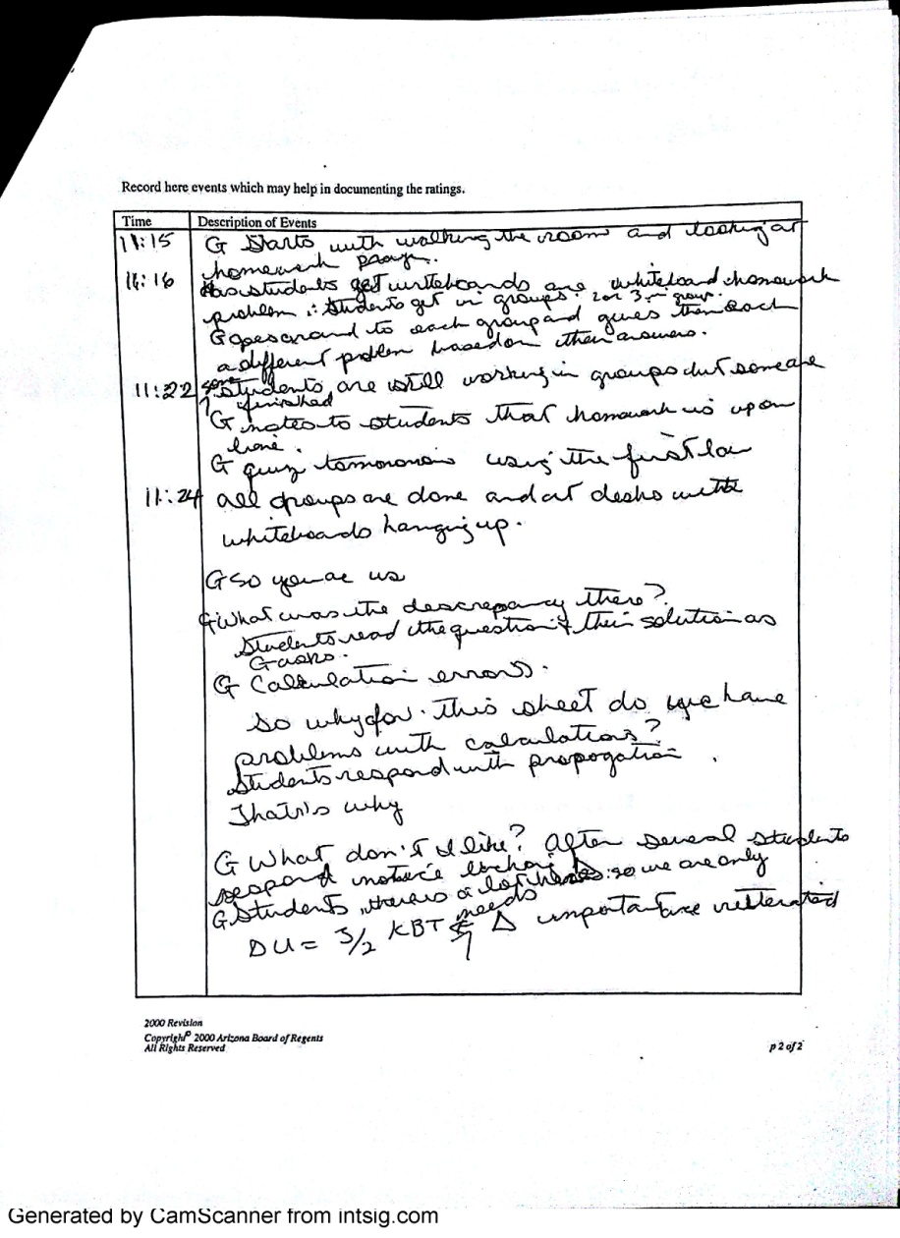
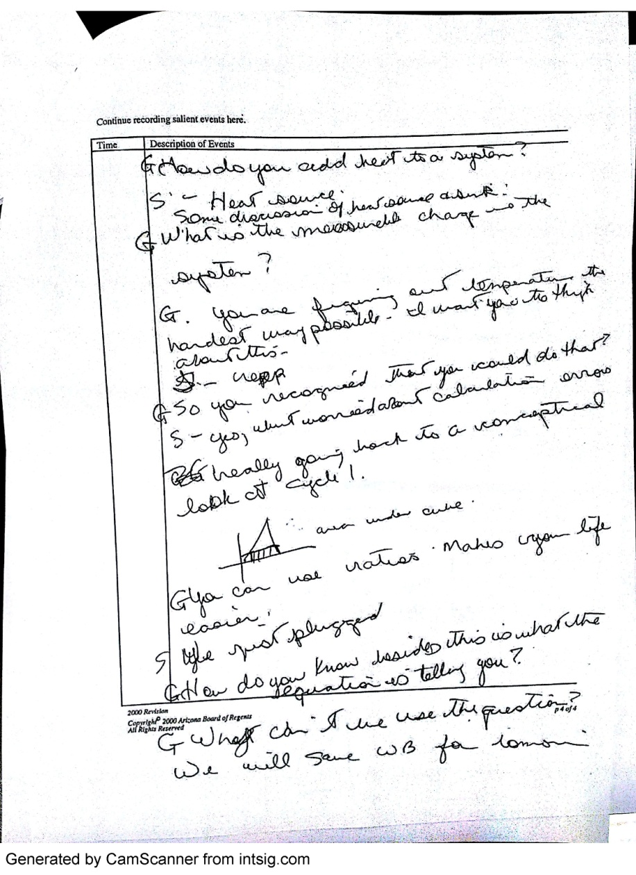
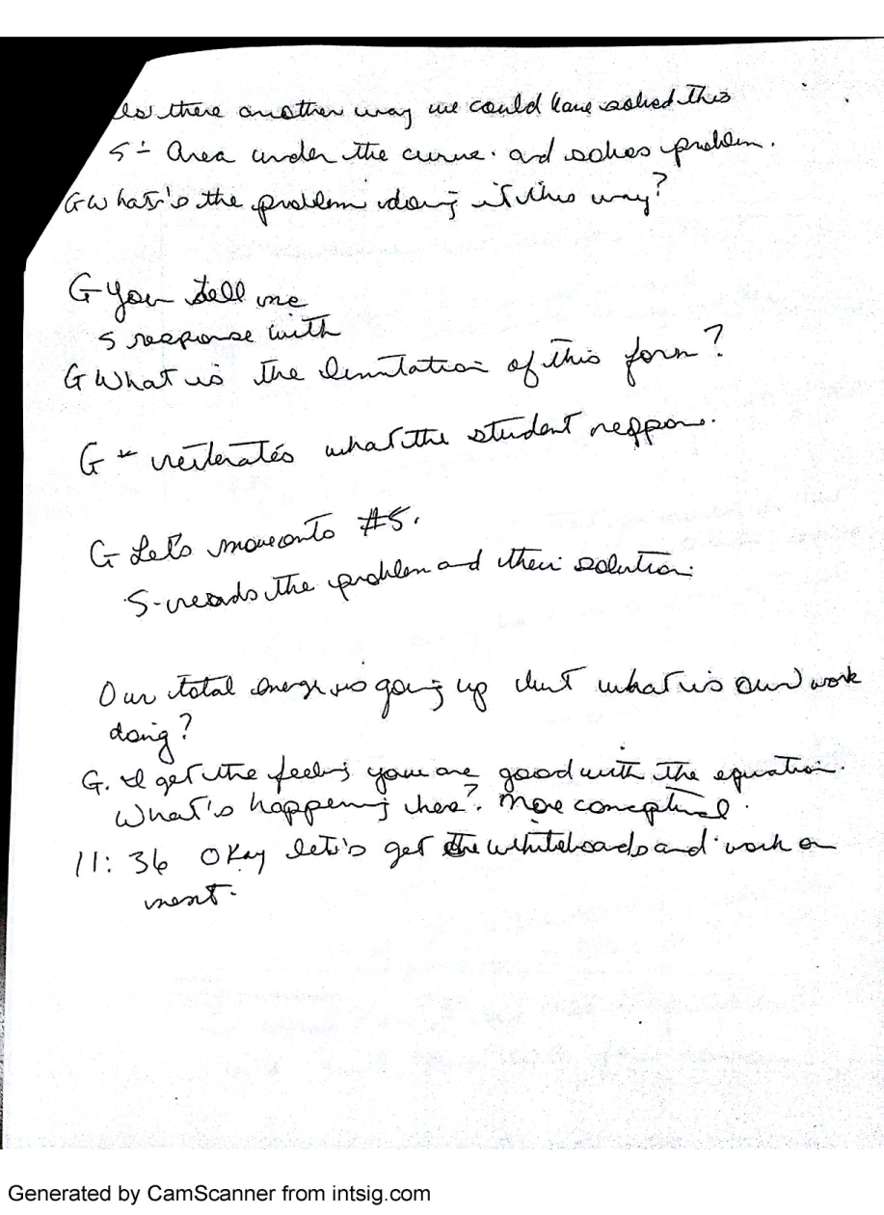
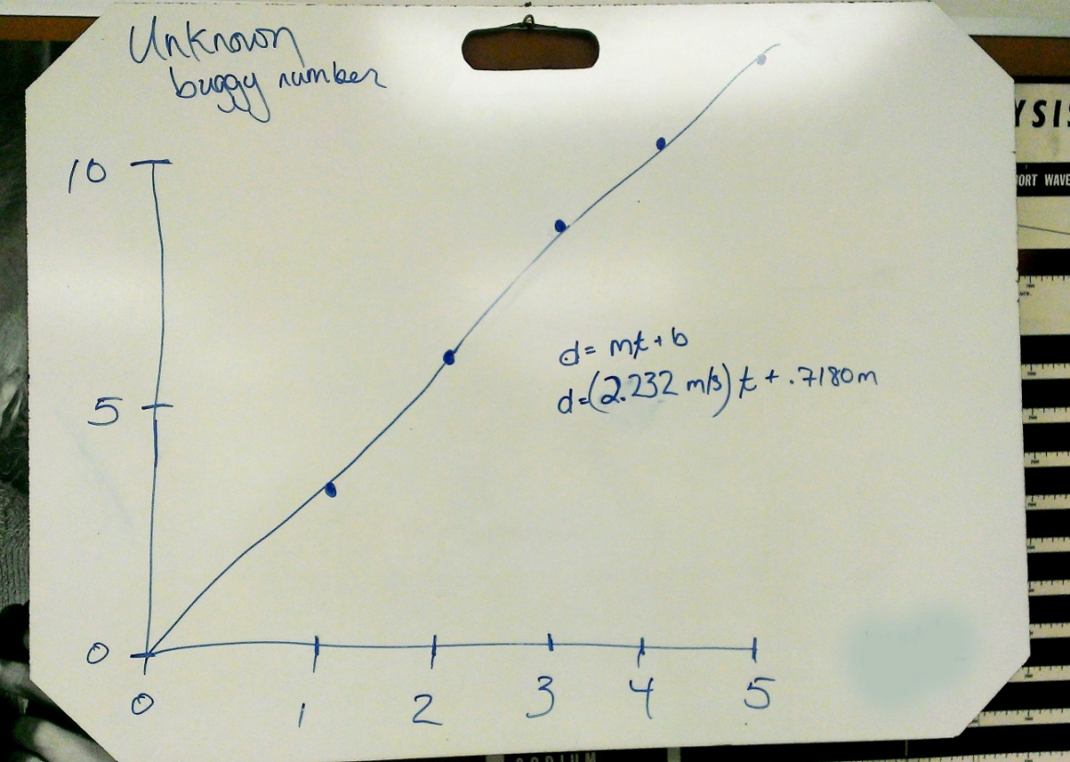
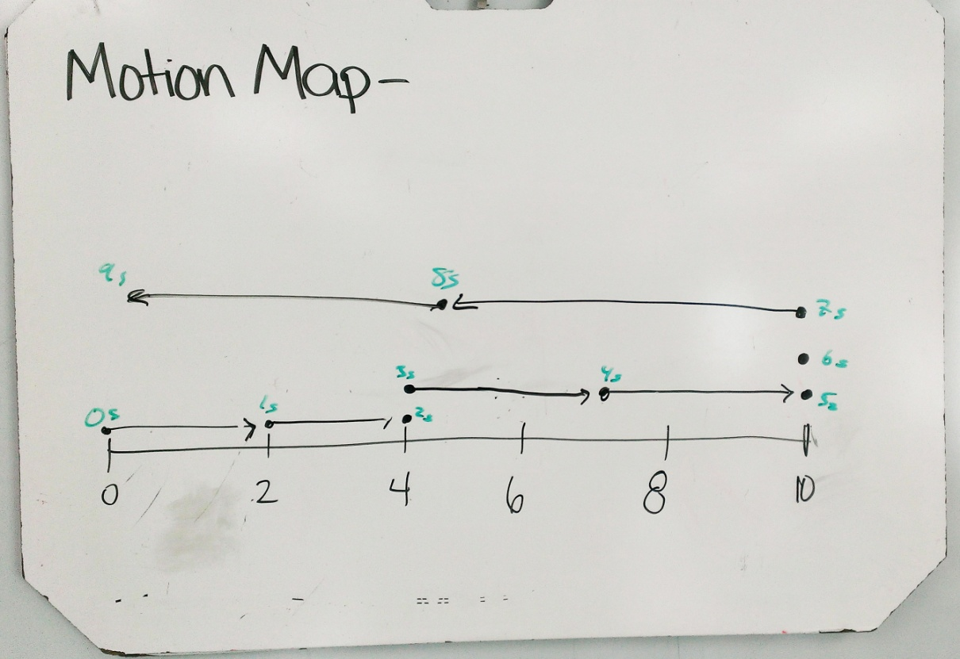
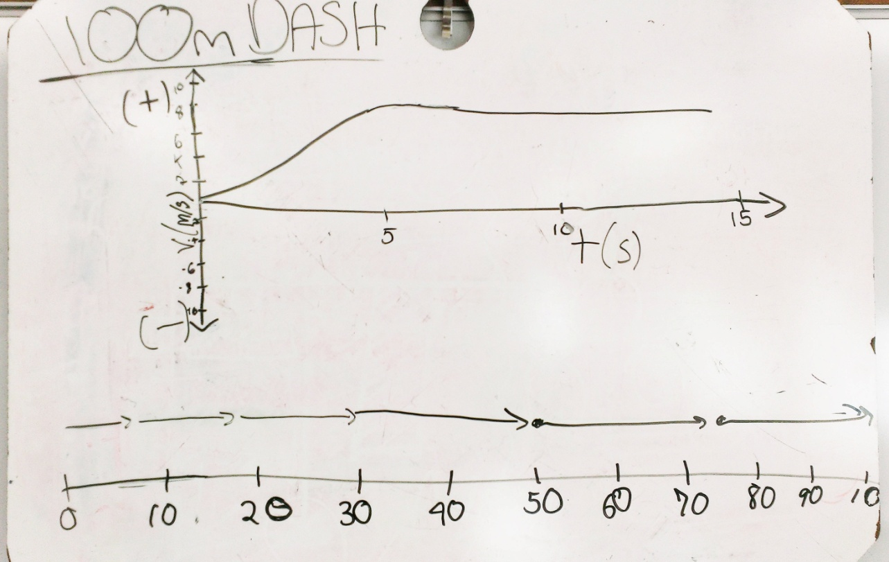
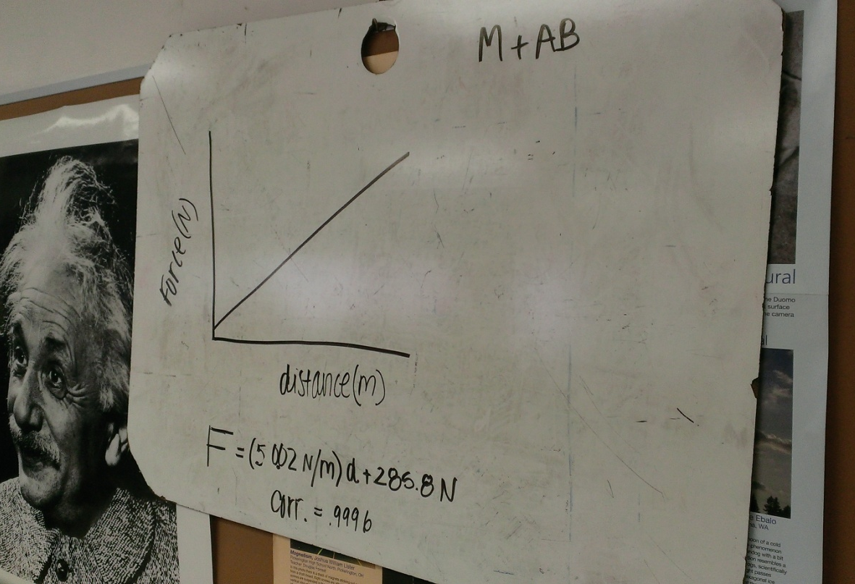
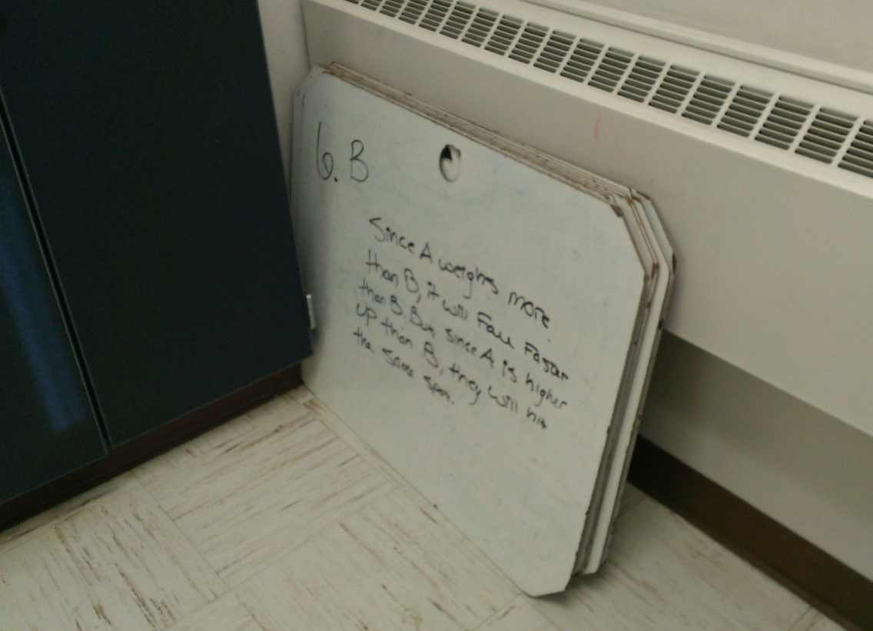
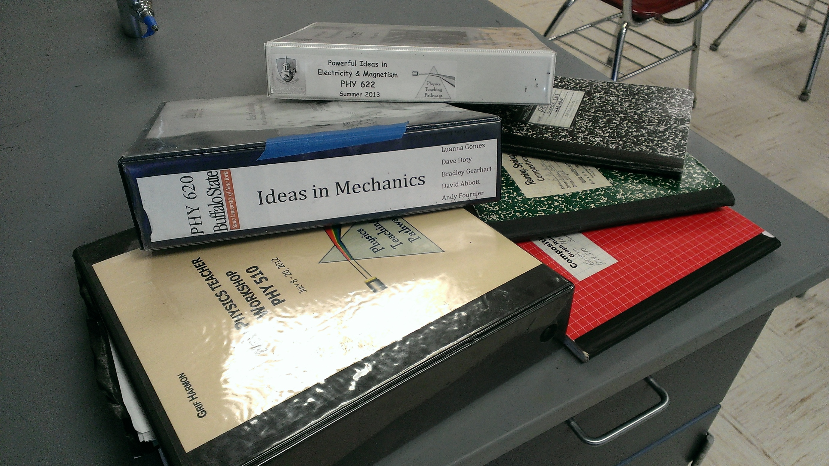
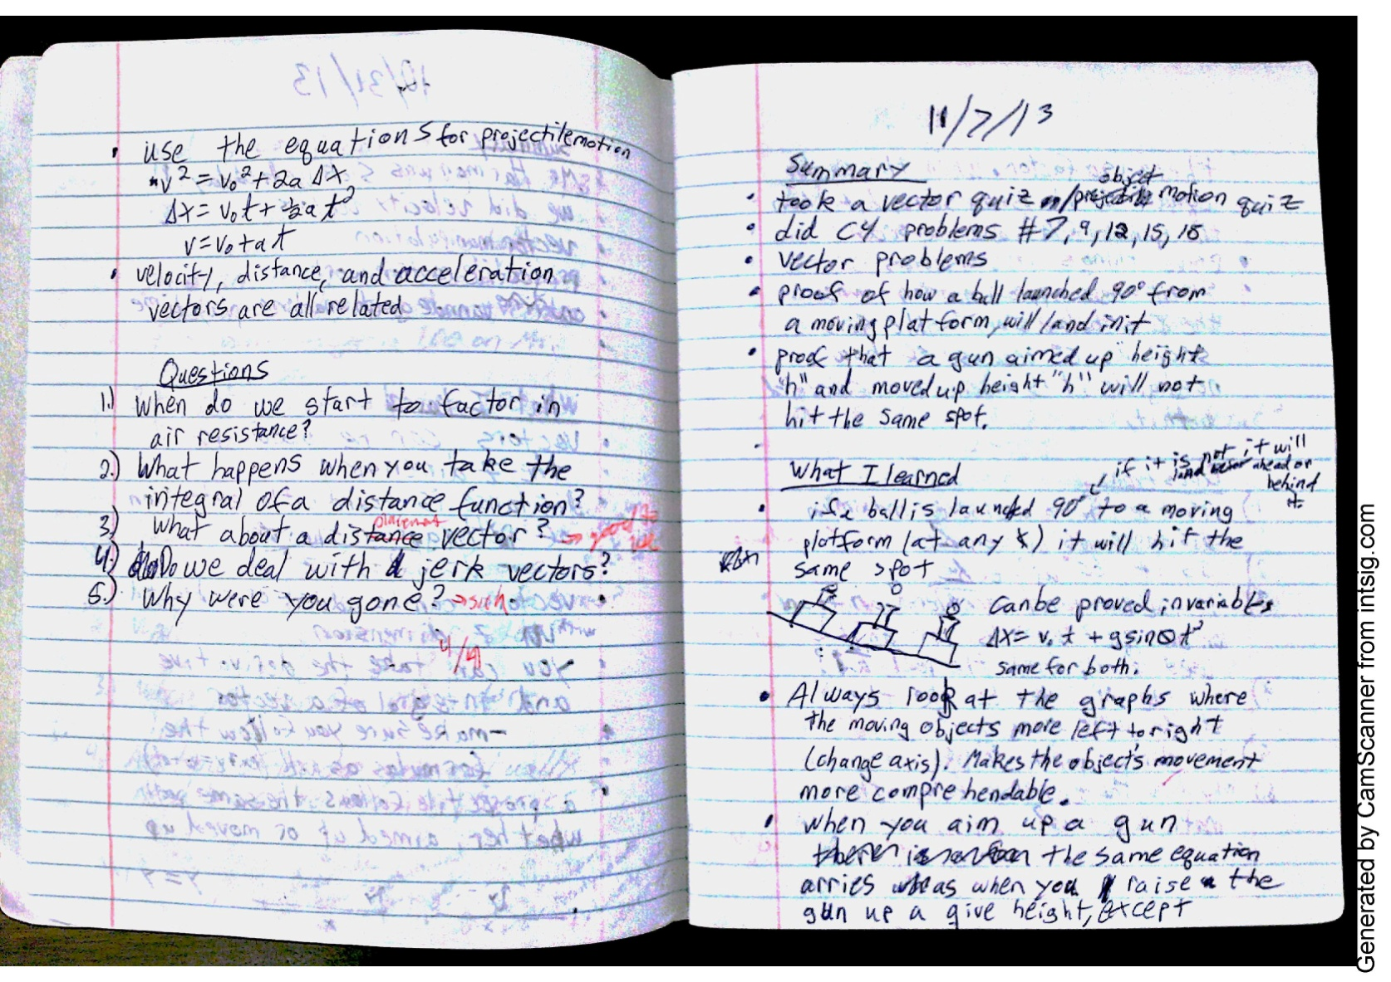
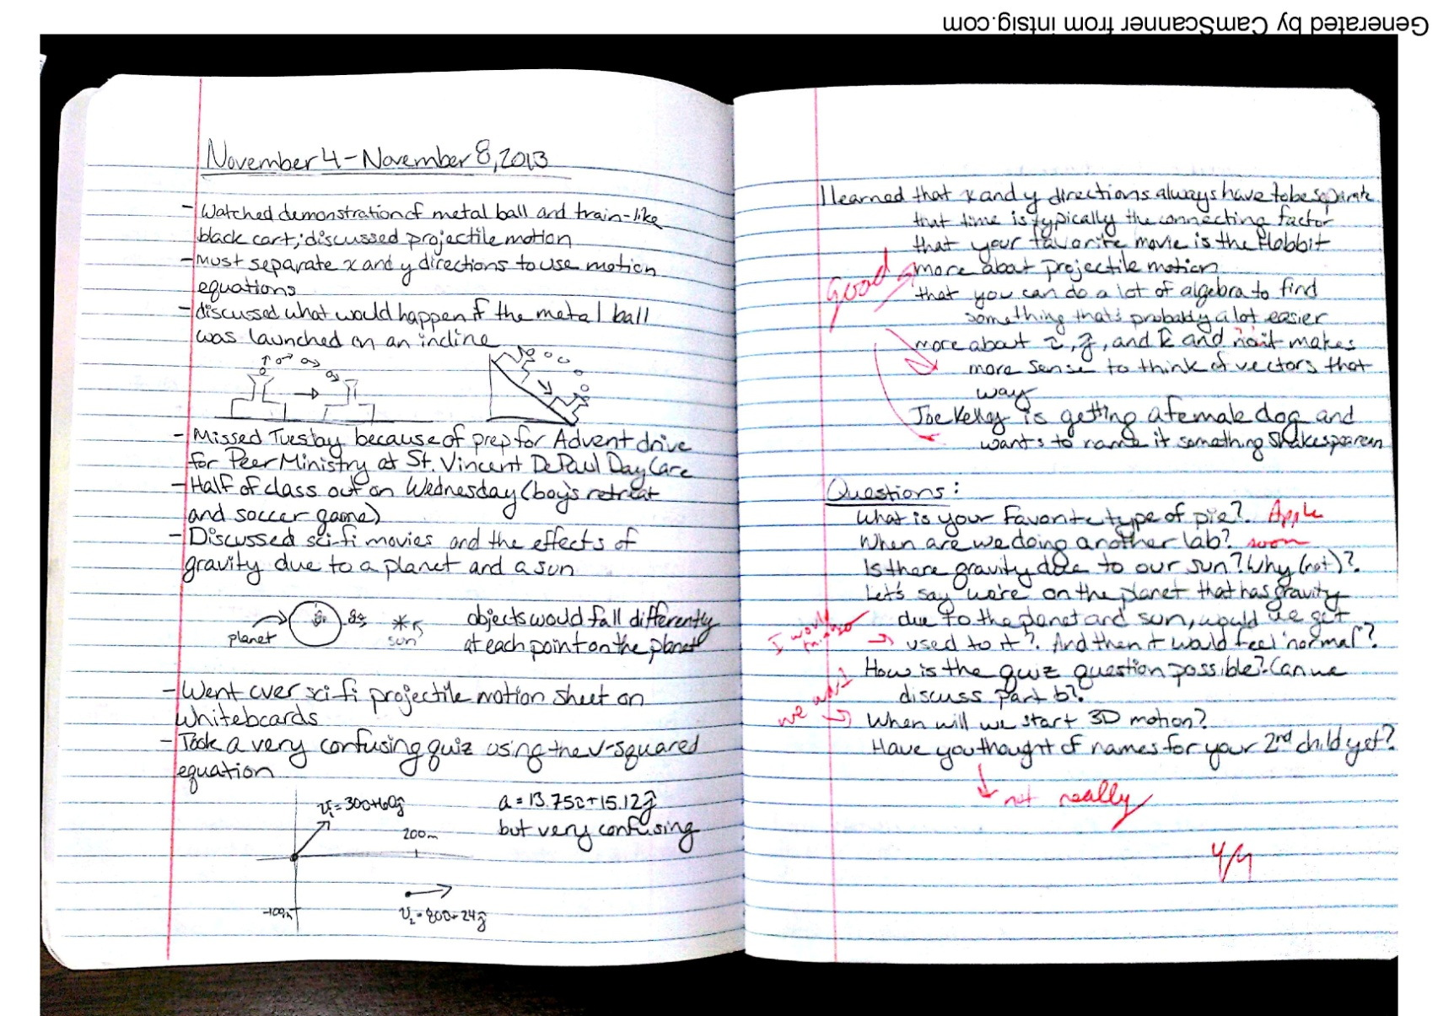
Using RTOP and Other Reformed Tools to Build and Strengthen My Teaching
Griffin Harmon, Christian Brothers Academy, Syracuse, NY 13214; gharmon@cbasyracuse.org
Kathleen Falconer, Dan MacIsaac, Buffalo State College
INTRODUCTION
EDUCATIONAL TOOLS
As a nontraditional teacher candidate, the Robert Noyce Teacher Scholarship Program has provided me with the opportunity to receive my masters in physics education at SUNY Buffalo State College. My involvement in physics education at Buffalo State has been an amazing experience. Through Buffalo State, I have been introduced to a wide range of educational tools that have greatly strengthened my ability to teach physics. Through this poster I intend to share some of the tools I picked up from Buffalo State and have found to be the most beneficial to my teaching experience.
Reformed Teaching Observation Protocol (RTOP)
I have been observed numerous times with the RTOP. The feedback I have received from being observed has been extremely valuable. Most importantly, RTOP has helped me develop the way I interact with students. RTOP looks closely at classroom culture, specifically in the area communication. It is easy to see where improvement is needed.
BACKGROUND
I graduated from Buffalo State College in the spring of 2007, with a BS in Physics. I began my undergraduate degree at Buffalo State as a physics education major, but switched to straight physics when I became involved in condensed matter research. I went on to Syracuse University’s physics PhD program, where I studied for one year.
In the summer of 2008 I took a full time teaching position at Christian Brothers Academy (CBA) in Syracuse, NY. I was immediately thrown into teaching general physics, honors physics, advanced placement physics, and honors chemistry with little to no experience in classroom instruction. Ultimately, I was successful my first year and have been building a strong physics program at CBA Syracuse ever since.
Currently I am teaching full time and am enrolled in Buffalo State College’s Physics Education M.S.Ed program. I expect to finish my degree in the spring of 2014.
Improvement Needed
Communication
Specific Lesson Notes
Whiteboarding
Student use of whiteboards is central to my physics instruction. Whiteboards provide a fun yet structured outlet for students to share in learning. Students take ownership of work, leading to greater understanding.
Reading Logs and Journaling
CBA SYRACUSE
Modeling Curriculum
In PHY620 and PHY622 at Buffalo State College, students are brought through the mechanics and electricity and magnetism modeling curriculums. I have used these materials extensively and recommend them very highly.
I hesitated using these tools in my classroom, but have employed them with great benefit to my students. The use of reading logs has been rolled out across all science courses at CBA. Journals have provided my students with an alternate mode of communication. The use of journals and reading logs also provide physics teachers with a useful way to meet common core curriculum requirements.
CBA Syracuse’s students come from all over central New York, from a wide range of socioeconomic backgrounds. While we do serve a good number of students from affluent families, a large percentage of our students receive need based financial aid. Most students come into CBA in 7th grade, but over the last few years we have seen more and more students coming in later. Incoming student’s science education backgrounds vary greatly.
As a Noyce Scholar I am charged with getting high need students interested and skilled in the sciences. CBA Syracuse has provided me that opportunity. As a rule, teachers at CBA Syracuse are not made aware of a students’ need situations, other than what individual students are willing to share. Over the last five years I have had a good deal of high need students go on to study science and engineering at college level.

