Slide 1
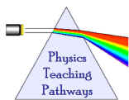
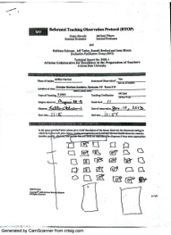
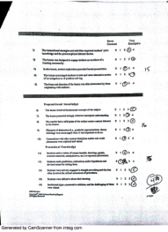
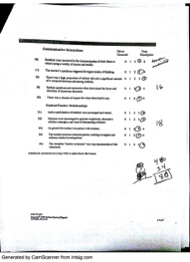
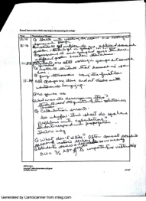
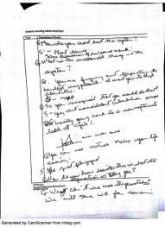
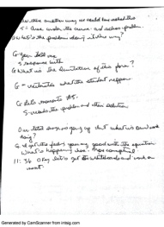
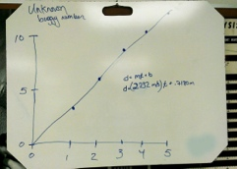
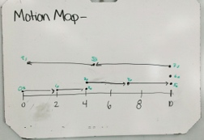
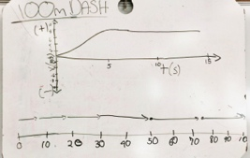
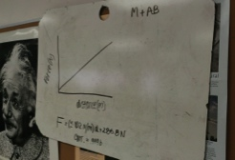
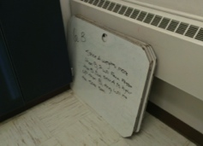
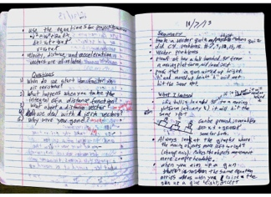
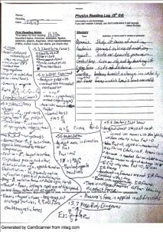
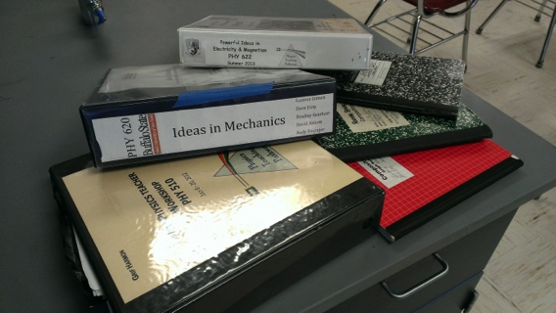
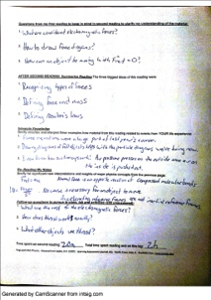
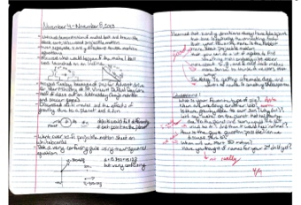
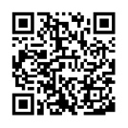
Using RTOP and Other Reformed Tools to Build and Strengthen My Teaching
Griffin Harmon, Christian Brothers Academy, Syracuse, NY 13214; gharmon@cbasyracuse.org
Kathleen Falconer, Dan MacIsaac, Buffalo State College
INTRODUCTION
EDUCATIONAL TOOLS
As a nontraditional teacher candidate, the Robert Noyce Teacher Scholarship Program has provided me with the opportunity to receive my masters in physics education at SUNY Buffalo State College. My involvement in physics education at Buffalo State has been an amazing experience. Through Buffalo State, I have been introduced to a wide range of educational tools that have greatly strengthened my ability to teach physics. Through this poster I intend to share some of the tools I have picked up from Buffalo State and have found to be the most beneficial to my teaching experience.
Reformed Teaching Observation Protocol (RTOP)
I have been observed numerous times with the RTOP. The feedback I have received from being observed has been extremely valuable. Most importantly, RTOP has helped me develop the way I interact with students. RTOP looks closely at classroom culture, specifically in the area communication. It is easy to see where improvement is needed.
BACKGROUND
I graduated from SUNY Buffalo State College in the spring of 2007 with a BS in Physics. I began my undergraduate degree at Buffalo State as a physics education major, but switched to straight physics when I became involved in condensed matter research. I went on to Syracuse University’s physics PhD program, where I studied for one year.
In the summer of 2008 I took a full time teaching position at Christian Brothers Academy (CBA) in Syracuse, NY. I was immediately thrown into teaching general physics, honors physics, advanced placement physics, and honors chemistry with little experience in classroom instruction. Ultimately, I had a successful first year and have been building a strong physics program at CBA Syracuse ever since.
Currently I am teaching full time and am enrolled in Buffalo State College’s Physics Education M.S.Ed program. I expect to finish my degree in the spring of 2014.
Improvement Needed
Communication
Specific Lesson Notes
Whiteboarding
Student use of whiteboards is central to my physics instruction. Whiteboards provide a fun yet structured outlet for students to share in learning. Students take ownership of work, leading to greater understanding. The boards I use were provided with registration in summer courses at Buffalo State College.
CBA SYRACUSE
CBA Syracuse’s students come from all over central New York, from a wide range of socioeconomic backgrounds. While we do serve a good number of students from affluent families, a large percentage of our students receive need based financial aid. Most students come into CBA as 7th graders but over the last few years, due to a variety of reasons, we have had a large number of students coming in to 9th and 10th grade. Because of the large net CBA Syracuse casts, incoming students’ science backgrounds vary greatly.
As a Noyce Scholar I am charged with getting high need students interested and skilled in the sciences. CBA Syracuse has provided me that opportunity. As a rule, teachers at CBA Syracuse are not made aware of a students’ need situations, other than what individual students are willing to share. Over the last five years I have had a good deal of high need students go on to study science and engineering at college level.
Reading Logs and Journaling
CONCLUSION
I hesitated using these tools in my classroom at first. However, I have employed them with great benefit to my students. The use of reading logs has been rolled out across all science courses at CBA. Journals have provided a form of dialog where students are not afraid to ask me genuine questions. As an added bonus, the use of journals and reading logs provide science teachers with a way to meet common core requirements.
Having experienced the modeling curriculum and having the materials readily available has helped me greatly. Six years into teaching , I use very few of the modeling worksheets in their original form. I have tailored my curriculum to my situation. Being observed regularly over the last year has validated my practices and has helped me to refine my technique further.
Common Core curriculum development has been a big deal at CBA Syracuse over the last year. Journaling and reading logs have been extremely valuable in helping my colleagues and I meet the demands of Common Core. Writing quality journal entries and reading logs takes effort on the student’s part. While my students do complain about journals and reading logs, most admit benefiting from completing the tasks.
I have found the educational tools discussed here to be essential to my development as a teacher. I realize that many physics instructors utilize similar tools, but I feel that the physics education program at Buffalo State has provided me with something extra. I have been given confidence in my instruction. I know that the methods of physics instruction I am employing are working. I also realize that there is always more to learn.
Modeling Curriculum
In the summer courses PHY620 and PHY622, at Buffalo State, students are walked through the mechanics and electricity and magnetism modeling curricula. My instruction is based heavily on these curricula.
REFERENCES
American Modeling Teachers Association (2013). Modeling curriculum. <http://modelinginstruction.org/>
Cummings, K., French, T., & Cooney, P. (2002). Student textbook use in introductory physics, PERC Proceedings.
Piburn, M., Sawada, D., Falconer, K., Turley, J. Benford, R., Bloom, I. (2000). Reformed Teaching Observation Protocol (RTOP). ACEPT IN-003. The RTOP rubric form, training manual and reference manual containing statistical analyses, are all available from
< http://PhysicsEd.BuffaloState.Edu/AZTEC/rtop/RTOP_full/PDF />. IN-001 contains the RTOP rubric alone, IN-002 contains rubric and training manual, IN-003 adds the statistical analyses
Podolefsky, N., & Finkelstein, N.(2006) “The perceived value of college physics textbooks:
Students and instructors may not see eye to eye,” The Physics Teacher 44(6), 338-342.
This activity was sponsored by the Integrated Science and Engineering Partnership (ISEP), NSF-MSP project DUE-1102998. Any opinions, findings, conclusions or recommendations presented are only those of the presenter grantee/researcher, author, or agency employee; and do not necessarily reflect the views of the National Science Foundation.
:
http://physicsed.buffalostate.edu/pubs/AAPTmtgs/AAPT2014Jan/

