Slide 1
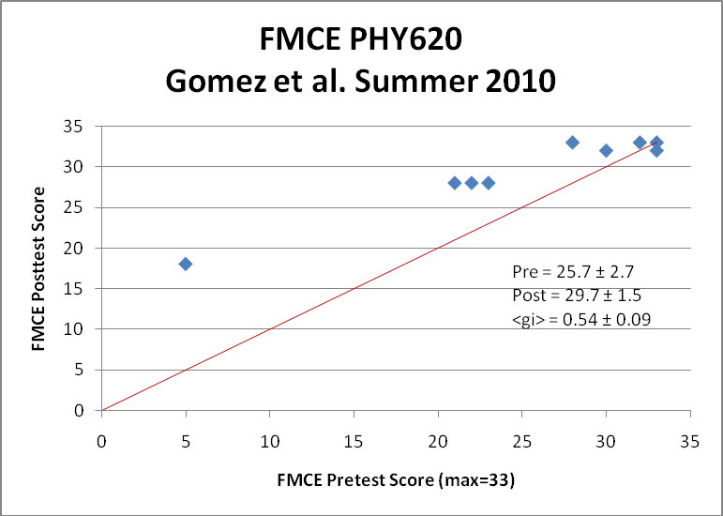
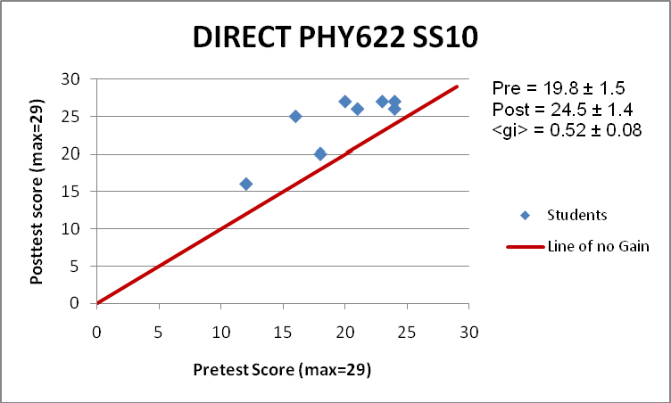
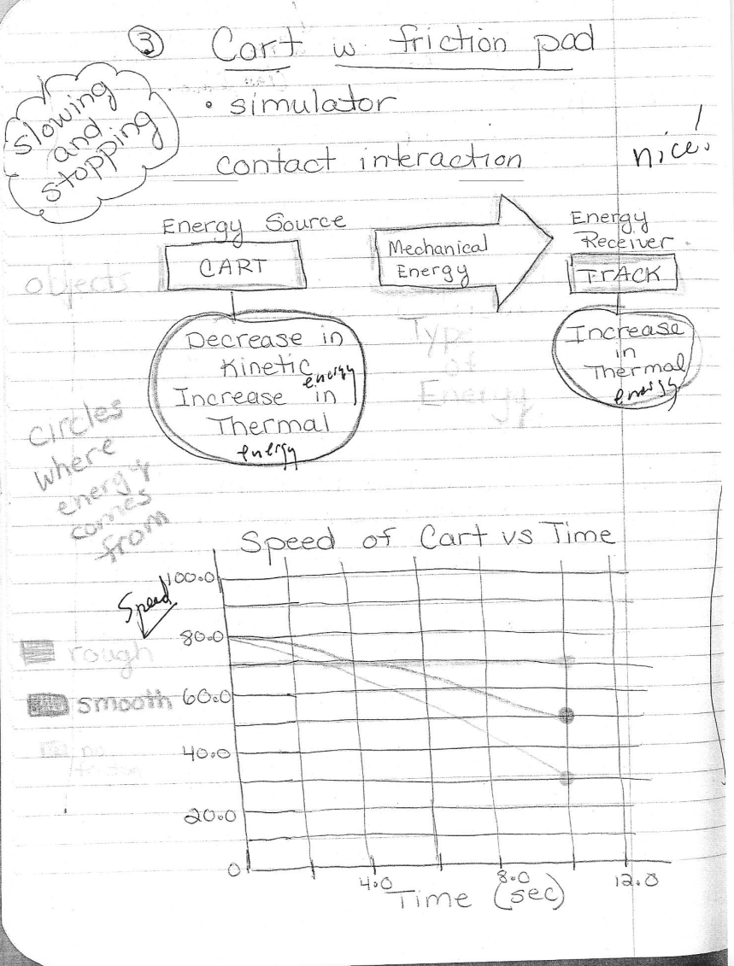
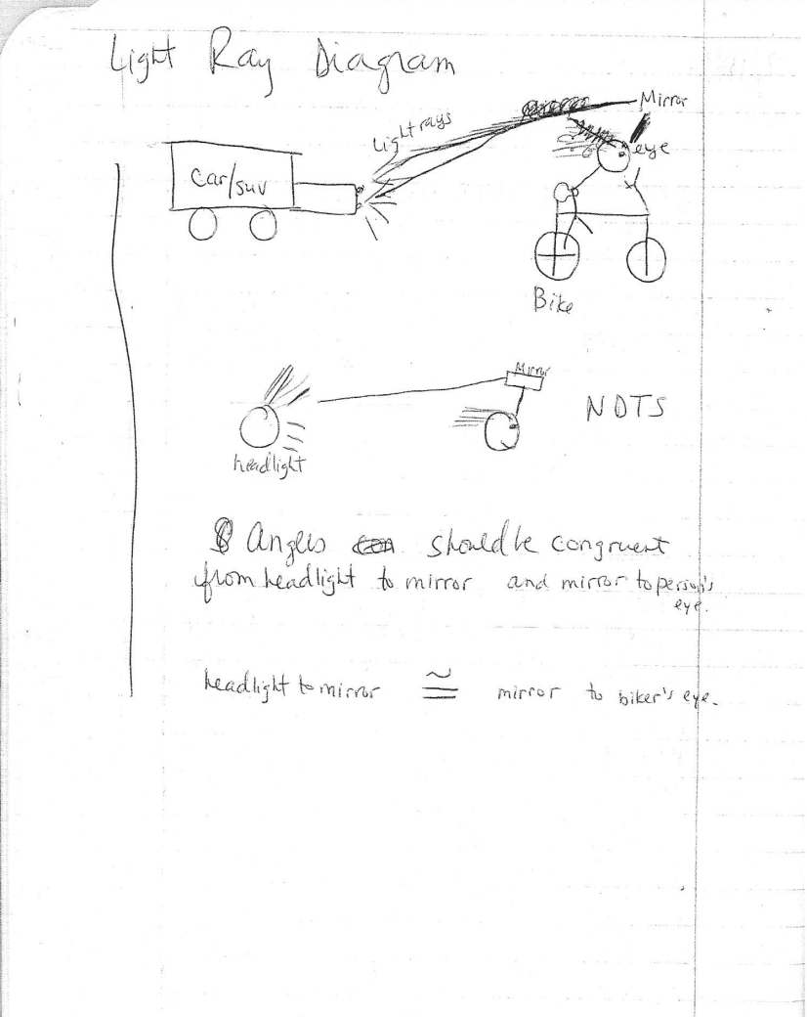
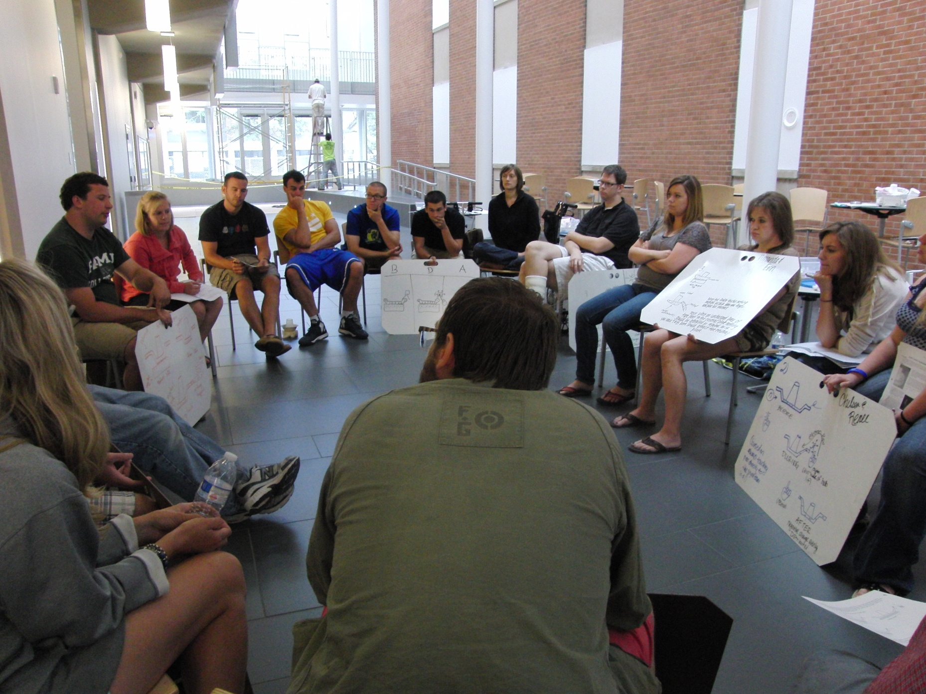
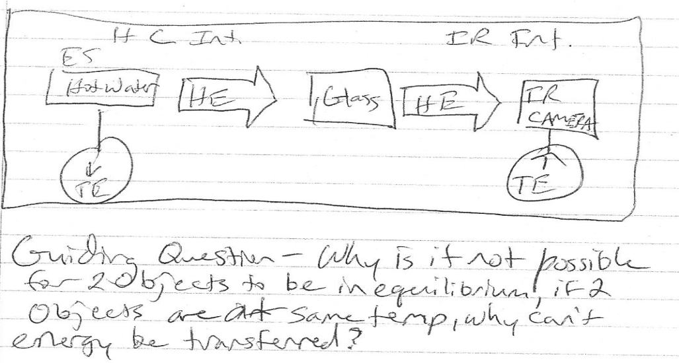
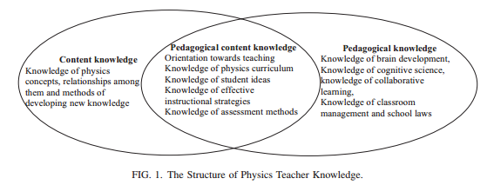
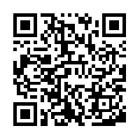
SUNY Buffalo State College
A Table of Specifications for a Physics Teaching PCK Instrument
Alyssa Cederman , Dan MacIsaac, David Abbott, Kathleen Falconer, & David Henry
SUNY Buffalo State College Department of Physics; cedead19@mail.buffalostate.edu <macisadl@buffalostate.edu>
As part of my graduate project in physics education, I am conducting a literature review and survey preparing a Table of Specifications for a possible instrument which could eventually assess the Pedagogical Content Knowledge (PCK) of HS physics teachers. This instrument might inform physics teacher candidate preparation or physics teacher professional development. For example, most introductory HS physics content includes significant mechanics, kinematics, some electrostatics, circuits, waves, sound and optics, so new teachers should know something about common student conceptual difficulties associated with these topics (like Aristotelian physics, confuting position, velocity and acceleration; graph reading, centripetal acceleration direction) as well as touchstone pedagogical measurements and activities (FCI and FMCE; developing kinematics equations from the motion of battery operated toys) and something of research-based introductory curricula. As part of my presentation I am seeking feedback and nominations of possible physics PCK topics for HS teachers (or specifications or even possible items).
SUNY Buffalo State College offers the M.S. Ed. – Physics (PHS) as well as the M.S. Ed. – Physics : Alternative Certification through NY Transitional B (PHA). The PHS is often sought by working STEM teachers seeking a second certification in physics (NYSED requires that physics teachers have 24-30cr of College PHY courses).
The PHA offers an initial certification for science, technology, engineering, and math professionals who have decided to change their careers. Alternative certification refers to a teacher certification program that differs from standard college programs of teacher preparation, usually by avoiding the extended guided field experience of student teaching. The PHA at SUNY Buffalo State College requires a year long mentorship for early field experience, and some educational courses in addition to the courses required by the PHS.
Both the PHS and the PHA degrees require participants to take all three courses from the summer academy. A large proportion (about 2/3) of summer academy participants are non-degree seeking students who seek NYSED physics certification only.
Quality Content Assessments & Teacher Assessments
Every summer academy course is evaluated. Attitudinal and conceptual content instruments are administered pre- and post- instruction. FCI, FMCE, TUG-K, CTSR, BEMA, CSEM, DIRECT, STEBI-B and MCTP have all been used. Our best results include PHY 622 DIRECT 2010 <g> = 0.52, PHY 620 2010 FCME <g> = 0.54, and PHY 620 2010 TUG-K <g> = 0.58, when we had relatively small class size and particularly strong discourse.
Pedagogical Content Knowledge
Common Misconceptions, Touchstone Activities, Research-based Curricula, & Effective Instructional Strategies
The SUNY Buffalo State Summer Physics Teachers’ Academy began in 2002, offering a backbone of three 6 credit courses: Process Skills in Teaching Physics (PHY 510), Powerful Ideas in Quantitative Modeling: Force, Motion, and Energy (PHY 620), and Powerful Ideas in Quantitative Modeling: Electricity and Magnetism (PHY 622).
These graduate level courses focus on physics content at the undergraduate level (necessitating math at the undergraduate level) and pedagogical content knowledge at the graduate level. Pedagogical content knowledge includes physics education research (PER) and science education research (SER) findings and science teaching methods. The programs’ physics content follows state requirements and PER findings, and therefore strays from traditional physics course curricula, such as allocating minimal time to thermodynamics and a large portion of time to modern physics, as demanded by the state via PER-informed curricula.
Modeled after the nationally famous Modeling Physics workshops held at Arizona State University, the 600-level summer academy courses are fifteen days long and intense. Participants assume both student and teacher roles as they work through PER-informed curricula such as Hestenes’ distinguished and well researched Modeling Physics curriculum, the AAPT’s Powerful Ideas in Physical Science (PIPS) and Goldberg’s Constructing Physics Understanding (CPU) curricula. As at ASU, these courses are team taught by NY master physics teachers and BSC physics faculty.
PHY 510 is a workshop locally developed to support new teachers who were assigned physics sections without physics certification, though it is annually tailored to the background of the participants. It focuses on “meeting NYSED requirements through activities NY master physics teachers have selected on an ad-hoc basis, leavened with formal PER and SER touchstone activities. “
The summer academy courses are offered for both non-degree teachers, who seek professional development or improved physics teaching skills, as well as degree candidates of the M.S. Ed. – Physics programs. Itinerantly there are other PHY5xx courses offered for elementary, middle and high school teachers.
Below are authors of this poster with a board full of physics teacher candidates, instructors, and alumni. On the right is a 2012 report that recognized the SUNY-BSC physics teacher preparation programs as amongst 11 outstanding programs in the nation.
Some research findings that been validated through the SUNY Buffalo State Summer Physics Teachers’ Academy are RTOP, curricula, and pedagogical techniques. The instructors have been assessed using Reformed Teaching Observation Protocol (RTOP). Some of the pedagogical tools used are reading logs; whiteboards, which encourage class discussion; student-created operational definitions; creation and analysis of simple apparatus; daily reflective journals; learning commentaries, teacher hat-student hat role-play, learning content in student mode and analysis in teacher mode. The images below illustrate varying degrees of reflection in journals, and a class whiteboard discussion.
The Summer Physics Teachers’ Academy’s 297 participants are 98% New York State residents. The female to male ratio is approximately 1:3. The reformed teaching and student-centered courses attracted a wide variety of participants, as shown by the list on the far right of this poster. In recent years, the course enrollments of the summer academy have dropped due to the slow economy and local school districts’ budgets. Note that all three courses were offered in 2009-2011.
76 Graduates:
22 PHA Graduates
54 PHS Graduates
20 Active Candidates:
15 PHS candidates
5 PHA candidates
96 Graduates and Active Candidates
36 Inactive Candidates
165 Non-majors taking summer courses
297 Total
Summer Academy economic viability issues (no courses run at a loss):
Need cross certification teachers and other non-degree seeking teachers
Must be connected to programs for in-service teachers (NYSED physics certification and state exams are rigorous; also online, evening classes)
Struggled with economic downturns (2010-12; now attracting out of state)
Academic issues:
Integrate master teachers and college physics faculty on instructional team
Many participants do not know their physics and are unaware of this (E&M)
Need for student-hat, teacher-hat role-play (participant identity and self-efficacy)
Tough state certification test and moderately rigorous state testing helpful
Summer Physics Teacher Academy community & recognition:
Not possible to start without serious institutional and Physics dept buy-in
We are sited in a greater community that includes: local physics teachers’ alliance.(WNYPTA), state and national sections of AAPT and NSTA / STANYS, College-wide.interdisciplinary collaboration with Engineering Technology, Earth Science and Science Education, Elementary Education and Reading, College-wide STEM outreach, other regional academic institutions (SUNY Buffalo and SUNY Jamestown Community College) and LEAs (Buffalo Public Schools, Boards of Cooperating.Educational Services (BOCES) representing 99 WNY LEAs, and LEAs directly)
External recognition (continuous support from NSF programs since 2002, T-TEP report, STANYS publications and conventions, all levels of AAPT) is necessary to sustain and demonstrate excellence given difficult economics and local politics
Formal advertising via state listservs and STANYS bulletin, maybe TPT next
Please Take One
References
American Association of Physics Teachers (AAPT) (2004). Powerful Ideas in Physical Science. Available from <http://www.aapt.org/Publications/pips.cfm>.
Arons, A. (1990). A guide to introductory physics teaching. Wiley. New York.
Etkina, E. (2010). Pedagogical content knowledge and preparation of high school physics teachers. PHYSICAL REVIEW SPECIAL TOPICS-PHYSICS EDUCATION RESEARCH, 6(2), 020110. doi:10.1103/PhysRevSTPER.6.020110
Fives, H. & DiDonato-Barnes, N. (2013). Classroom test construction: The power of a table of specifications. Practical Assessment and Research Eval.18(1). Available from http://pareonline.net/
Goldberg, F (2000). Constructing physics understanding (CPU) project.. Available from <http://cpucips.sdsu.edu/web/CPU/default.html>.
Henry, D., Henry, J., Riddoch, S. (2006). Whiteboarding your way to great student discussions. Sci. Scope. April/M., 51.
Hestenes, D. (1993). Modeling Instruction in High School Physics (NSF Grant ESI 9353423), Information about the workshops can be obtained by visiting the Project’s web site at http://modeling.asu.edu/
Hake, R. (1998). Interactive engagement versus traditional methods: a six-thousand-students survey of mechanics test data for introductory physics courses. Am. J. Phys. 66(1), 64-74.
MacIsaac, D.L. & Falconer, K.A. (2002, November). Reforming physics education via RTOP. The Physics Teacher 40(8), 479-485. Available from
< http://physicsed.buffalostate.edu/pubs/TPT/TPTNov02RTOP/ >, describes physics-specific RTOP use.
Piburn, M., Sawada, D., Falconer, K., Turley, J. Benford, R., Bloom, I. (2000). Reformed Teaching Observation Protocol (RTOP). ACEPT IN-003. The RTOP rubric form, training manual and reference manual containing statistical analyses, are all available from
< http://PhysicsEd.BuffaloState.Edu/AZTEC/rtop/RTOP_full/PDF />. IN-001 contains the RTOP rubric alone, IN-002 contains rubric and training manual, IN-003 adds the statistical analyses
Redish, E. (1994). Implications of cognitive studies in teaching physics. Am. J. Phys. 62(9), 796-803.
HS/MS Summer school enrollees in PHY510, PHY620 and PHY622 (only)
 | 510 | 620 | 622 | Total HS/MS Physics
2002 | 24 | 27 | - | 51
2003 | 27 | - | 33 | 60
2004 | 21 | 31 | - | 52
2005 | 21 | - | 29 | 50
2006 | 16 | 29 | - | 45
2007 | 19 | - | 28 | 47
2008 | 14 | 25 | - | 39
2009 | 20 | 14 | 10 | 44
2010 | 20 | 10 | 8 | 38
2011 | 16 | 10 | 11 | 37
2012 | 8 | 6 | - | 14
2013 | 16 | - | 17 | 33
This activity was sponsored by the Integrated Science and Engineering Partnership (ISEP), NSF-MSP project DUE-1102998. Any opinions, findings, conclusions or recommendations presented are only those of the presenter grantee/researcher, author, or agency employee; and do not necessarily reflect the views of the National Science Foundation.
This poster is available from:
http://physicsed.buffalostate.edu/pubs/AAPTmtgs/AAPT2015Jan/

