Slide 1
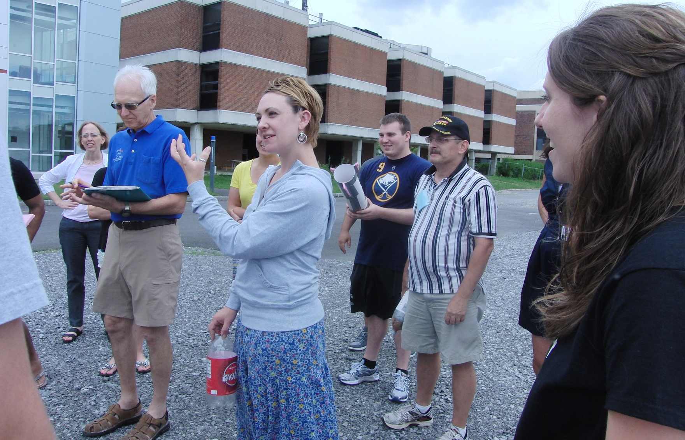
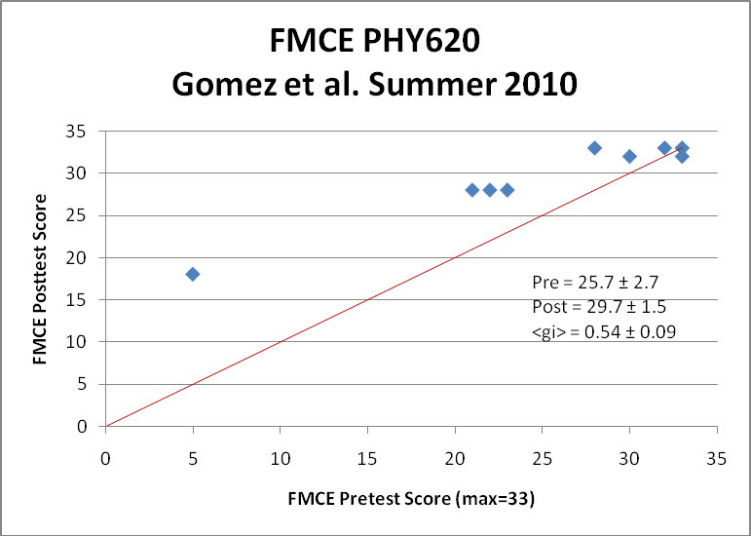
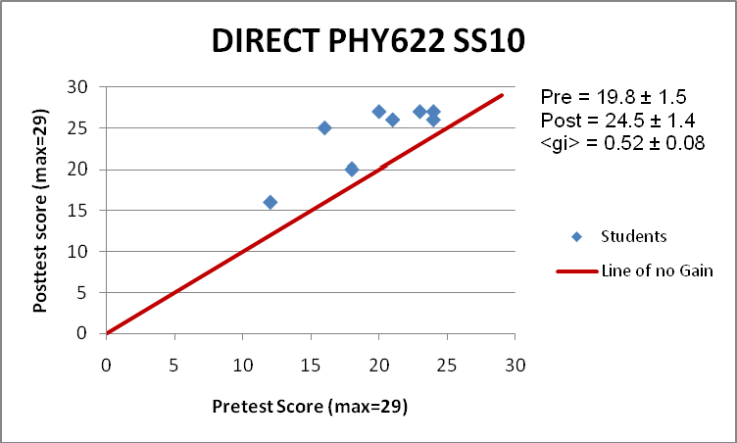
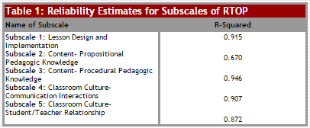
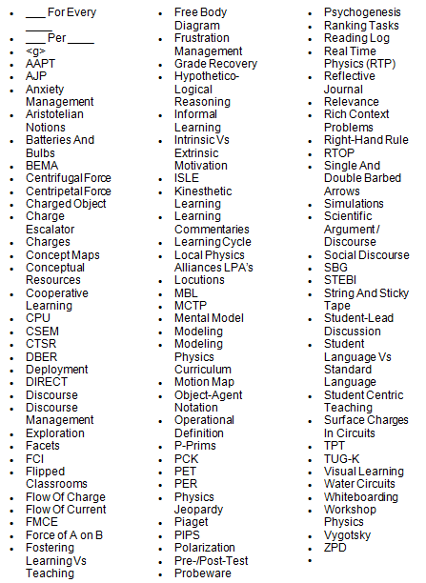
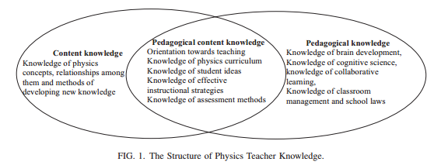
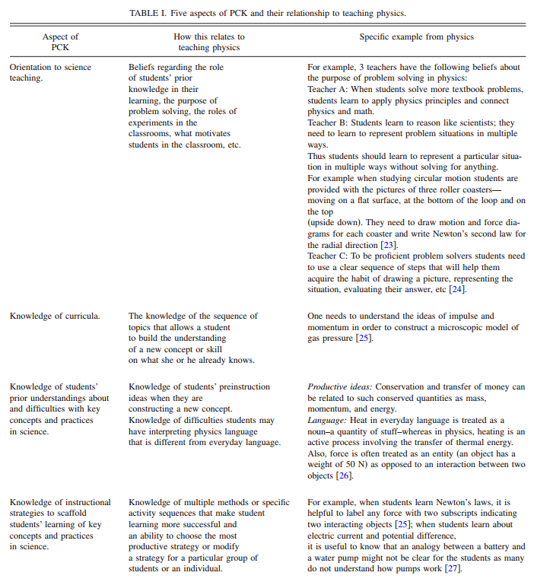
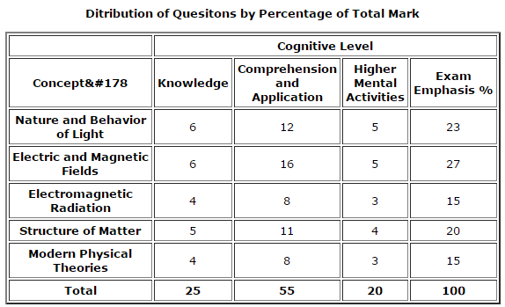
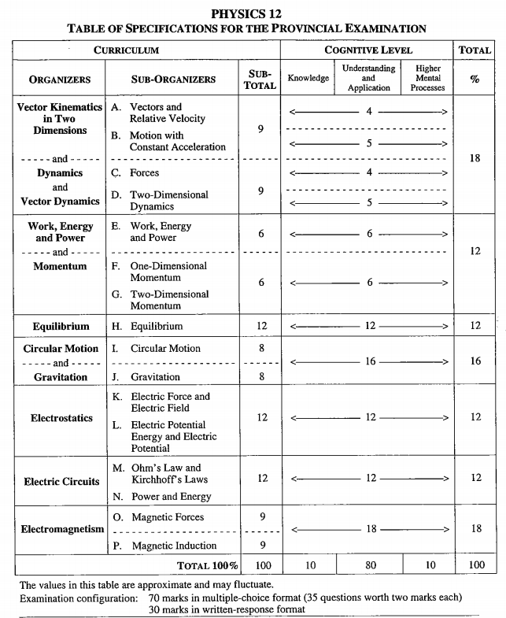
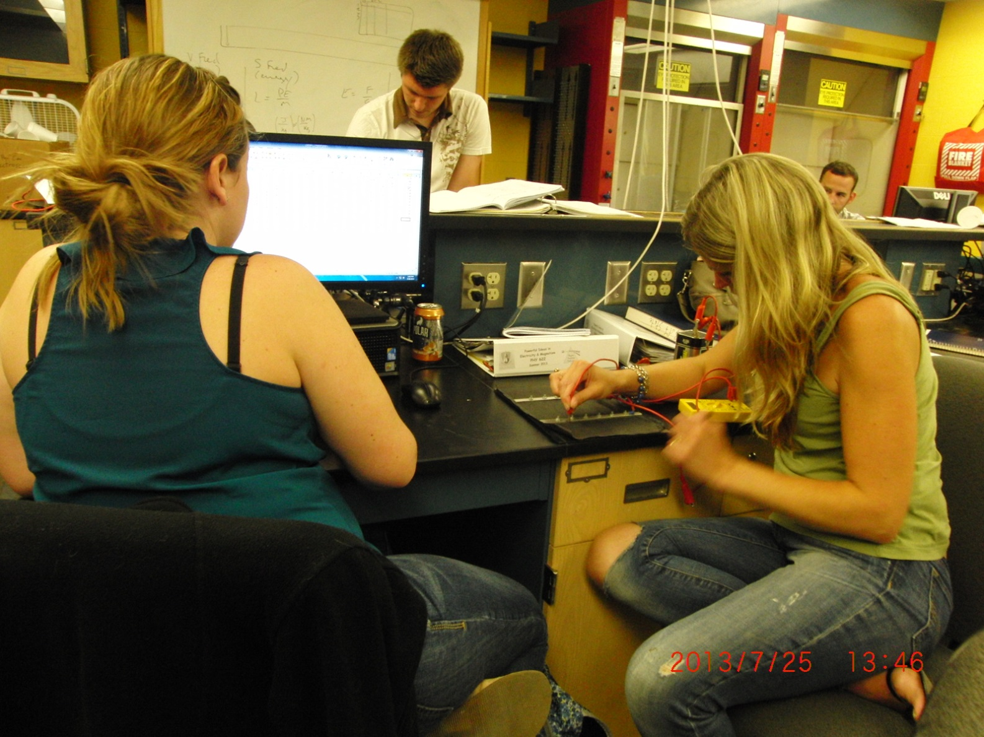
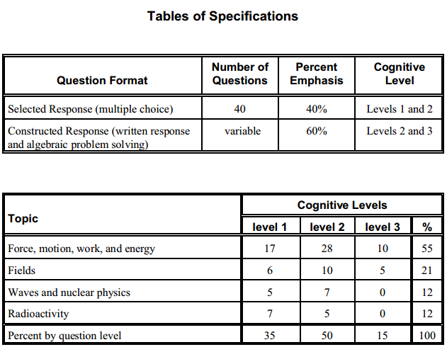
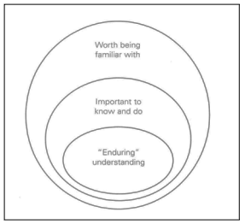
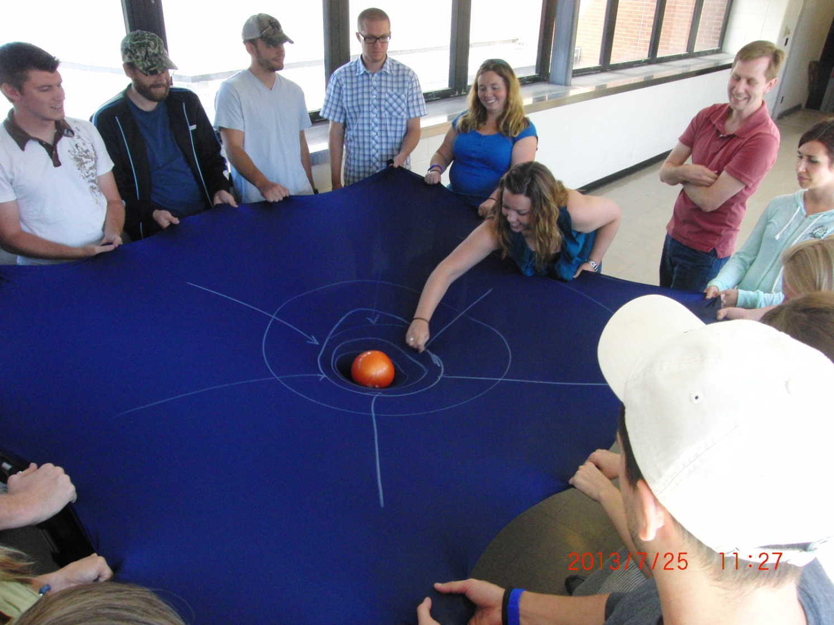
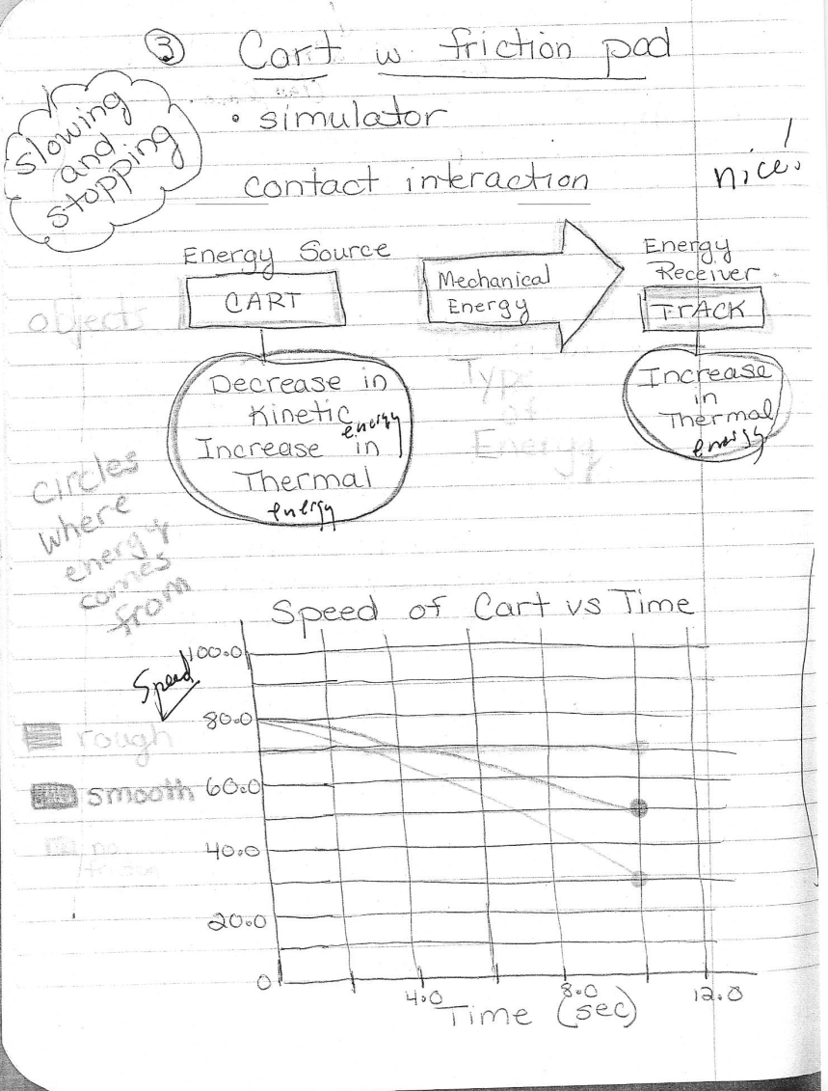
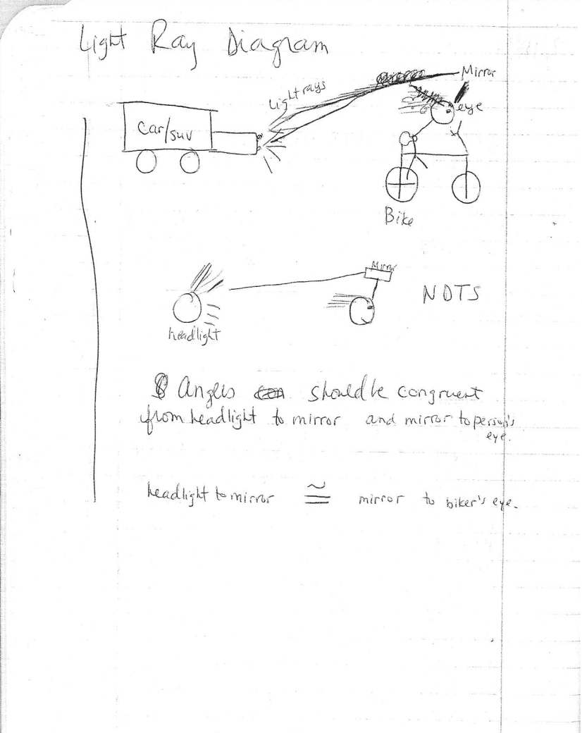
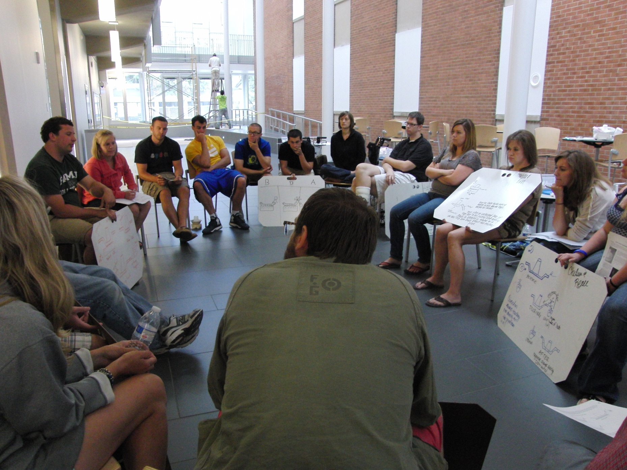
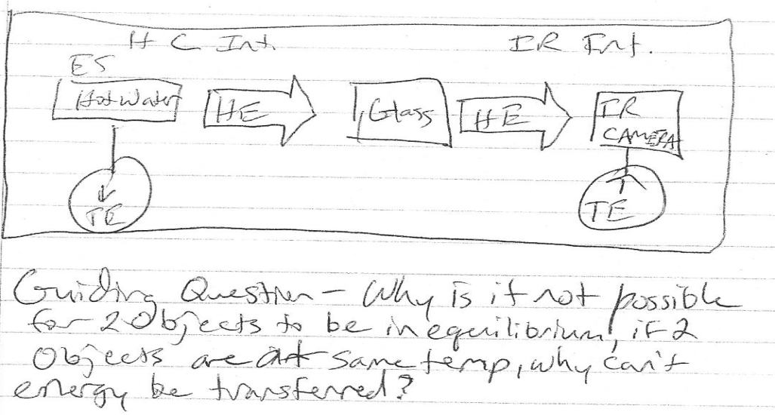
A Table of Specifications for a
Physics Teaching PCK Instrument
Alyssa Pauli & Dan MacIsaac; SUNY Buffalo State College Department of Physics;
adcede19@gmail.com & macisadl@buffalostate.edu
As part of my graduate project in physics education, I am conducting a literature review and survey preparing a Table of Specifications for a possible instrument which could eventually assess the Pedagogical Content Knowledge (PCK) of HS physics teachers. This instrument might inform physics teacher candidate preparation or physics teacher professional development. For example, most introductory HS physics content includes significant mechanics, kinematics, some electrostatics, circuits, waves, sound and optics, so new teachers should know something about common student conceptual difficulties associated with these topics (like Aristotelian physics, confuting position, velocity and acceleration; graph reading, centripetal acceleration direction) as well as touchstone pedagogical measurements and activities (FCI and FMCE; developing kinematics equations from the motion of battery operated toys) and something of research-based introductory curricula. As part of my presentation I am seeking feedback and nominations of possible physics PCK topics for HS teachers (or specifications or even possible items).
Quality Content Assessments & Teacher Assessments
Attitudinal and conceptual content instruments should be administered in every physics course pre- and post- instruction to show gains from the course. FCI, FMCE, TUG-K, CTSR, BEMA, CSEM, DIRECT, STEBI-B and MCTP are some of the assessments that may be used. Teacher candidates should be familiar with some of these assessments in taking the assessment themselves for a given course and practice interpreting results. Sample results from two intense physics education summer courses at Buffalo State College are shown below, when they had relatively small class size and particularly strong discourse.
An assessment of teachers that has been proven to be informative by research is the Reformed Teacher Observation Protocol (RTOP). Above, a table indicates the reliability of the RTOP assessment for each subscale. RTOP has significant topics that can contribute to a physics PCK TOS.
Pedagogical Content Knowledge
Physics Tables of Specifications
Pedagogical content knowledge (PCK) is unique from content knowledge and pedagogical knowledge. Content knowledge is knowledge in a given field that allows students to learn maximally accurate concepts. This content knowledge is required by physicists and physics teachers alike. Pedagogical knowledge, or the knowledge of how people learn, remember, and mentally develop, is a requirement shared among teachers in every content area. PCK is the mixture of pedagogical knowledge and content knowledge in a specific field. The PCK required is different for every content area. Subsequently, physics PCK is professional knowledge unique to those who teach physics.
PCK has been defined by Shulman as “the special amalgam of content and pedagogy that is uniquely the providence of teachers, their own special form of professional understanding.” Such an understanding as PCK is vital to building a classroom that maximizes student learning in physics.
Students do not efficiently acquire physics content knowledge by solely reading about the physics content and listening to lecture, but efficiency is increased with increasing engagement. Physics PCK is thought to have a similar learning efficiency function, due to overlap in physics content.
The diagram and the table below are from Etkina’s “Pedagogical content knowledge and preparation of high school physics teachers.” The diagram shows that the importance of the PCK is that it combines content knowledge with pedagogical knowledge. The table describes five aspects of physics PCK.
A Table of Specifications (TOS) consists of a two-way chart or grid relating instructional objectives to the instructional content. The column of the chart lists the objectives or "levels of skills" to be addressed; the rows list the key concepts or content the test is to measure. A TOS helps teachers align objectives, instruction, and assessment. It identifies not only the content areas covered in class, it identifies the performance objectives at each level of the cognitive domain of Bloom's Taxonomy. Teachers can be assured that they are measuring students' learning across a wide range of content and readings as well as cognitive processes requiring higher order thinking. The use of a TOS ensures that teachers include test items that tap different levels of cognitive complexity when measuring students' achievement.
Below are some examples of TOS for physics content assessments. Note that each of them identifies topics as well as levels of understanding to allocate focus.
About RTOP http://physicsed.buffalostate.edu/
Suggested Physics PCK Topics
To put together a table of specifications for a physics PCK assessment, I have created a list of Physics PCK jargon that should have conceptual meaning to teachers who have great physics PCK understandings. A sample of the list is displayed to the right. To view the updated list, visit http://tinyurl.com/PhysicsPCKJargon.
I will be conducting a survey to identify the most important components of physics PCK. Please email adcede19@gmail.com if you are interested in participating.
Pedagogical content knowledge and preparation of high school physics teachers by Etkina http://journals.aps.org/
Nova Scotia Examinations Physics 12 http://hortonhighschool.ca/
References
American Association of Physics Teachers (AAPT) (2004). Powerful Ideas in Physical Science. Available from <http://www.aapt.org/Publications/pips.cfm>.
Arons, A. (1990). A guide to introductory physics teaching. Wiley. New York.
Cerbin, B. (2009). Writing better objective tests. Center for Advancing Teaching & Learning of Univ. Wisconsin La Crosse. Available from http://www.uwlax.edu/
Etkina, E. (2010). Pedagogical content knowledge and preparation of high school physics teachers. PHYSICAL REVIEW SPECIAL TOPICS-PHYSICS EDUCATION RESEARCH, 6(2), 020110. doi:10.1103/PhysRevSTPER.6.020110
Fives, H. & DiDonato-Barnes, N. (2013). Classroom test construction: The power of a table of specifications. Practical Assessment and Research Eval.18(1). Available from http://pareonline.net/
Goldberg, F (2000). Constructing physics understanding (CPU) project.. Available from <http://cpucips.sdsu.edu/web/CPU/default.html>.
Henry, D., Henry, J., Riddoch, S. (2006). Whiteboarding your way to great student discussions. Sci. Scope. April/M., 51.
Hestenes, D. (1993). Modeling Instruction in High School Physics (NSF Grant ESI 9353423), Information about the workshops can be obtained by visiting the Project’s web site at http://modeling.asu.edu/
Hake, R. (1998). Interactive engagement versus traditional methods: a six-thousand-students survey of mechanics test data for introductory physics courses. Am. J. Phys. 66(1), 64-74.
Loughran, J., Berry, A., and Mulhall, P. (2006). Understanding and Developing Science Teacher Pedagogical Content Knowledge. Sense Publishers, Rotterdam, Taipei.
MacIsaac, D.L. & Falconer, K.A. (2002, November). Reforming physics education via RTOP. The Physics Teacher 40(8), 479-485. Available from
< http://physicsed.buffalostate.edu/pubs/TPT/TPTNov02RTOP/ >, describes physics-specific RTOP use.
Noschese, F. (2013). Noschese 180: A picture a day for the school year. Wordpress. Available from https://noschese180.wordpress.com/
Notar, C., Wilson, J., Yunker, B., & Zuelke, D. (2004). The table of specifications: Insuring accountability in teacher made tests. J. of Instruc. Psych. 31(2), 115. Available from http://go.galegroup.com/
Piburn, M., Sawada, D., Falconer, K., Turley, J. Benford, R., Bloom, I. (2000). Reformed Teaching Observation Protocol (RTOP). ACEPT IN-003. The RTOP rubric form, training manual and reference manual containing statistical analyses, are all available from
< http://PhysicsEd.BuffaloState.Edu/AZTEC/rtop/RTOP_full/PDF />. IN-001 contains the RTOP rubric alone, IN-002 contains rubric and training manual, IN-003 adds the statistical analyses
Redish, E. (1994). Implications of cognitive studies in teaching physics. Am. J. Phys. 62(9), 796-803.
Physics 30 Diploma Exam Blueprint http://www.uleth.ca/
Physics 12 AGS Provincial Exam Workbook http://mainstreetags.files.wordpress.com/
This activity was sponsored by the Integrated Science and Engineering Partnership (ISEP), NSF-MSP project DUE-1102998. Any opinions, findings, conclusions or recommendations presented are only those of the presenter grantee/researcher, author, or agency employee; and do not necessarily reflect the views of the National Science Foundation.
Writing Better Objective Tests by Cerbin http://www.uwlax.edu/
This poster is available from:
http://physicsed.buffalostate.edu/pubs/AAPTmtgs/AAPT2015Jan/

