Slide 1
Physics Teachers Summer Academy
Overview and Reflections
David Abbott, Dan MacISaac, Alyssa Pauli
macisadl@buffalostate.edu

Slide 2
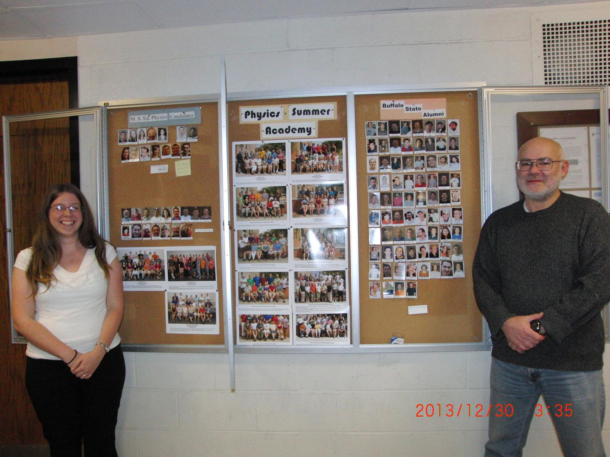
Who we serve
In principle:
Anyone who wants to become a (better) physics teacher
In practice:
Primarily NYS residents w/o NYSED Physics cert.
New/in-service NYS teachers w/o NYSED prof. cert.
Pre-service teacher candidates w/o NYSED initial cert.
Primarily non-degree candidates
3 Male : 1 Female

Slide 3
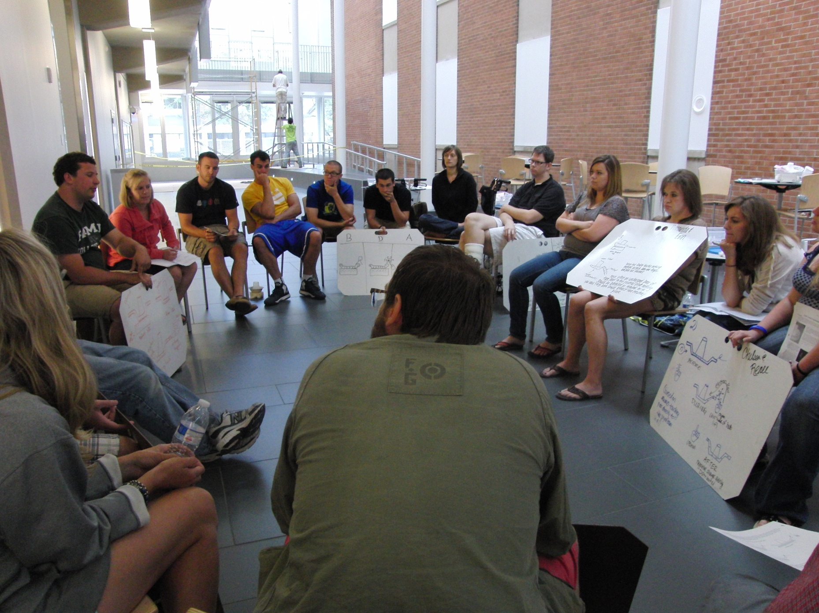
Summer Academy Courses
Focus:
Physics at the intro undergrad. level
Pedagogy and PCK at the graduate level
The big three (6 cr each):
PHY510 Process Skills in Teaching Physics
PHY620 Powerful Ideas in Quantitative Modeling: Force, Motion and Energy
PHY622 Powerful Ideas in Quantitative Modeling: Electricity and Magnetism
Features:
Short and Intense (8+ hr/day for 2 or 3 weeks)
Informed by SER, PER
Team taught: BSC faculty and adjuncts (practicing or retired HS PHY teachers)
PHY620/622 primarily Modeling Physics curriculum
Required in BSC grad. degree programs

Slide 4
Content Knowledge

Slide 5
Making it work (politically)
Make profit for college
“big tent” clientele (include non-PHY, non-degree!)
Calculate break-even enrollment (during summer: ~5!)
Build collaborations and tap synergies
Local physics teacher alliances (WNYPTA, RAPTOR)
STEM teacher prep scholarships (Noyce)
At BSC (Tech. Ed. and Sci. Ed.) and regionally (UB, JCC)
Take advantage of stringent NYS cert. requirements
Get recognized
NSF Grant money
Get candidates to publish (STANYS, AAPT)
T-TEP Report

Slide 6
Noyce Fellowships
NSF program
Significant tuition assistance ($10k-$15K/yr, up to two years)
For new K-12 STEM teachers
Service obligation (2 years high needs school per year of award)
Two grants at Buffalo State (Phase 1 and Phase 2)
Delighted to share our Proposals and our Reports

Slide 7
Noyce (BSC Physics)
Phase 1
N = 13 (3 female)
Grads = 11 (2 PHS, 6 PHA, 2 BS Ed, 1 out of state)
Phase 2 (1/2011-12/2015)
N = 3 (all male)
Grads = 0
1 teaching already (but not in high needs)
 | Met SO | Did not meet SO
Teaching now | 4 | 6
Not teaching | 1 | 2

Slide 8
Challenges/Opportunities
Internal
Team teaching
College admin (summer)
Teach physics and PCK simultaneously
Students’ grasp of material (esp. E&M)
Recruiting (word of mouth, listserv)
External
Declining enrollments (nationally)
New M.S. Ed. program at BSC
Course enrollments vs. degree candidates
Political climates

Slide 9
Should we be worried?

Slide 10
PhysTEC model
Undergraduate degree in Physics
“Rising above the Gathering Storm”
Data: In ~50% of HS classes, PHY (and CHE) teacher has no BA/BS in content area
Claim: BA/BS in content and proper cert predicts success of students (evidence?)
Needs of public schools?
Numbers game:
need ~3000 new PHY teachers per year,
only ~5000 PHY BS/BA granted
State-by-state cert. differences
Source: http://www.phystec.org/webdocs/shortage.cfm

Slide 11
Citations and contact info
Contact: Dan MacIsaac: macisadl@buffalostate.edu
http://physicsed.buffalostate.edu/pubs/

