Slide 1

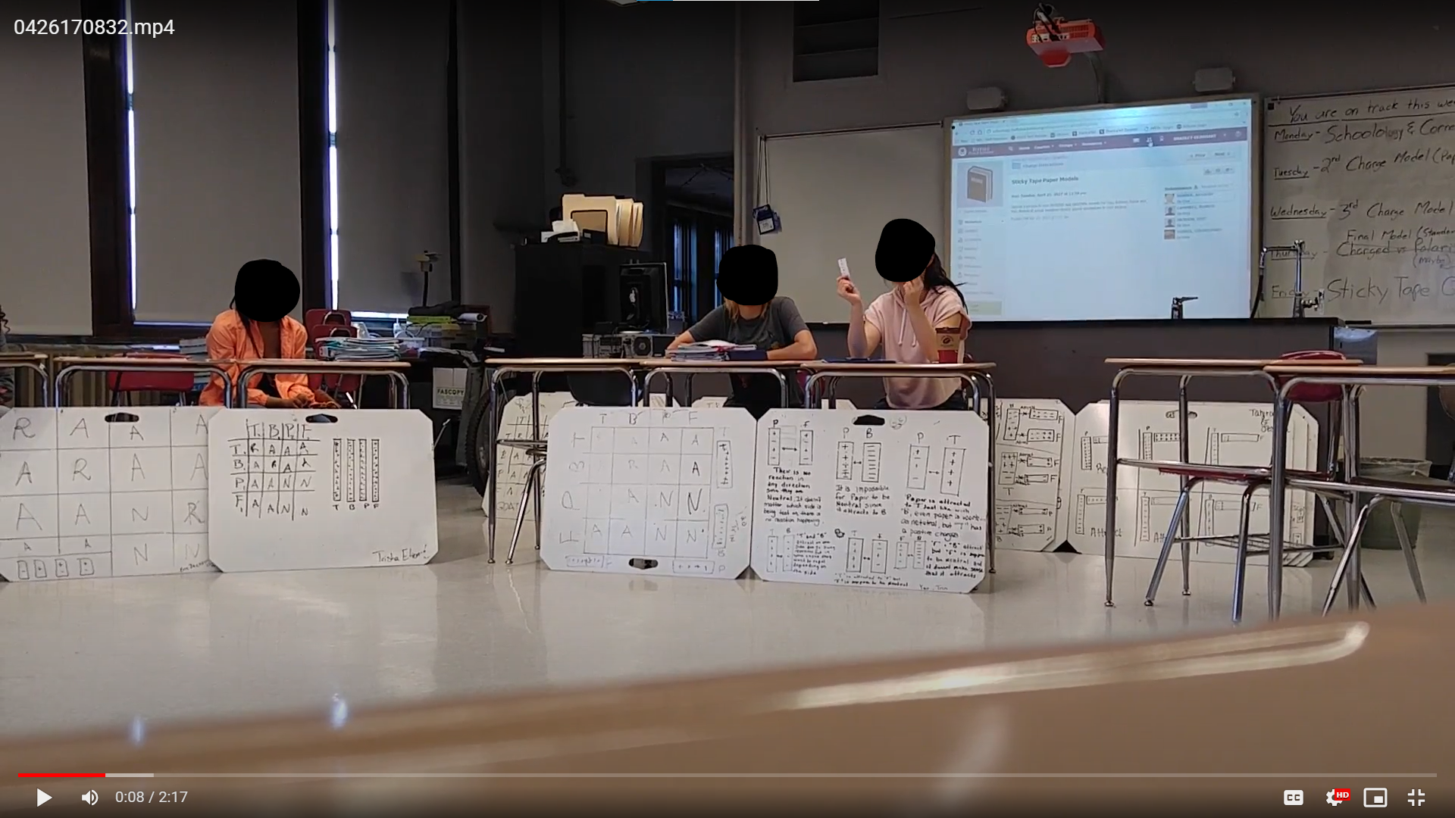
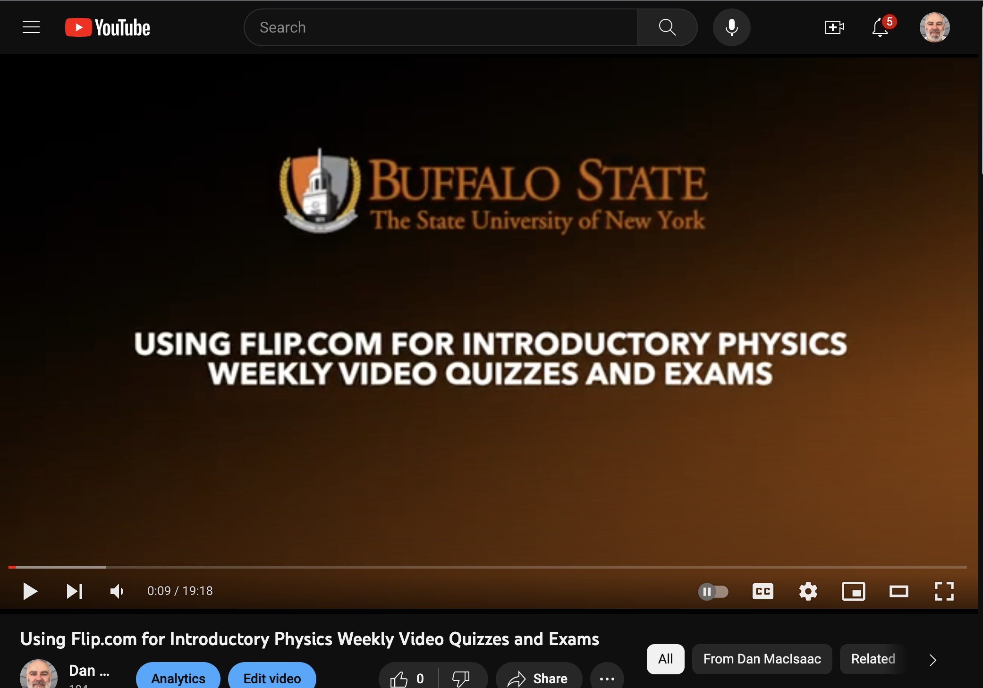
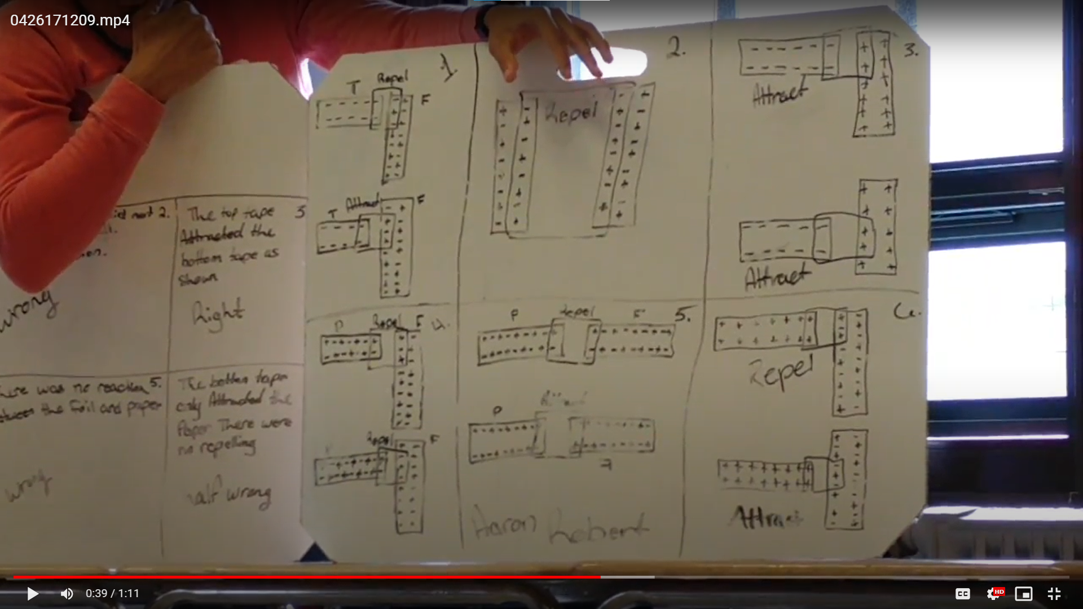
Student Authored Video in Physics Learning
Dan MacIsaac, Department of Physics · Bradley Gearhart, Hutch Tech HS, Buffalo Public Schools
Background
Grade School Students and Preservice Teachers
Dissemination: Books, Articles & Videos
Since 2017 the authors and colleagues have been experimenting and publishing about having students create video presentations about physics to promote their learning. This started with freshman physics at Buff State, then added high school physics and graduate courses for physics teachers.
A very small subset of these student video presentations are available from DM’s YouTube channel and from the authors, as well as rubrics, guidelines, how-to and PD videos, and publication
Timeline
- 2017 MacIsaac Uni-Köln Sabbatical; video exp starts in Buffalo
- 2018 – 2022 NY, USA and German practitioner’s presentations
- 2019 TPT article; Uni-K send grad students; exp starts HTHS
- 2020 GIREP (Euro Physics Educ Research Assn) presentation
- 2022 Springer Book published with video physics chapter
- Nov 2023 STANYS presentation on videos for HS physics
- Jan 2023; two 20-30min Prof Devt videos produced with Uni-K
Future Directions
We are currently continuing applied classroom research on:
- HS students generating video animations in powerpoint via cut and paste, particularly for electrostatic phenomena
- using brief Flip.com videos for students to explain their solutions to standard and enriched undergraduate physics problems.
Adding Student Video Projects to Physics Courses (TPT 2019)
Our first peer-reviewed paper for a national Physics Teacher practitioner audience. Gives the implementational basics for classroom reproduction and experimentation with student videos.
Acknowledgements
Hutch Tech HS students preparing animations for a video on electrostatics; Buff state students recording a video on radioactive decay, here showing half life calculations.
We recognize our many patient and hardworking students, colleagues and co-authors, as well as SUNY Instructional Innovational Technology Grant, US National Science Foundation and German Federal Government and länder financial support. All findings, opinions and errors are our own, not our funders.

