Slide 1
Fostering Physics Content and Pedagogy Learning by Future Physics Teachers via Student Authored YouTube Video Projects
David ABBOTT, Brad GEARHART and Dan MacISAAC Physics Department, SUNY Buffalo State College, 1300 Elmwood Ave, Buffalo NY 14222 USA
Kathleen FALCONER, Florian GENZ, Stefan HOFFMANN and André BRESGES Universität zu Köln Institut für Physik und ihre Didaktik, Gronewaldstr. 2 50931 Köln
Jeremias WEBER Berufskolleg Werther Brücke, Bachstraße 17, 42275 Wuppertal, Germany

Slide 2
Abstract
We describe a curricular innovation for STEM teacher preparation -- the use of video projects in undergraduate and graduate physics courses for future physics teachers at SUNY Buffalo State. US courses were adapted under the guidance of our colleagues’ similar work at Universität zu Köln [1]. Our students prepared end of course short “proof of concept” rough video vignettes of 5-10min addressing both physics content and physics pedagogical topics. YouTube [2] example videos are provided, and insights are shared.

Slide 3
Goals
Our video making goals for teachers include:
Developing teaching technical skills using video and media as representation tools – e.g. animation, dialogue and video presentations
Learning physics content through reflectively planning and preparing visual representations of physics content to their classmates
Practicing physics instructional development using student learning outcomes literature and known learning difficulties to prepare videos for their own students
Learning the pedagogy of physics by developing presentations for their teaching colleagues on instructional techniques, touchstone learning activities, and research driven interventions.

Slide 4
Procedures
Student “rough cut” or “proof of concept” group video projects comprise 10% of their course overall grade.
A short email proposal (10% of project credit) is required about mid-semester, identifying a topic (often selected from a teacher-provided list), listing group members and roles, addressing safety, identifying and requesting materials and other required resources, and stating a working title.
About 75% through the course, a storyboard and annotated bibliography are due for another 10% of project credit.
The video (which must contain mathematics, other multiple representations, and references in the final credits) is presented (40% of credit) in the last weeks of class, and classmates and instructors provide brief feedback.
The short final reflective report (40%) is due at the final exam – the report includes an abstract and references, final transcript and storyboard, and discussion of strengths, weaknesses and suggestions for reshooting a second edition. A vanishing few of these videos are placed on YouTube with permission of all students.

Slide 5
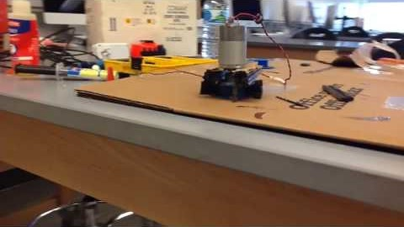
Electric Water

Slide 6
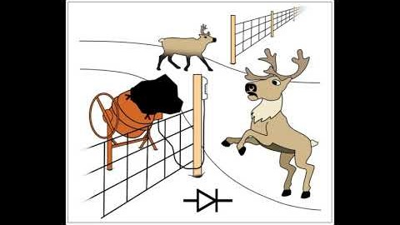
PN Junctions, PV Cells and LED Function

Slide 7
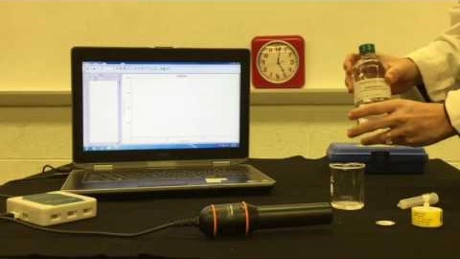
Half-Life Experiments

Slide 8
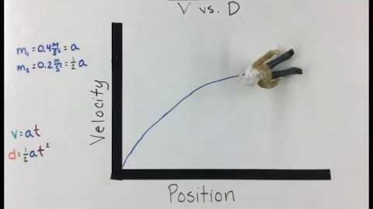
Linearization and Kinematics Equations

Slide 9
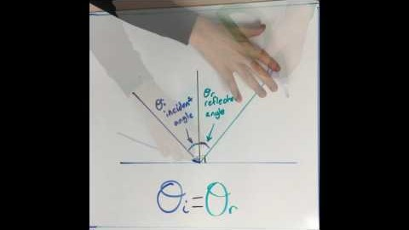
Law of Reflection

Slide 10
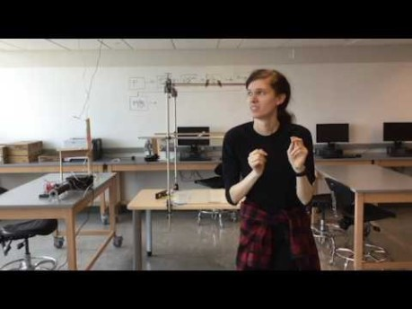
Breaking the 4th Wall

Slide 11
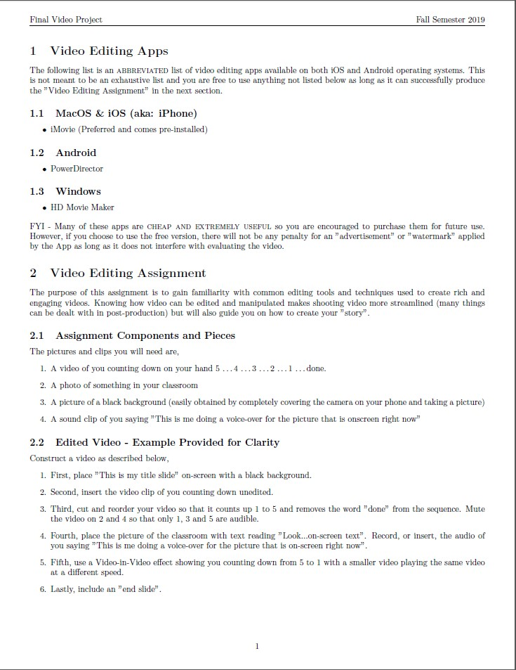
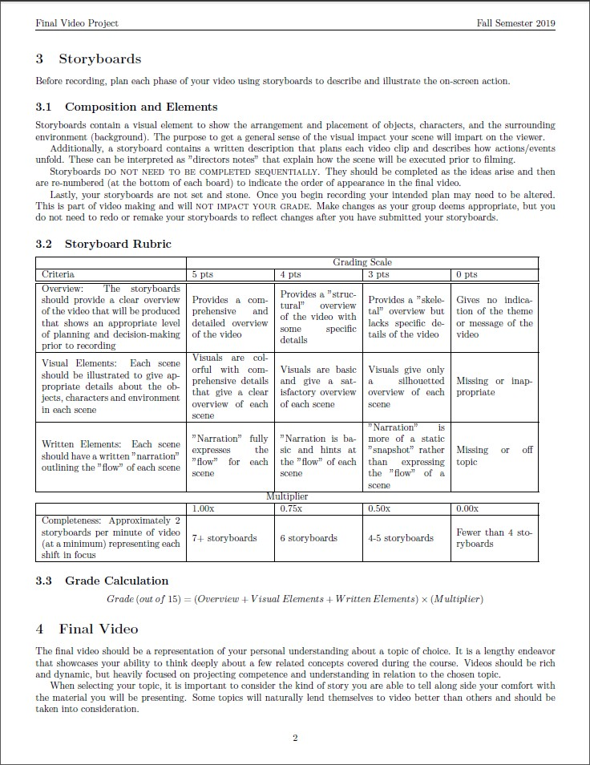

Slide 12
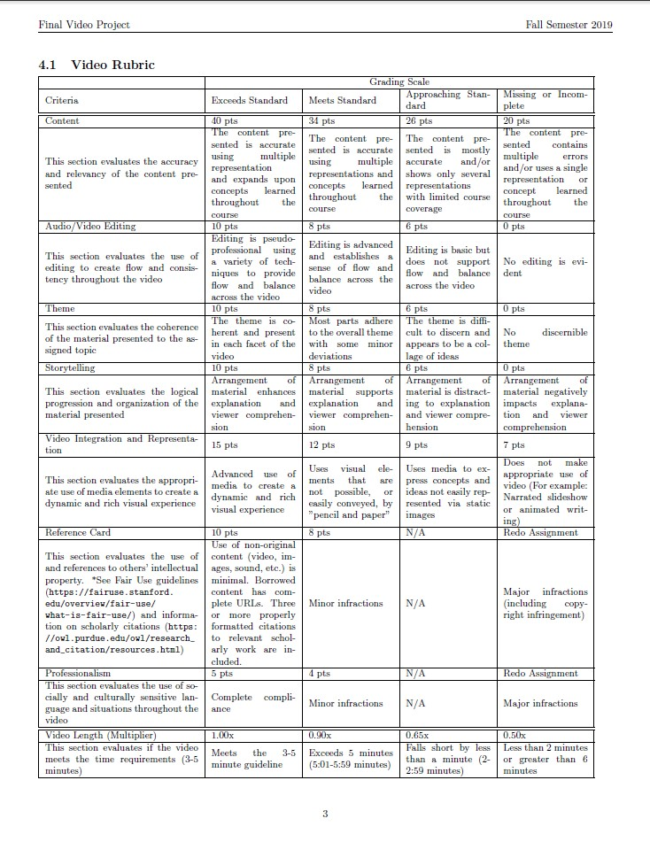
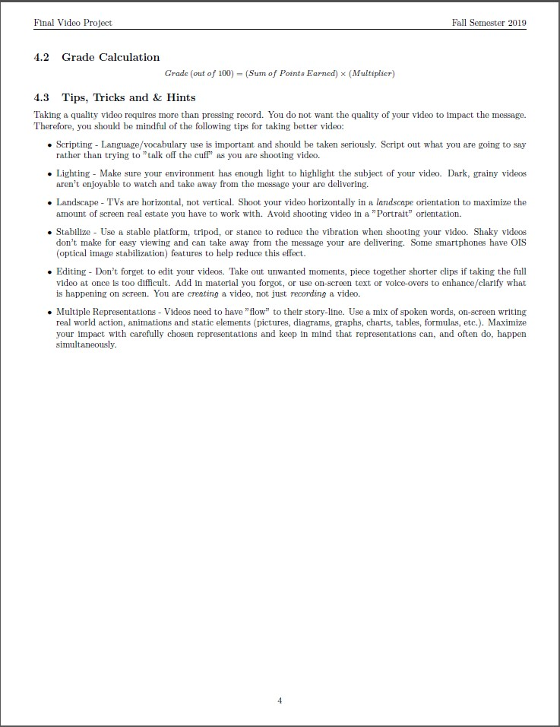

Slide 13
Conclusions and Lessons Learned
Students are enthusiastic and have fun doing video projects. We focus on physics content and learning process, not product – foster clear thinking and communication, not preparing Hollywood directors. Students must be continuously refocused on the content and the learner, else they can get distracted by technical and stylistic issues (in-group humor, music, special effects). Students must manage time carefully with review by the instructor.

Slide 14
References
[1] D. Abbott, A. Roberts, D. MacIsaac, K. Falconer, F. Genz, S. Hoffmann, A. Bresges, & J. Weber, Adding Student Video Projects to Physics Courses, Phys. Teacher 57 (April 2019) 224-228.
[2] D. MacIsaac. (2020 Oct 1). Retrieved from https://www.youtube.com/user/danmacvids/ .
[3] M. Kearney. Towards a learning design for student-generated digital storytelling, The Future of Learning Design Conference, (2009), University of Wollongong Research Online.
[4] R. P. Hechter and M. D. Guy. Promoting creative thinking and expression of science concepts among elementary teacher candidates through science content movie creation and showcasing, Contemp. Issues Technol. Teach. Educ. 10(4), (2010) 411–431.
[5] G. Hoban, J. Loughran, and W. Nielsen. “Slowmation: Pre-service elementary teachers representing science knowledge through creating multimodal digital animations,” J. Res. Sci. Teach. 48(9), (2011) 985–1009.
[6] M. V. Pereira, S. de Souza Barros, L. A. de Rezende Filho, and L. H. de A. Fauth, “Audiovisual physics reports: Students’ video production as a strategy for the didactic laboratory,” Phys. Educ. 47 (1), 44–51 (2012).
[7] A. Prud’homme-Genereux, “Student-produced videos for the flipped classroom,” J. Coll. Sci. Teach. 45 (3), 58 (2016).
[8] D. A. Muller, “Designing Effective Multimedia for Physics Education,” PhD dissertation (School of Physics, University of Sydney Australia, (2008).
[9] R. L. Coates, A. Kuhai, L. Z. J. Turlej, T. Rivlin, and L. K. McKemmish, “Phys FilmMakers: Teaching science students how to make YouTube-style videos,” Eur. J. Phys. 39, 015706 (2018).
[10] D. MacIsaac. (2017, May 20). Electric Water [Video file]. Retrieved from https://youtu.be/FpC_cxF1QNg .
[11] D. MacIsaac. (2020, May 22). PHY522 Flashlight Overview: PN Junctions, PV Cells and LED function [Video file]. Retrieved from https://youtu.be/RZdUF2bq54w .
[12] D. MacIsaac. (2016, July 28). Half Life Beta Version [Video file]. Retrieved from https://youtu.be/rEu1JePXXwI .
[13] D. MacIsaac. (2016, Nov 11). Using Formative Assessments in the Physics Classroom V2 [Video file]. Retrieved from https://youtu.be/PHOZRy__Yms .
[14] D. MacIsaac. (2016, Oct 6). Linearization and the Kinematics Equations V2 [Video file]. Retrieved from https://youtu.be/ODvLr_zkfwE .
[15] D. MacIsaac. (2017, March 27). Law of Reflection sample video project [Video file]. Retrieved from https://youtu.be/9ozpJUBV3R0 .
[16] D. MacIsaac. (2017, April 27). Breaking the 4th Wall: Making a Physics Video [Video file]. Retrieved from https://www.youtube.com/watch?v=iecXeKgdnuU .

Slide 15
Contact Email
David Abbott – abbottds@buffalostate.edu
Dan MacIsaac – macisadl@buffalostate.edu
Bradley Gearhart - bgearhart@buffaloschools.org
Kathleen Falconer – kathleenfalcone@mac.com
Andre Bresges – andre.bresges@uni-koeln.de
Stefan Hoffmann – stefan.hoffman@uni-koeln.de
Florian Genz – florian.genz@uni-koeln.de
Jeremias Weber – jeremias.weber@physik.uni-frankfurt.de

