Slide 1
An Introduction to
Research On Physics Teaching For Teachers
Dan MacIsaac & Kathleen Falconer
<physicsed.buffalostate.edu/pubs/PHHD/>
Dan MacIsaac, Associate Professor of Physics & AAPT Fellow State Univ of NY-Buffalo State College Buffalo NY 14222 USA <danmacisaac@gmail.com> <http://PhysicsEd.BuffaloState.edu>
Fifth International Fellow, Faculty of Natural and Social Sciences Institute for Natural Sciences, Geography and Technical Education Pädagogische Hochschule Heidelberg University of Education

Slide 2
Abstract: An Introduction to Research On Physics Teaching For Teachers
PHY500: Physics Education Seminar (online) is designed to
lay a foundation of Pedagogical Content Knowledge (PCK) in high school Physics Teaching scholarship,
engage high school Physics Teachers as practical consumers of physics and science education scholarship, and
foster critical reflection on their own teaching practices.
We describe content, activity, and lessons learned from offering PHY500 to more than 125 high school physics teachers since 2002.

Slide 3
Setting and Logic
PHY 500 is a course for teachers – professional educational practitioners. In general these participants are consumers of PER (Physics Education Research) and SER(Science Education Research) literature.
Future master physics teachers and future teacher leaders able to make critical, informed decisions about
their own physics classroom learning and teaching practices
physics curricula
professional development
their own profession
What PHY500 is NOT: A literature course for PER researchers or Doctoral Candidates.

Slide 4
Masters Degree Programs
PHY500: Seminar in Physics Education is a required introductory course for two terminal masters' programs:
M.S.Ed. (Physics) mainly taken by BIO, CHM, GLG, some MAT, some PHY teachers
M.S.Ed. (Physics with NYSED Transitional B Certification) for STEM professional becoming teachers
Note that most NY teachers certify twice – to earn full (NYSED Professional) certification teachers must obtain a suitable masters degree.
Degree Programs:
enrolled 12 graduate students at present
almost another 125 alumni
125 students have completed PHY500 since it was first offered in 2002.
PHY500 has always been an online offering.

Slide 5
Masters Degree Programs
Considerations underlying PHY500 included:
develop physics teacher Content and Pedagogical Content Knowledge
develop teacher familiarity with appropriate literature for an eventual PHY690: Masters' Project
must be offered online to enroll downstate (NYC, Long Island) and out of state students
must expose students to M.S.Ed. (Physics) programs philosophy and shared definitions of what good physics learning environment can look like (Reformed Teaching Observation Protocol)
must assess candidate dispositions for physics teaching (particularly alternate certification candidates) for M.S.Ed. (Physics) Programs at beginning and end of program (NCATE; candidate advising and counseling)
develop graduate student scholarly reading and writing skills (APA format, scholarly discourse)

Slide 6
What PER and SER is important?
In groups, please answer the following question:
What research, research papers, etc. would you consider important for new teachers to read for their development as teachers?

Slide 7
Content and Activities
FOR US at first:
critical reflective thinking about
the state of teachers' own physics subject knowledge and pedagogical knowledge (Arons; Beichner; Hestenes, Wells & Swackhamer; McDermott & Redish; McDermott & Shaffer, -- standard instruments like FCI, TUG-K etc; PER and SER touchstone activities)
teachers' and students' own physics learning (Beichner; Hake; Hestenes, Wells & Swackhamer,
teachers' own physics teaching (Arons; Hake, MacIsaac & Falconer; Sawada, Baker, Bauer, Benford, Birk, Bloom and Falconer)
expose students through readings to a wide variety of research-informed physics learning experiences and practices (Finklestein, Adams, Keller, Perkins & Podolefsky; Sokoloff & Thornton; Thornton)

Slide 8
List of Readings and Schedule
Schedule:
Schedule revision as of 27Oct15
 | Monday | Topics / readings | Comments
1 | 25-Jan-16 | Beichner: Intro to PER | read; be prepared to briefly comment on Skype
2 | 1-Feb-16 | Arons Ch1
3 | 8-Feb-16 | Arons Ch2
4 | 15-Feb-16 | Arons Ch3 | Due Tues midnight (President's Day recess)
5 | 22-Feb-16 | Hestenes FCI & Modeling
6 | 29-Feb-16 | Sokoloff ILD
7 | 7-Mar-16 | Hake IE vs trad instruction
8 | 14-Mar-16 | Beichner TUG-K
9 | 21-Mar-16 | Spring Break no classes | can read ahead (McDermott RL-PER1 for final paper)
10 | 28-Mar-16 | Dreyfus Bonds Energy Interdisciplinary | Final paper proposal due
11 | 4-Apr-16 | Thornton Uncomm Knowledge
12 | 11-Apr-16 | Finklestein Simulations | Easter Monday; Due Tuesday midnight
13 | 18-Apr-16 | McDermott Batt/Bulbs | Abstract and outline for final paper
14 | 25-Apr-16 | MacIsaac RTOP
16 | 2-May-16 | Arons Ch12
16 | 9-May-16 | Final Project presentation to class

Slide 9
Reading Logs

Slide 10
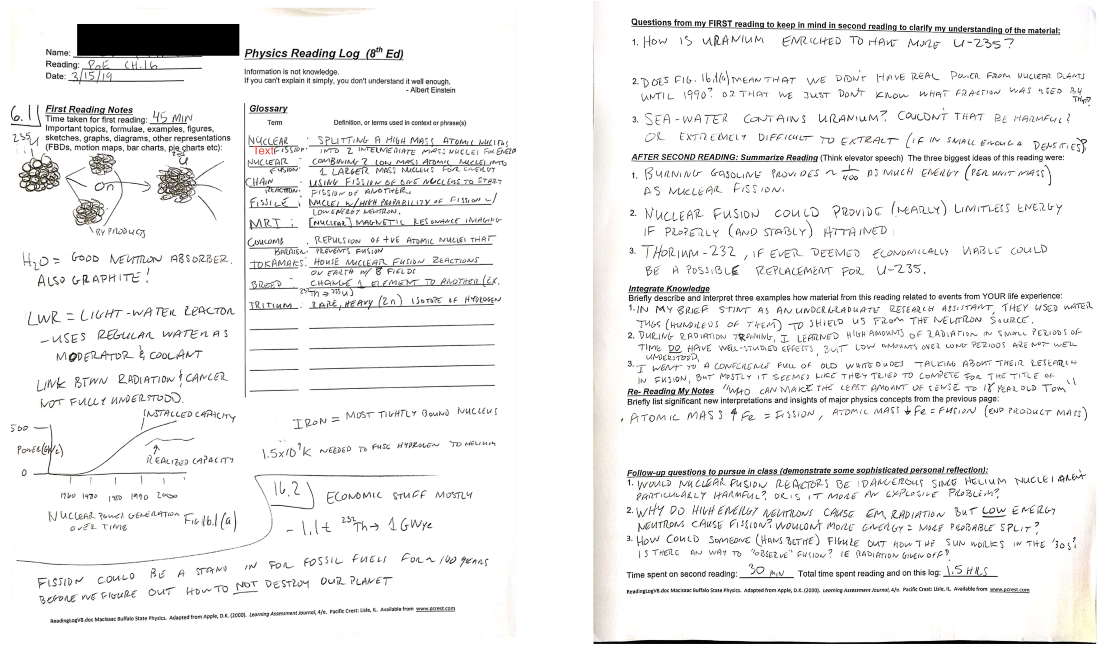
Reading Logs

Slide 11
Sample Weekly Structure:
Students are given all reading assignments at the start of the course and are shown how to search literature online. Students are given a weekly reading assignment and required to write a three to five page reflective reaction paper about some sharply limited aspect (one or two ideas at most) of the reading and the students' own lived experience. Readings are significant works, not readily amenable to summarization; the goal is instead to first identify ONLY one or two ideas within the readings that resonate with the lived experience (either teaching or learning physics) of the PHY500 student. These lived experiences are then analyzed through the reading, and described by the student. Students submit these reflective reaction papers on a Monday, and are expected to comment on a colleagues’ paper by Thursday in a round-robin format where each comments on both writing mechanics (spelling grammar, format, readability) and intellectual content. Typically each course student comments on all or almost every other student’s writing at some point in the course. Original essays and marked up annotated essays (all done in MS Word) are shared with all class students on a password protected (BlackBoard) class website. The instructor annotates every essay during week one (Arons Ch1) and then reads and briefly comments on essays for the rest of the course. The instructor also marks up papers if a class member is unavailable to do so.
A rubric and exemplars are available to students to guide their weekly annotations of one another. There is a lengthier final paper on a negotiated individual topic, and we have experimented with (and largely abandoned) required graded synchronous and synchronous chat sessions on the weekly readings.

Slide 12
Teacher Reflections from the Course
For example a Chemistry teacher becoming a physics teacher reflects on their own mechanics knowledge and the FCI:
This past summer was the first time I took the FCI or knew what it was, and it was an eye-opening experience for me. I realized that despite all of the formulas I had learned and the problem solving skills that I had, I was very unsure of some basic concepts about forces in physics, and now, after taking it a few times, I’m quite sure that I failed it horribly the first time. However, I’ve learned a lot over the last 9 months and this time I did extremely well.
…
One of the most important things about the FCI is knowing how this test can be used and what its purpose is. Without knowing these things the test is worthless. First, the FCI is “not a test of intelligence; but is a probe of a belief system.” Its purpose is to determine whether a student has excepted (or adopted) a Newtonian view of forces or whether they believe in commonsense alternatives based of life experiences. So really its purpose is to address common misconceptions (or preconceptions, as Arons would call them). This test will not tell you which students are going to do well on a conventional physics test or regents exam because it is purely conceptual and does not assess mathematical skills, memorized formulas, or problem solving skills.

Slide 13
Teacher Reflections from the Course
Interpreting her own lived experiences in college via Sokoloff and Thornton’s ILDs:
Sokoloff and Thornton’s ILD (Interactive Laboratory Demonstrations) force students to do something they usually don’t. It forces them to think about and process the information. Better yet, for those students who already knew they needed to process the information, it give them time to process, and also to discuss the information with their peers. My lectures in college made no sense to me. The way I would figure information out was to form a study group, take my copiously copied lecture notes with me and all of us would have a powwow trying to decipher what it all meant. Usually we would only be able to get so far and then all of us would draw straws to pick who got to go ask the professor the questions we needed answered to further our understanding. I usually got the short straw. Having the chance to discuss physics concepts in class, with the professor right at our finger tips if we got stuck would have been a great learning environment in college.

Slide 14
Teacher Reflections from the Course
A teacher partially analyzes her own Classroom practice through Beichner’s TUK-K article:
The last thing I’ve tried with my students is to have my students write a story or pick a pre-existing nursery rhyme and graph a distance verses time, velocity verses time and acceleration verses time graph for the motion of the character in the story. Students had some difficulty with this as well. I modeled the Isty-Bitsy Spider for them (I got this out of the STAR review book if anyone is interested) and then had them come up with their own. Many of my students chose Jack and Jill. They were able to draw the displacement verses time graph but the other graphs were mostly unsuccessful attempts. I would say about a third of my students drew all three graphs for Jack and Jill to look like a hill, which does make reasonable sense, but everything was down hill from there. The velocity vs. time graphs looked similar and so did the acceleration verses time graphs. Beichner’s research showed very similar results. In fact he said that thinking about a graph as an actual picture of motion was the most common mistake a student makes. I could definitely see that most of my students needed more work on graphing, but after spending two weeks on it, I had to move on. I was a little discouraged because after spending so much time the progress was very small.

Slide 15
PHY500 Lessons Learned
Online teaching a a LOT of work, and it is difficult to get high quality discourse online (low quality is easy – story about a teacher who took another DE course who paid her 10yr old daughter to take her seat for an hour)
Enrollment is pretty high (about 8 to 12 / year) and a large fraction enroll in PHY500 as non-degree or visiting students, then apply to one of the M.S.Ed. programs and change degree status.

Slide 16
PHY500 Lessons Learned
Some activities are less suitable for teachers – the “Purer PER and SER” seems to become less compelling as classroom immediacy is lost -- E.g. in order of less to more immediate readings:
Less Accessible More Accessible
Piaget (no longer required);
Hake; FCI, Batteries and Bulbs, ILDs
Arons is highly accessible; seen as a reference work (used also in PHY518, 520, 525, 620, & 622). We are moving to include Action Research Literature for those few masters students who do classroom research.

Slide 17
PHY500 Lessons Learned
Teachers often are initially taken aback by their self-scored standardized conceptual physics instrument results – they don’t know what they don’t know initially.
Teachers love the standardized conceptual physics instruments like FCI, TUG-K; we literally restrain teachers from starting their own research as these M..S.Ed. programs do not teach research methods. Many teachers do informally explore use of these instruments in their classes (esp FCI).
Some PHY500 students who are working physics teachers can test ideas from PER readings in their classes and report back that very week to the class (extraordinarily powerful).

Slide 18
Final words
PHY500 students usually don't know what they don't know (Arons, Standardized tests and touchstone activities)
Thank you.
Dan MacIsaac, Associate Professor of Physics & AAPT Fellow State Univ of NY-Buffalo State College Buffalo NY 14222 USA <danmacisaac@gmail.com> <http://PhysicsEd.BuffaloState.edu>
Fifth International Fellow, Faculty of Natural and Social Sciences Institute for Natural Sciences, Geography and Technical Education Pädagogische Hochschule Heidelberg University of Education

Slide 19
Bibliography:
Arons, A. B. (1997). Teaching Introductory Physics. New York: Wiley. Ch1-3 & 12.
Beichner, R.K. (1994, August). Testing student interpretation of kinematics graphs. American Journal of Physics, 62(8) 750-762.
Dreyfus, B.W., Sawtelle, V., Turpen, C., Gouvea, J., and Redish, E.F. (2014). Students’reasoning about “high-energy” bonds and ATP: A vision of interdisciplinary education. Physical Review of Special Topics – Physics Education Research, 10, 010116-1-16.
Finklestein, N.D., Adams, W.K., Keller, C.J., Kohl, P.B., Perkins, K.K., Podolefsky, N.S., Reid, S., and LeMaster, R. (2005). When learning about the real world is better done virtually: A study of substituting computer simulations for laboratory equipment. Physical Review Special Topics: Physics Education Research 1, 010103. Available from <http://prst-per.aps.org/>.
Hake, R.R. (1998, January). Interactive-engagement versus traditional methods: A six-thousand-student survey of mechanics test data for introductory physics courses. American Journal of Physics, 66(1) 64-74.
Hestenes, D., Wells, M. & Swackhamer, G. (1992, March). Force concept inventory. The Physics Teacher, 30(3) 141-163.
MacIsaac, D.L. & Falconer, K.A. (2002, November). Reforming physics instruction via RTOP. The Physics Teacher, 40(8) 479-485.
McDermott, L.C. & Redish, E.F. (1999, September). RL-PER1: Resource letter on physics education research. American Journal of Physics, 67(9) 755-767.
McDermott, L.C & Shaffer, P.S. (1993, January). Erratum:"Research as a guide for curriculum development: An example from introductory electricity. Part I: Investigation of student understanding" [American Journal of Physics, 66(11) 994-1003.] American Journal of Physics, 61(1) 81.
McDermott, L.C & Shaffer, P.S. (1992, November). Research as a guide for curriculum development: An example from introductory electricity. Part II: Design of instructional strategies. American Journal of Physics, 60(11) 994-1003.
Piaget, Jean & Garcia, Rolando (1989). H. Feider, Trans. Psychogenesis and the history of science. NY: Cambridge Univ Press. Chapters 1&2, p30-87.
Shaffer, P.S. & McDermott, L.C & (1992, November). Research as a guide for curriculum development: An example from introductory electricity. Part II: Investigation of student understanding. American Journal of Physics, 60(11) 1003-1013.
Sokoloff, D.R. & Thornton, R.K. (1997, September). Using interactive lecture demonstrations to create an active learning environment. The Physics Teacher, 35(6) 340-346.
Thornton, R.K. (2002). Uncommon knowledge: Student behavior correlated to conceptual learning. Unpublished manuscript available from the author.

