Slide 1
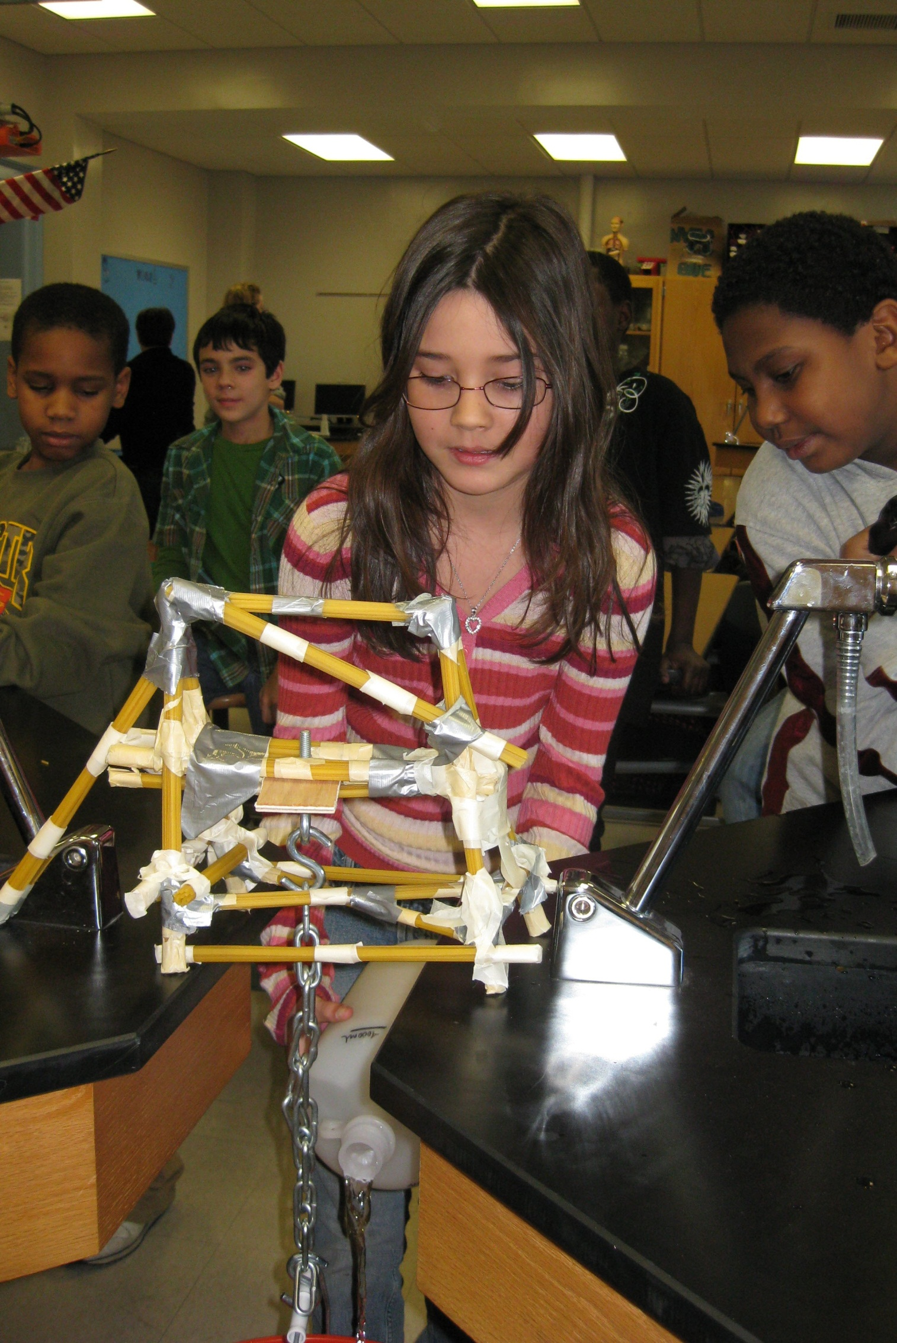
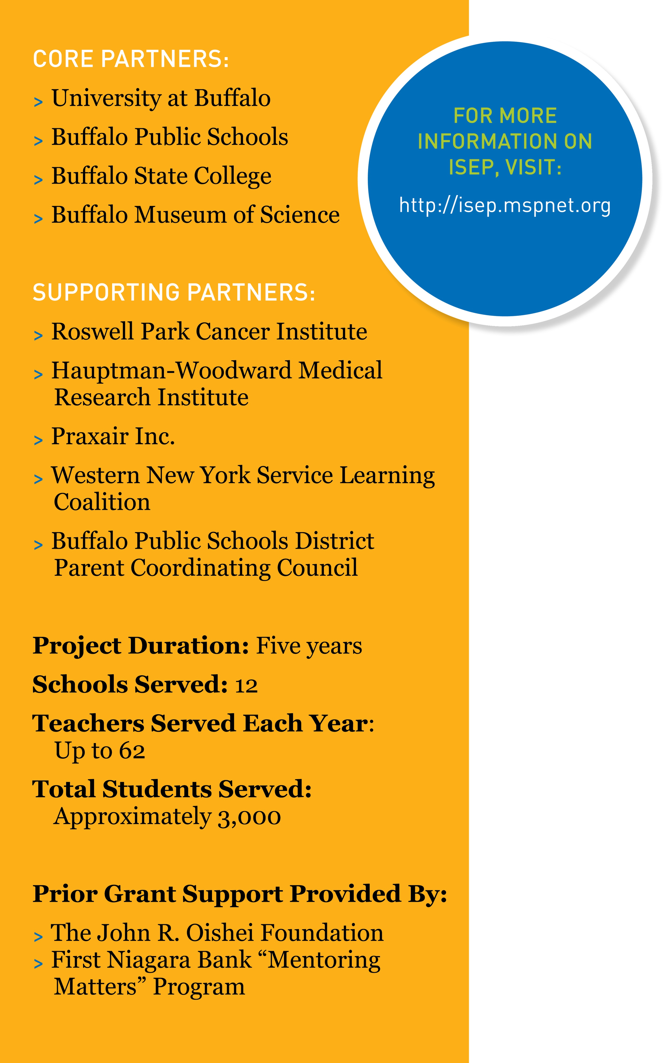
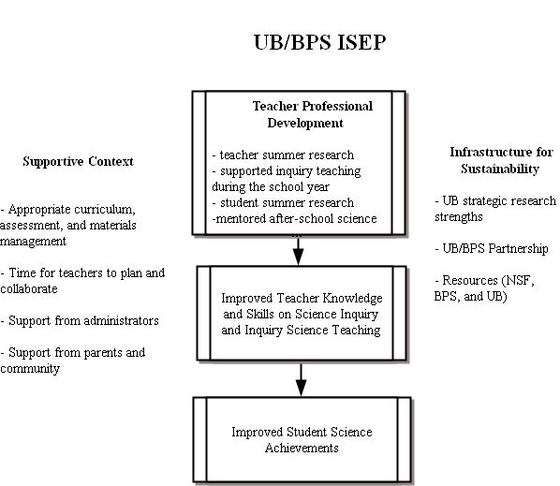
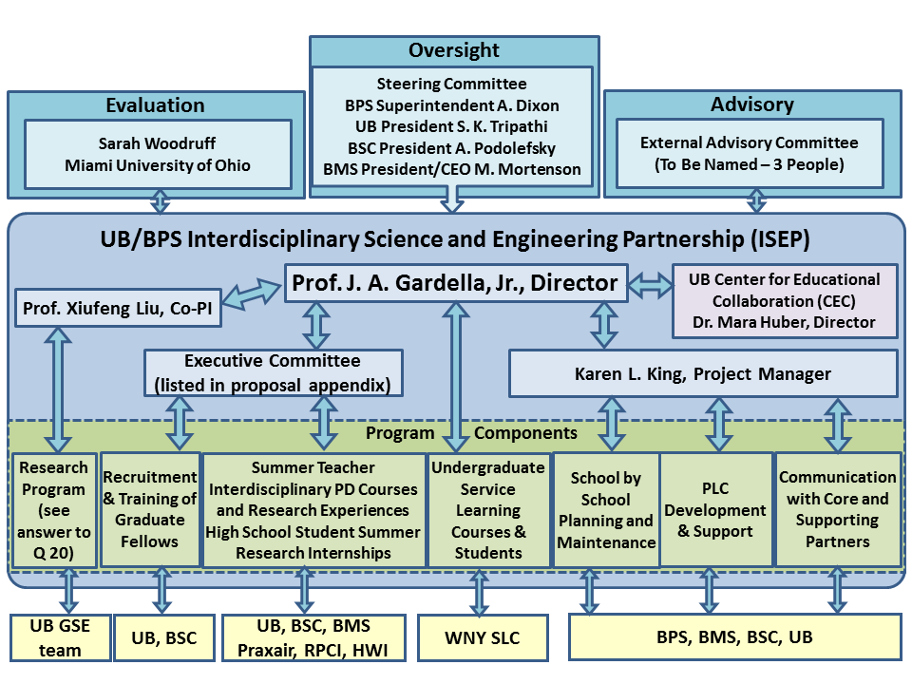
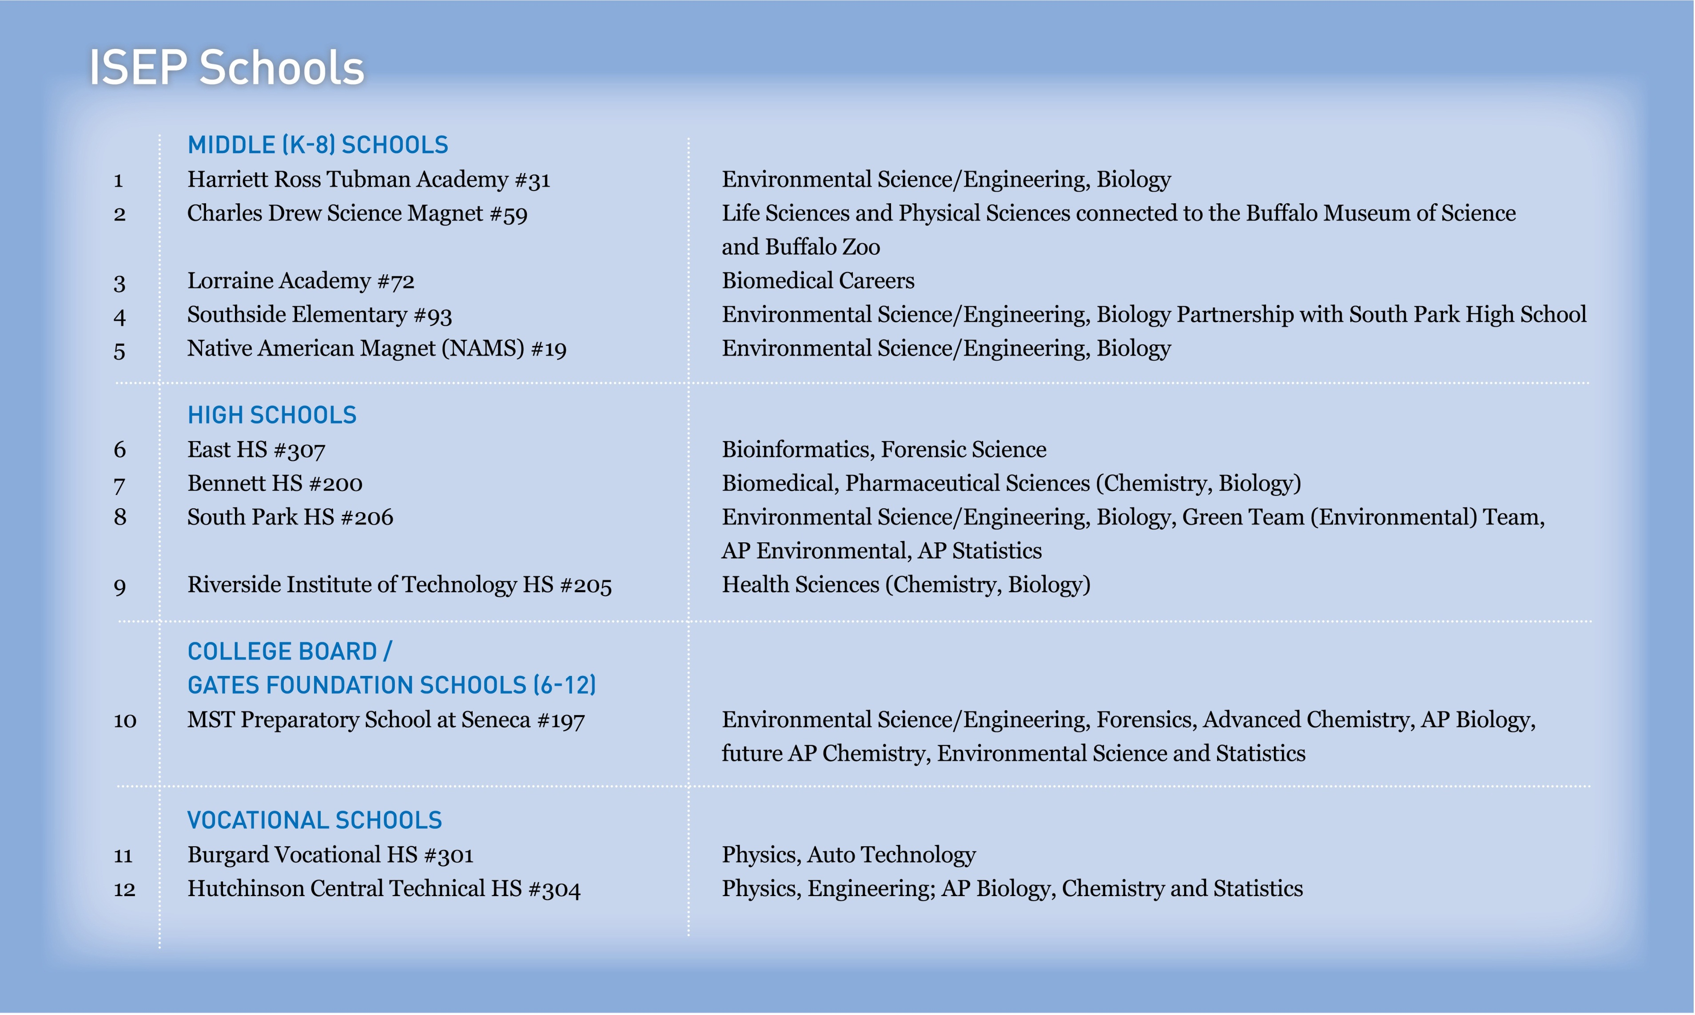
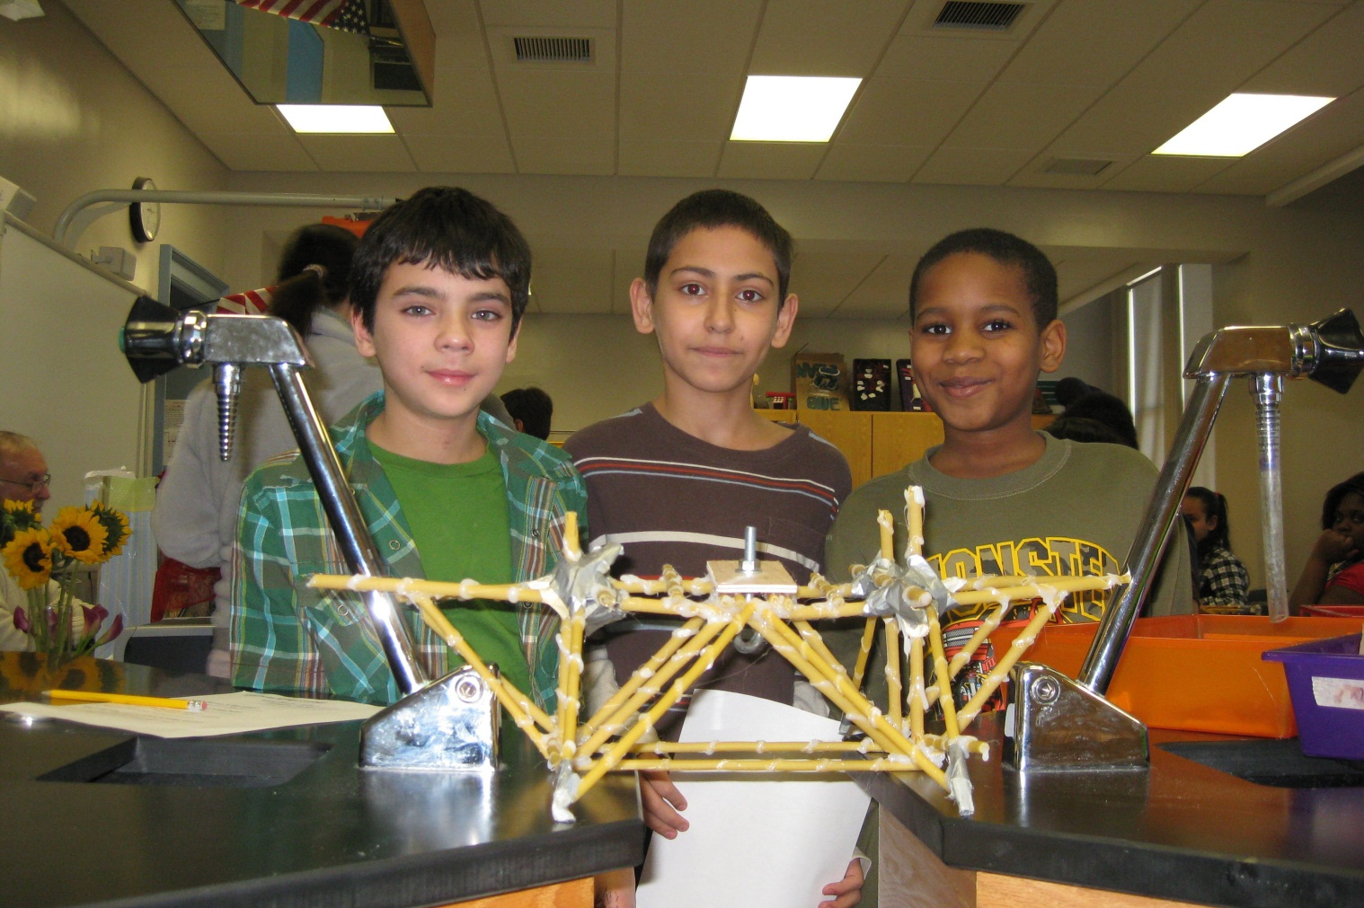
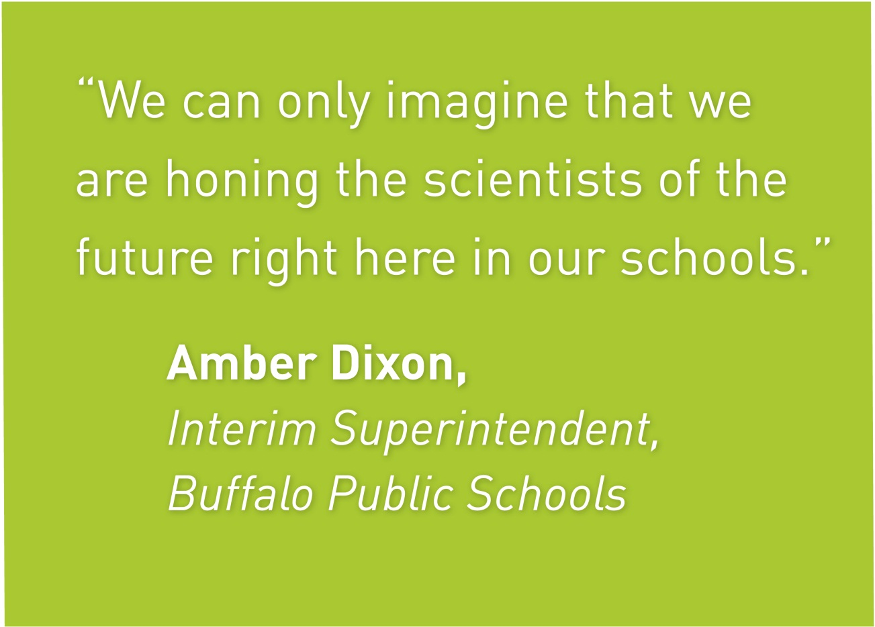
Interdisciplinary Science and Engineering Partnership (ISEP)
Targeted MSP: Transition from Middle to High School
Joseph A. Gardella, Jr., PI, Karen L. King, Project Manager (University at Buffalo)
Daniel L. MacIsaac, CoPI, Catherine Lange, STEM Faculty (Buffalo State College)
Bryon J. McIntyre (Buffalo Schools District Parent Coordinating Council)
EFFECTIVE STEM TEACHING
PROFESSIONAL DEVELOPMENT TO EFFECTIVE
STEM TEACHING: THEORY OF ACTION
CHALLENGES
Effective STEM teaching in a high needs urban school district is supported by increased content knowledge, gained from interdisciplinary research experiences and supported by enhanced learning communities, supported by wrap around college/university STEM faculty and students in classroom and after-school programs.
Based on a synthesis of literature on teacher professional development, Desimone (2009) identified the following commonly agreed-on critical features of effective teacher professional development programs: (a) content focus – opportunities for teachers to enhance their content knowledge and pedagogical content knowledge; (b) active learning – opportunities for teachers to engage in active learning; (c) coherence – alignment with teachers’ personal beliefs and school and districts’ priorities; (d) duration – prolonged activity span; and (e) collective participation – learning communities within the same department, grade, or school. The above general features of effective teacher professional development are consistent with the science teacher professional development literature. For example, Loucks-Horsley, Hewson, Love, and Stiles (1998) defined seven principles of effective mathematics and science teachers’ professional development: (a) a well-defined image of effective classroom learning and teaching; (b) opportunities for teachers to build knowledge and skills; (c) modeling the strategies teachers will use with students; (d) building a learning community; (e) supporting teachers as leaders; (f) providing links to other parts of the education system; and (g) providing for continuous assessment and improvement. Based on the models of Desimone (2009) and the NSF’s Local Systematic Change (LSC) through Teacher Enhancement program in the 1990s (Banilower, Heck & Weiss, 2007), the conceptual framework informing our MSP is shown in Figure below. While there is a consensus on the critical features of effective science teacher professional development, much remains unknown about the mechanism through which these features interact to affect teachers’ knowledge and skills, which in turn affects student achievement. Particularly, the UB/BPS MSP focuses on interdisciplinary science inquiry. Research is needed to understand the processes and conditions in which science teachers develop interdisciplinary science inquiry knowledge, and how this knowledge may be translated into interdisciplinary pedagogical content knowledge (PCK) that ultimately improves student science learning.
Alignment of ISEP MSP program with Race to the Top PLA funding in many of the schools chosen for program.
Identification and training of graduate fellows and undergraduate service-learning students in mentoring, pedagogy, curricula and school cultures.
Engagement of teachers in developing research based teaching tools that are linked with summer interdisciplinary research opportunities.
Navigating school and building cultures with principals, teachers, teacher coaches, and Buffalo Public Schools leadership.
Coordinating supporting partners for research opportunities and classroom support.
Developing expanded PLCs for communication between middle and high school teachers, parents, university/ college faculty and students.
Identifying consistent service-learning support for up to 240 students for classroom and after school support.
ISEP Research Questions
What are science teachers’ conceptions of interdisciplinary science inquiry? How do their conceptions change through intensive summer research and ongoing professional developments?
How do science teachers translate interdisciplinary science inquiry experiences and understanding gained in university research laboratories into their classroom inquiry instructional practices, i.e. how do science teachers develop interdisciplinary science inquiry PCK?
How do professional learning communities (PLCs) support teacher development of interdisciplinary science inquiry PCK?
STATUS/STRATEGIC PLAN
Five year strategic plan developed and submitted, implementation of first year strategic plan underway.
Graduate fellows for each school recruited and placed in all schools.
Teacher recruitment and placement in interdisciplinary research and courses currently underway for summer 2012.
Research team and evaluation team collecting baseline data.
All 12 schools have strategic research driven STEM themes.
BIBLIOGRAPHY
Abell, S. K. (2007). Research on science teacher knowledge. In S. Abell and N. Leaderman (eds.), Handbook of research on science education, pp1105-1149, New York: Routledge.
Desimone, L. M. (2009). Improving impact studies of teachers' professional development: Toward better conceptualizations and measures. Educational Researcher, 38(3), 181-199.
DuFour, Richard, Eaker, R., and DuFour, Rebecca, Editors, (2005) On Common Ground: The Power of Professional Learning Communities, Solution Tree, National Educational Services: Bloomington, IN.
Epstein, J. L. & Sanders, M. G. (2006). Prospects for change: Preparing educators for school, family, and community partnerships. Peabody Journal of Education, 81(2), 81-120.
Gardella Jr., J.A. Maciejewski, H.M. and Huber, M.B. "Service Learning in urban, high needs schools: Building from science education to the University at Buffalo/Buffalo Public Schools Partnership", Chapter in Civic Service: Service-Learning with State and Local Government Partners, David Redlawsk and Thomas Rice, Editors, Jossey Bass, San Francisco, CA, 2009, pp 189-212.
Geddis, A. N. (1993). Transforming subject-matter knowledge: The role of pedagogical content knowledge in learning to reflect on teaching. International Journal of Science Education, 15, 673-683.
Loughran, J., Mulhall, P., & Berry, A. (2004). In search of pedagogical content
Knowledge in science: Developing ways of articulating and documenting professional practice. Journal of Research in Science Teaching, 41(4), 370-391.
Peterson, R., & Treagust, D. (1995). Developing preservice teachers’ pedagogical reasoning ability. Research in Science Education, 25, 291-305.
Schulman, L. (1986). Those who understand: Knowledge growth in teaching. Educational Researcher, 15(2), 4-14.
van Driel, J., Verloop, N., & de Vos, W. (1998). Developing science teachers’ pedagogical content knowledge. Journal of Research in Science Teaching, 35(6), 673-696.
.

