Slide 1
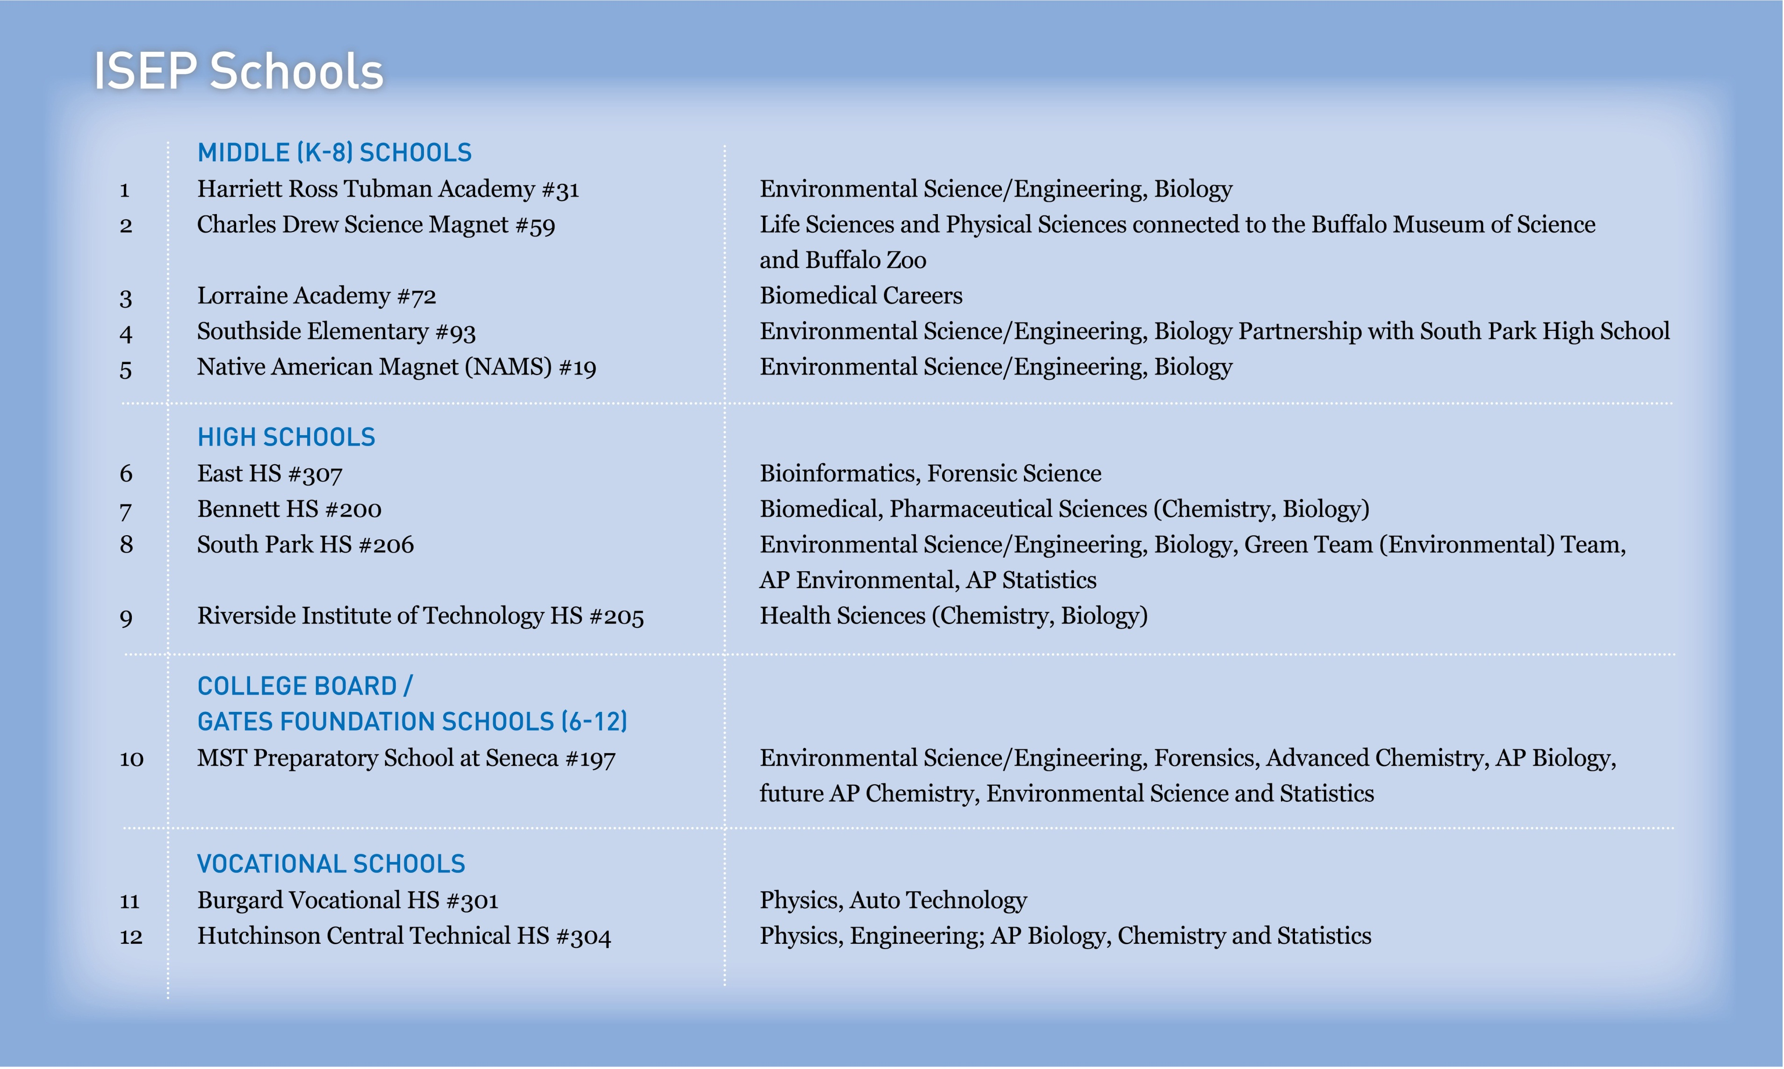
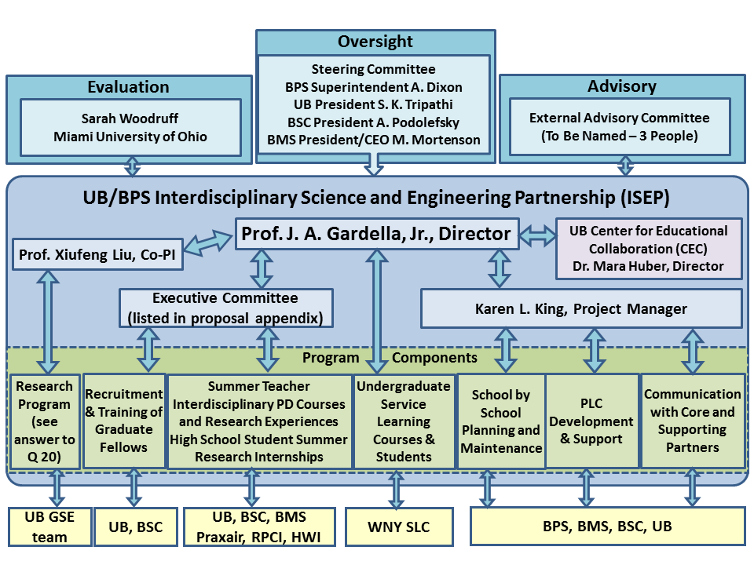
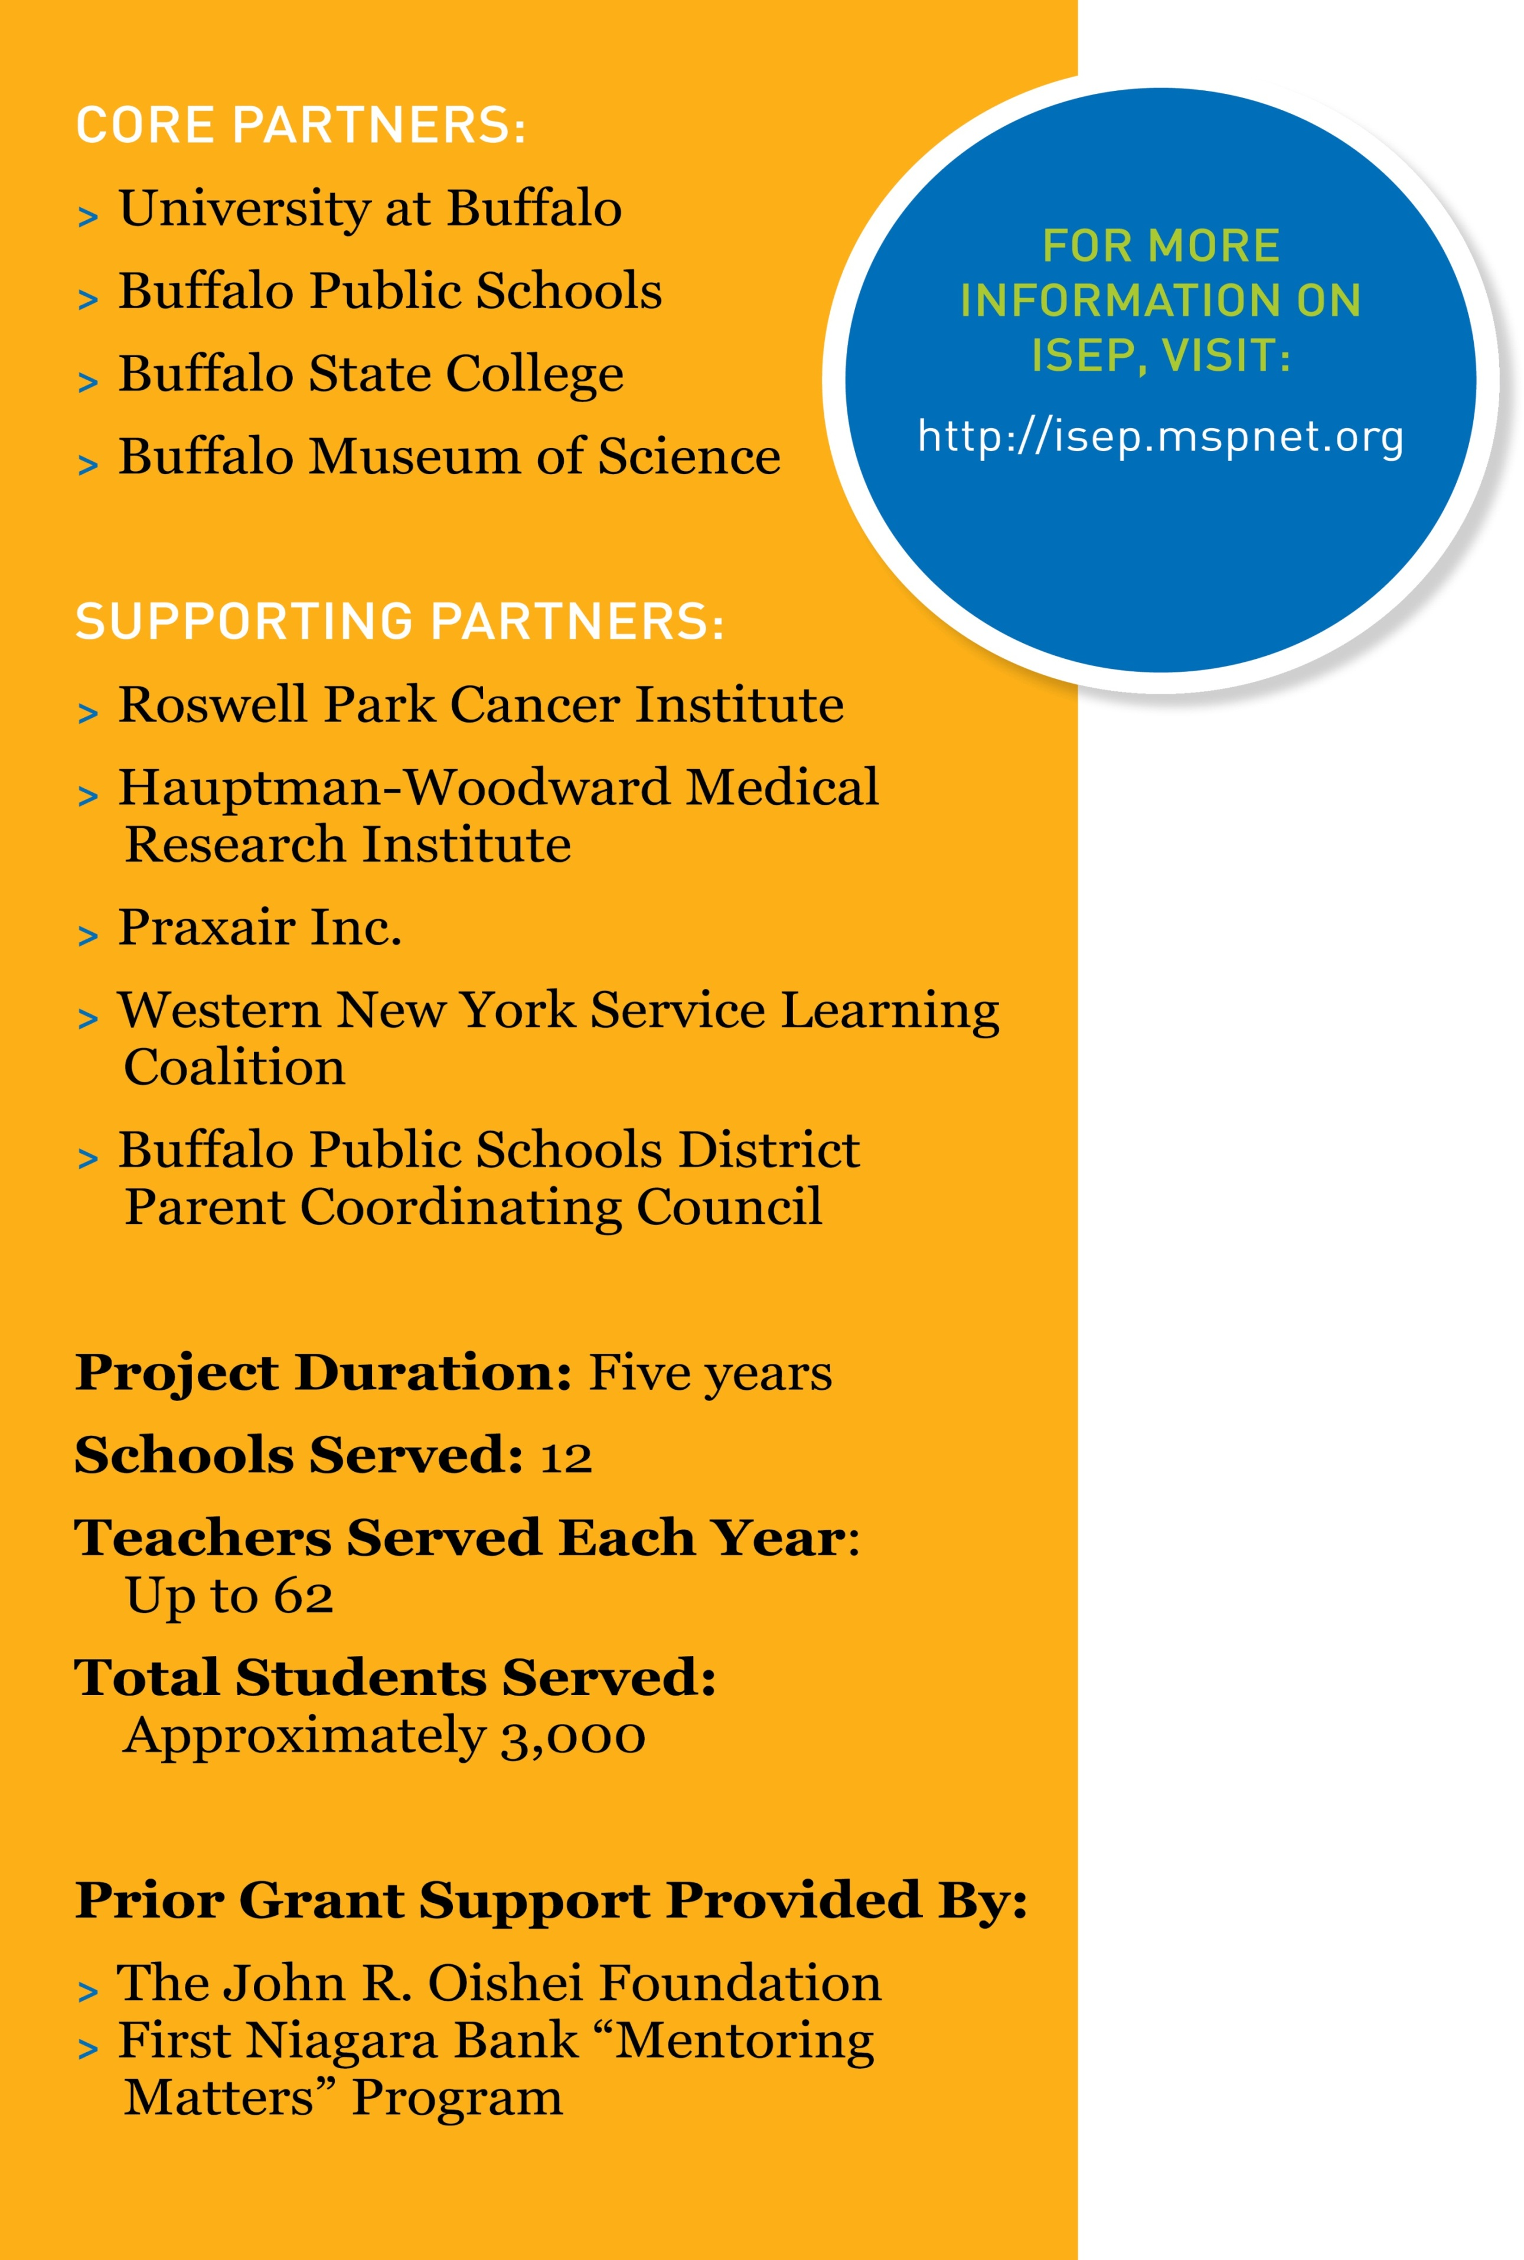
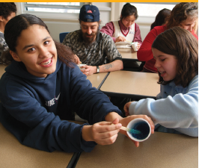
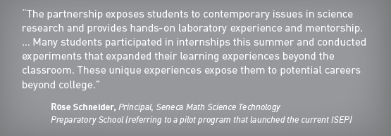
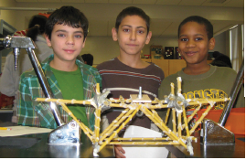
Interdisciplinary Science and Engineering Partnership (ISEP)
NSF Funded Targeted MSP: Transition from Middle to High School
Joseph A. Gardella, Jr., PI, Karen L. King, Project Manager, Xiufeng Liu, CoPI (University at Buffalo)
Daniel L. MacIsaac, CoPI, Catherine Lange, STEM Faculty (Buffalo State College)
PROJECT OVERVIEW
ISEP PROGRAM COMPONENTS
MANAGEMENT
The ISEP Partnership was awarded a five-year, $9.8 million grant from the National Science Foundation (NSF) in September 2011 to expand the program from collaborations in two BPS schools to twelve high needs middle and high schools. Supported with resources totaling more than $10 million, this promising program aims to transform how science is taught in the Buffalo Public Schools. The focus of the ISEP is the critical middle school experiences of students in science and engineering, as they transition to high school. The project uses an innovative approach to teacher professional development among high-needs urban schools (including “feeder” middle schools and their corresponding high schools). This is accomplished through courses and interdisciplinary research experience, development of science and technology classroom materials aligned with state science learning standards, and inquiry-based curricula. Sample research topics include nanotechnology, molecular biology, pharmacokinetics, and response to natural and manmade emergencies, areas developed as strategic research and educational strengths under UB2020.
The ISEP also combines novel mentoring approaches and expanded Professional Learning Communities (PLCs) to build leadership and resources for improving science education. The PLCs cultivate mentoring relationships involving middle and high school teachers and students, UB and Buffalo State College science/engineering/technology faculty, education faculty, undergraduate students and graduate students, volunteer professionals and parents. .
Summer teacher professional development centered on 1-2 month research or coursework placements of science, technology, mathematics and special education teachers from all 12 schools.
School based STEM focus areas are developed in concert with school principals, teachers and BPS district STEM leadership.
Research placements involve research in subjects including interdisciplinary environmental science and engineering, extreme events engineering, biomedical research and education, biology, physics, biomedical engineering and materials science and engineering.
Research partners include UB science, engineering and medicine, Roswell Park Cancer Institute, Hauptmann Woodward Institute and Praxair Technology Center.
Teachers with specific interests are placed in a specially designed summer course at Buffalo State College.
Buffalo Museum of Science provides program resources with informal learning support after-school and on weekends, planning and implementation space for teachers and experienced staff for teacher support.
Teachers are supported during the academic year with wrap-round academic support in class and after school with Ph.D. students from UB science, engineering and medical basic science departments and undergraduates from UB and Buffalo State College in service learning and internship courses. These students support implementation in classrooms and after-school programs and focus on mentoring BPS students.
Innovative Professional Learning Communities (PLCs) are set up to promote communication between middle and high school teachers, parents, graduate and undergraduate students and university research faculty to promote connections between middle and high school STEM classroom content and parent participation in support of classroom work and design of the projects.
Paid summer research internships are available for high school students.
Key research questions are investigated by UB research team to examine project hypotheses.
Program evaluation is accomplished by an independent team at Miami University of Ohio.
INNOVATIONS
Serves students and tracks their progress during the pivotal transition from middle to high school (a time when many young people lose interest in science).
Emphasizes engineering design activities, as well as interdisciplinary science inquiry.
Develops Professional Learning Communities and opportunities to share ideas face-to-face, or through social media.
Involves undergraduate and graduate students from UB, Buffalo State College and other area colleges, as well as volunteer faculty and science/engineering/technology professionals from the academic and corporate communities.
erves Buffalo’s rapidly growing immigrant population, in which more than 80 languages are spoken, including students from Burma, Somalia and many other nations.
Uses new labs and facilities through Buffalo’s comprehensive school reconstruction project—the first of its kind in New York State student science learning.
CHALLENGES AND BARRIERS
Alignment of ISEP MSP program with Race to the Top PLA funding in many of the schools chosen for program has not been achieved due to lack of communication with NY State Ed.
Identification and training of graduate fellows and undergraduate service-learning students in mentoring, pedagogy, curricula and school cultures.
Engagement of teachers in developing research based teaching tools that are linked with summer interdisciplinary research opportunities.
Navigating school and building cultures with principals, teachers, teacher coaches, and Buffalo Public Schools leadership.
Coordinating supporting partners for research opportunities and classroom support.
Developing expanded PLCs for communication between middle and high school teachers, parents, university/ college faculty and students.
Identifying consistent service-learning support for up to 240 students for classroom and after school support.

