Slide 1
Lessons from the June 2009 NYS Regents Physics Examination – Notes for the Classroom
NYSS AAPT Fall Conference
Syracuse, New York – October 17, 2009
J. Zawicki, SUNY Buffalo State College
T. Johnson, Western New York Regional Information Center

Slide 2
Objectives
To increase student success on science assessments
Knowledge
Skills
Methods
Analysis of Student Performance (Aggregate)
Program Review/Brainstorming Teaching Strategies
Implementation of Changes
Evaluation of Efficacy

Slide 3
Curriculum/Standards
Frameworks
Syllabi
Guides
Blueprints
Benchmarks
validity
correlation
Objective tests
Portfolios
Performance assessments
Program Evaluations
Teacher Observations
Group Activities
Instructional styles
Print materials
Equipment
Facilities
Technology
Community
alignment
Assessment/Evaluation System
Instructional Program

Slide 4
Assessment Formats
Classroom Measures
Formative
Embedded assessments
Prediction activities (predict/observe/explain)
Whiteboard activities
Informal assessments
Documentation and record keeping
Summative
Final assessments
hands-on
pencil-and-paper
Statewide Assessments
Multiple Choice
Short Constructed Response
Open-Ended

Slide 5
ITEM ANALYSIS
Select Target Areas for Improvement
Overview
Areas of success
Areas for improvement
Suggest Program Revision
Brainstorm Instructional Strategies
Implement Strategies/Interventions
Evaluate Intervention Efficacy

Slide 6
5.4 Energy Relationships
Item | Difficulty | 1 (0) | 2 (1) | 3 (2) | 4
31-MC | 0.58 | 370 | 532 | 1366 | 3133
32-MC | 0.66 | 1134 | 259 | 448 | 3561
71-CR | 0.80 | 681 | 636 | 4026 | ---
44-MC | 0.59 | 573 | 1174 | 445 | 3208
33-MC | 0.68 | 451 | 3678 | 173 | 1101
35-MC | 0.58 | 3154 | 400 | 1473 | 380

Slide 7
5.4 Energy Relationships
Item | Difficulty | 1 | 2 | 3 | 4
31-MC | 0.58 | 370 | 532 | 1366 | 3133

Slide 8
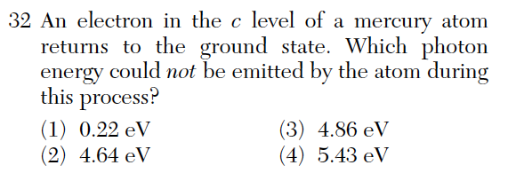
5.4 Energy Relationships
Item | Difficulty | 1 | 2 | 3 | 4
32-MC | 0.66 | 1134 | 259 | 448 | 3561

Slide 9
5.4 Energy Relationships
Item | Difficulty | (0) | (1) | (2)
70-CR* | 0.94 | 282 | 5062 | ---
71-CR | 0.80 | 681 | 636 | 4026
72-CR* | 0.63 | 1910 | 3434 | ---

Slide 10
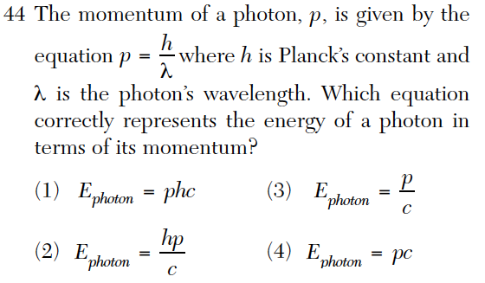
5.4 Energy Relationships
Item | Difficulty | 1 | 2 | 3 | 4
44-MC | 0.59 | 573 | 1174 | 445 | 3208

Slide 11
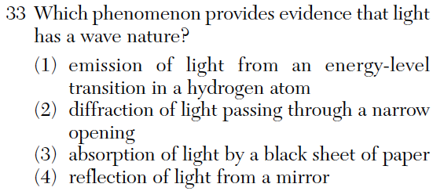
5.4 Energy Relationships
Item | Difficulty | 1 | 2 | 3 | 4
33-MC | 0.68 | 451 | 3678 | 173 | 1101

Slide 12
5.4 Energy Relationships
Item | Difficulty | 1 | 2 | 3 | 4
35-MC | 0.58 | 3154 | 400 | 1473 | 380

Slide 13
4.3 Students can explain variations in wavelength and frequency in terms of the source of the. . .
Item | Difficulty | 1 (0) | 2 (1) | 3 (2) | 4
68-CR | 0.80 | 776 | 496 | 4073 | ---
69-CR | 0.76 | 1233 | 4112 | --- | ---
67-CR | 0.87 | 415 | 403 | 4527 | ---
66-CR | 0.75 | 1308 | 4037 | --- | ---
25-MC | 0.64 | 117 | 3463 | 709 | 1118
26-MC | 0.64 | 598 | 3488 | 596 | 715
58-CR | 0.55 | 2352 | 2994 | --- | ---
23-MC | 0.35 | 534 | 1906 | 1980 | 982

Slide 14
4.3 Students can explain variations in wavelength and frequency in terms of the source of the. . .
Item | Difficulty | (0) | (1) | (2)
68-CR | 0.80 | 776 | 496 | 4073
69-CR | 0.76 | 1233 | 4112 | ---

Slide 15
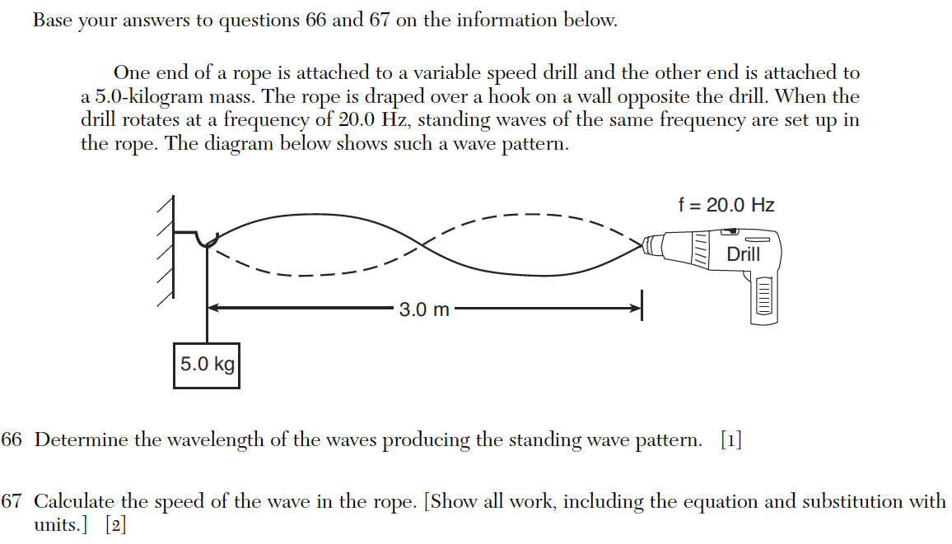
4.3 Students can explain variations in wavelength and frequency in terms of the source of the. . .
Item | Difficulty | (0) | (1) | (2)
67-CR | 0.87 | 415 | 403 | 4527
66-CR | 0.75 | 1308 | 4037 | ---

Slide 16
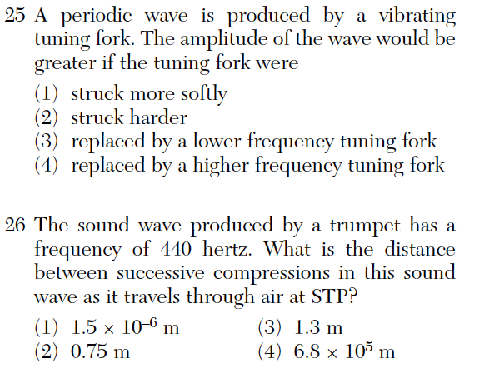
4.3 Students can explain variations in wavelength and frequency in terms of the source of the. . .
Item | Difficulty | 1 | 2 | 3 | 4
25-MC | 0.64 | 117 | 3463 | 709 | 1118

Slide 17
4.3 Students can explain variations in wavelength and frequency in terms of the source of the. . .
Item | Difficulty | 1 | 2 | 3 | 4
26-MC | 0.64 | 598 | 3488 | 596 | 715

Slide 18
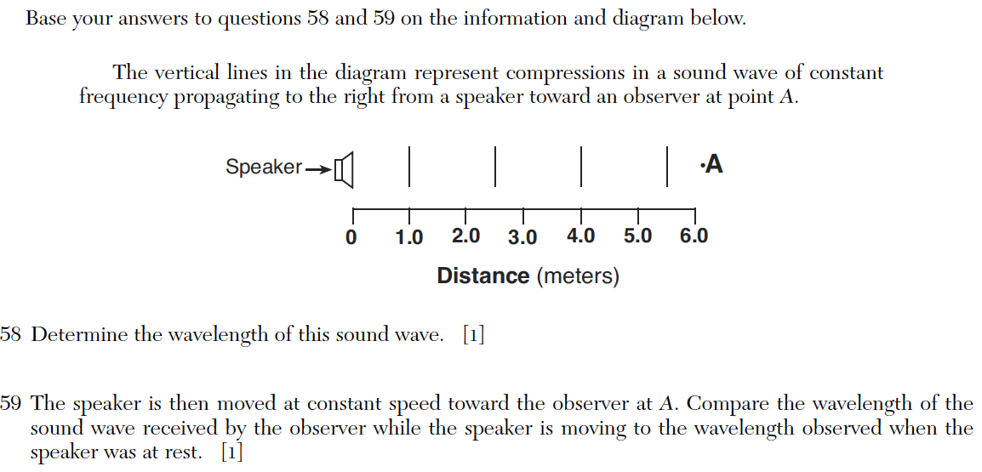
4.3 Students can explain variations in wavelength and frequency in terms of the source of the. . .
Item | Difficulty | (0) | (1)
58-CR | 0.55 | 2352 | 2994
59-CR* | 0.65 | 1851 | 3495

Slide 19
4.3 Students can explain variations in wavelength and frequency in terms of the source of the. . .
Item | Difficulty | 1 | 2 | 3 | 4
23-MC | 0.35 | 534 | 1906 | 1980 | 982

Slide 20
5.1g A projectile's time of flight is dependent upon the vertical component of its motion.
Item | Difficulty | 1 | 2 | 3 | 4
05-MC | 0.69 | 57 | 1261 | 3731 | 355

Slide 21
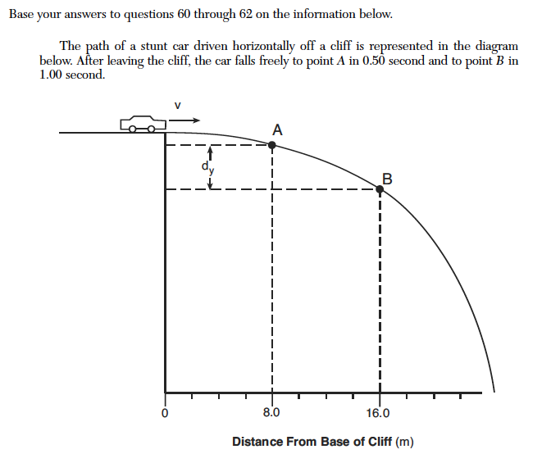
5.1g A projectile's time of flight is dependent upon the vertical component of its motion.

Slide 22
5.1g A projectile's time of flight is dependent upon the vertical component of its motion.
Item | Difficulty | (0) | (1) | (2)
60-CR* | 0.74 | 1320 | 4025 | ---
61-CR | 0.4 | 3190 | 2155 | ---
62-CR | 0.4 | 2430 | 1497 | 1418

Slide 23
Questions, Comments, Concerns?
J. Zawicki, SUNY Buffalo State College
zawickjl@buffalostate.edu
(716) 878-3800

