Slide 1
PD for Physics Teachers by Physics Teachers
David Abbott
abbottds@buffalostate.edu
SACS-AAPT: October 12, 2018
Clemson SC

Slide 2
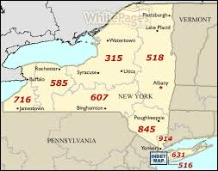
BSC Crash Course
BSC
~5 FT physics faculty
BA, BS, MS Ed
UB
40+ physics faculty
BA, BS, MS, PhD
BUF → NYC (8 hrs)
BUF → YYZ (2 hrs)

Slide 3
WNYPTA Basics
Who:
BSC personnel
High school teachers (20-30 active members, public and private)
What:
Meetings (one Sat. AM per month during AY @ BSC Physics)
Annual Physics Olympics
Listserv
http://physicsed.buffalostate.edu/WNYPTA/
When:
since 1997 (Abbott since 2006)

Slide 4
BSC Personnel
Dan MacIsaac (BSC Physics)
Runs BSC PHY Teacher Prep Program
Active in AAPT (recently made AAPT Fellow)
Back from sabbatical at Cologne (Germany)
David Henry (BSC El. Ed. and Reading)
Co-runs teacher prep program
Runs NYS Master Teacher program office at BSC (https://www.suny.edu/masterteacher/)
David Abbott (BSC Physics)
BSC Physics Instructional Support (procurement, shop, work studies)

Slide 5
What’s in it for teachers? (2017 survey; N=33)
Networking (#1)
Job placement
Share ideas, opportunities, materials
Physics-specific PD (#2)
Stuff for teaching (#3)
Make and takes
Borrow equipment
Official PD credit
Comments:
“WNYPTA provides far more useful PD than anything my school district provides for me. WNYPTA is subject-specific and designed by teachers who are actually in the trenches using materials with their students. The PD is not just a one-day dog and pony show, it is a career-long search for growth and improvement.”
“The yearly Physics Olympics is an absolutely outstanding contribution that WNYPTA makes to students. Even if it only did the Physics Olympics, it would still be a very worthy organization.”
“Getting large whiteboards into the classroom is the one of the most important things WNYPTA has done for local physics teachers. They have changed they way I teach.”

Slide 6
What’s in it for the college?
Recruiting
Students- undergrads (physics) and grad students (teacher candidates)
Adjuncts
Networking
for teacher prep program (observation venues for PSTs, jobs for grads)
for undergrads (service ops)
for BSC Physics (guest speakers)
Evidence of community outreach (grants, T&P)
Innovative teaching/teachers

Slide 7
Physics teacher prep @ BSC
No undergrad teacher prep program in PHY
Alternative certification
Requires BS or BA in PHY or related field
No teaching experience required
Student teaching happens on the job
Cross certification
Already certified in science (not PHY)
Summers, nights and online
Cornerstone: AMTA’s Modeling Physics curriculum

Slide 8
What does a meeting look like?
Saturday 9am-noon
Social: coffee and donuts
Intros, sharing and announcements
Guest(s)
Make and take
Example agendas
https://listserv.buffalo.edu/cgi-bin/wa?A2=ind1809&L=WNYPTA-LIST&F=&S=&P=1719
https://listserv.buffalo.edu/cgi-bin/wa?A2=ind1802&L=WNYPTA-LIST&F=&S=&P=2756
https://listserv.buffalo.edu/cgi-bin/wa?A2=ind1710&L=WNYPTA-LIST&F=&S=&P=3183
https://listserv.buffalo.edu/cgi-bin/wa?A2=ind1510&L=WNYPTA-LIST&F=&S=&P=9415 (Kelly O’Shea!)

Slide 9
2017-2018 topics, presenters
Next Gen NYSSLS workshop open to all STEM teachers (Sept 2017)
How to make a video with time overlaid (Magnusson, Oct 2017)
Numerical analysis with Excel (Ciripli, Oct 2017)
Physics Olympics planning (Nov 2017)
Electricity misconceptions (Henry, March 2018)
Half-life, neutron activation, LN2 demos (Demarco, April 2018)
Sound and other outdoors exp’t. (Graf and others, May 2018)
Projection TV deconstruction (Yap, May 2018)

Slide 10
2017 Joint meeting: WNYPTA NYSS-AAPT
Meeting agenda:
http://physicsed.buffalostate.edu/WNYPTA/meetings/2017-18/NYSS-AAPT-5-20-17/MeetingAgenda/

Slide 11
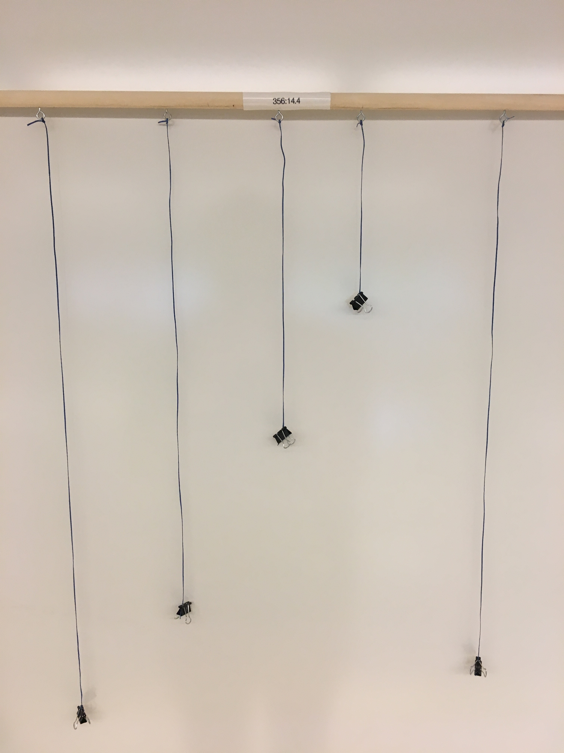
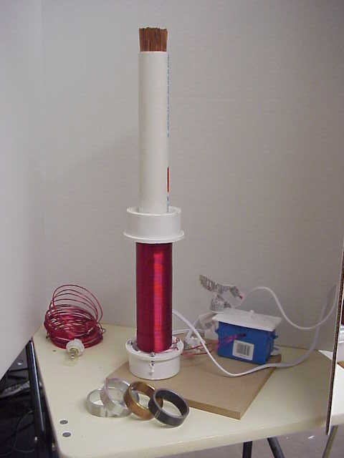
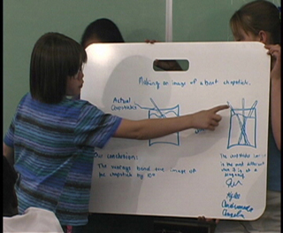
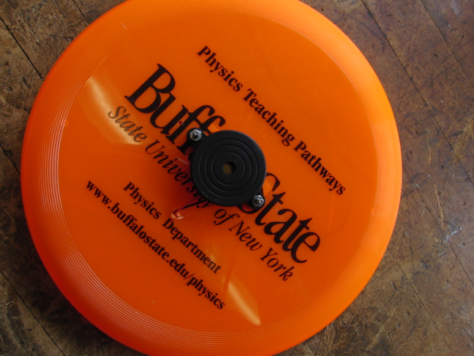
Selected make & takes
Resonance strings
Doppler Frisbee
Whiteboards (http://physicsed.buffalostate.edu/AZTEC/BP_WB/index.html)
Current balance experiment
Resistance boards
Ring flinger
Series/parallel bulb
Board bender
Drop/kick

Slide 12
WNYPTA Physics Olympics
the un-Science Olympiad
run by HS, MS teachers
Design events, build apparata
Run demo show
Run events
admin and support by BSC
Food
Prizes
T-shirts
Volunteers

Slide 13
Physics Olympics Schedule
8am – 9am Registration
9am – noon Three events
Noon – 12:45pm Physics Fete, Lunch
12:45pm- 1:15 Awards, T-shirt distribution

Slide 14
WNYPTA Physics Olympics Video
https://youtu.be/cRgzVURwZaQ
Produced by Mike Belling (Williamsville East HS)

Slide 15
Physics Olympics photos

Slide 16
More Physics Olympics photos

Slide 17
Records
Web site
Schedule
Archive
Listserv
Hosted by UB (not BSC)
~300 addresses
Archive
Handful of posts per month
The “book”

Slide 18
Peripheral organizations
BSC Physics
BSC Student Organizations (PHY Club, Chem. Club, NSBE)
NYS Master Teacher Program
AAPT
National
Regional (Joint meetings)
STANYS
AMTA (American Modeling Teachers Association)
RAPTOR
CNYPTA

Slide 19
Money
Sources
BSC Physics
BSC College Foundation
Individual donors
Corporate?
Grants
NYS Master Teachers
Outlays
Physics Olympics (~2k$)
Food, T-shirts for 100 kids
Prizes
Apparatus, materials for events
Meetings (<$1k$)
Coffee and donuts
Make and takes

Slide 20
Why it works for us
University assets:
A good team (covering teacher prep, physics, tech, $$)
Undergrads
Website and listserv hosting
Teacher prep program
Dedicated local teachers:
Regular attenders/contributors
Private school teachers, retired teachers
No pressure approach
Teacher candidate to participant pipeline
Good communication/relationships between Uni. and HS teachers

Slide 21
Our Challenges
Keeping the ideas flowing!
Regular availability of university personnel for meetings
Competing (paid) PD options for outstanding teachers
Spring attendance
Record keeping
New directions?
Serving needier populations
Different/new collaborators (corporations, professional orgs, non-PHY science teachers)

Slide 22
Needs for talk
PO pix!
Mention role of undergrads
How it might look different at Clemson
Involve undergrads! (Does CU have LAs?)
How does PHY teacher prep work here?
Leverage unique resources (e.g. equipment van)
Kelly O’Shea meeting evidence
2004 star-studded affair evidence
Science Saturday idea
Getting guests

Slide 23
Attendance by month (2010-2017)

